Slide 1





Postprocessing NWP model output for the
needs of snow hydrological modelling
Tobias Jonas, Adam Winstral, Nora Helbig, Michael Schirmer
WSL Institute for Snow and Avalanche Research SLF
Davos / Zürich, Switzerland
2nd Annual Workshop
17‐19 October, 2016
University of Grenoble
LGGE
Grenoble, France

Slide 2
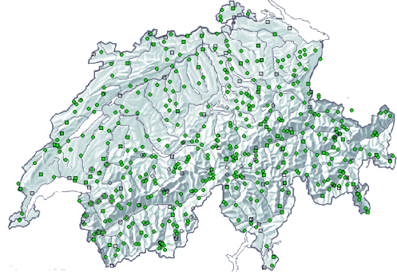
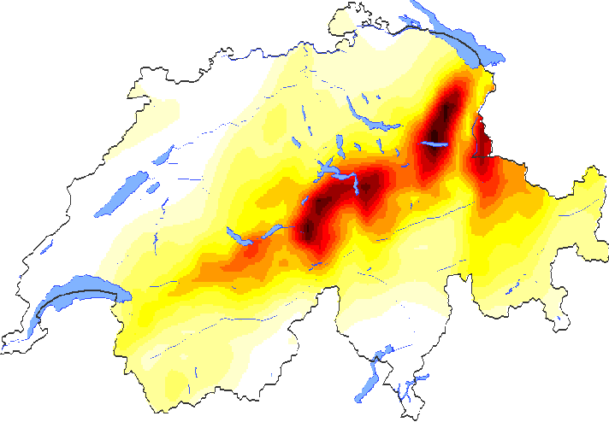
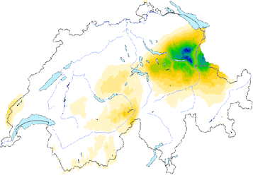
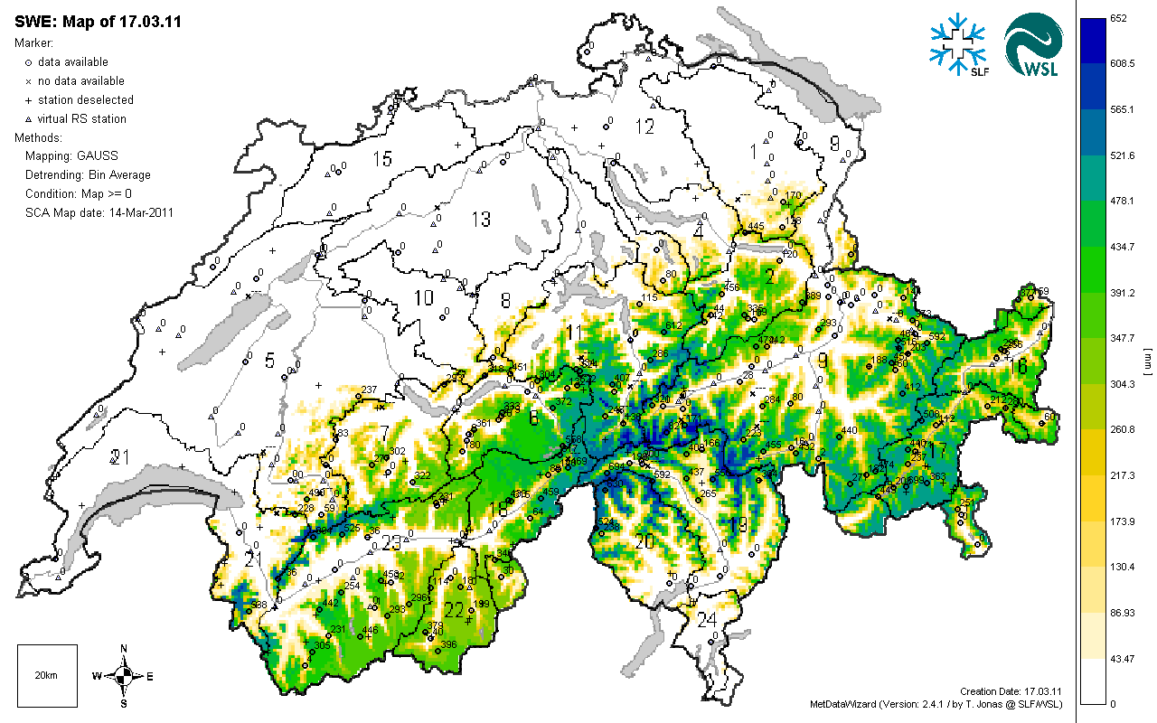
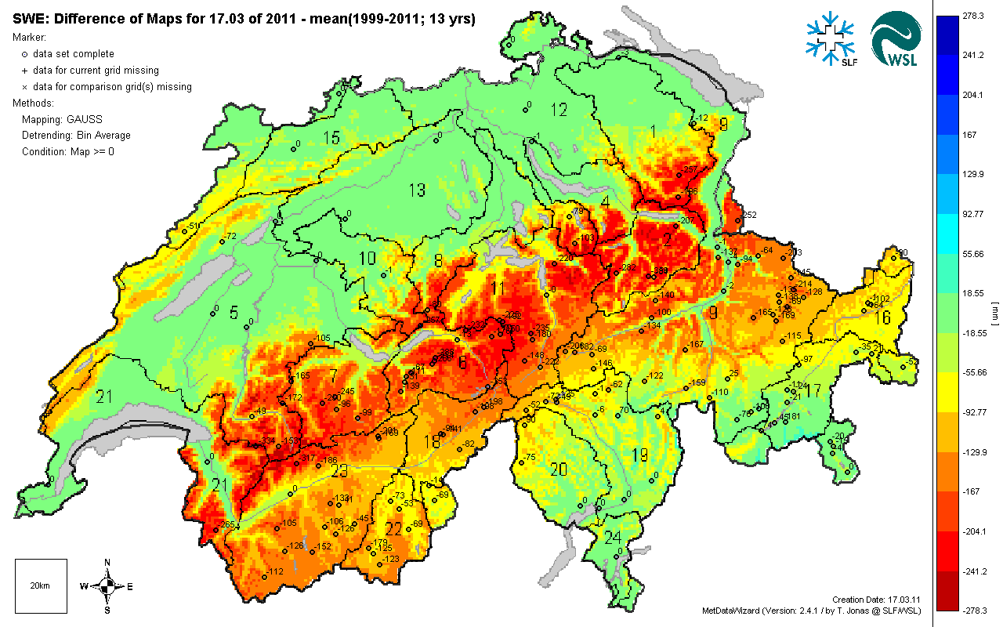
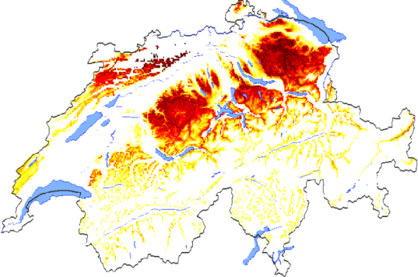
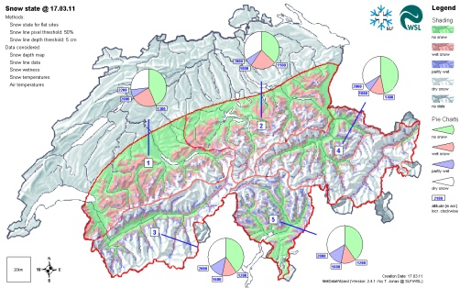
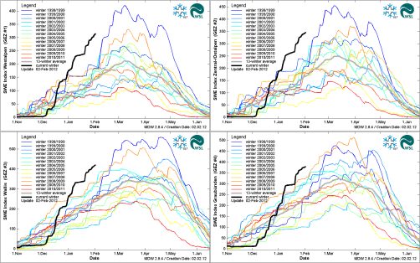
Operational snowmelt modelling in Switzerland
SWE Monitoring
MWP (Forecast)
Meteo Observations
Data Assimilation
NWP (Analysis)
Reanalysis Products
Met Data Postprocessing
EB Snowmelt Model
Operational
Products
intro ► data assimilation ► debiasing ► downscaling ► terrain corrections ► fusion of datasets ► summary

Slide 3
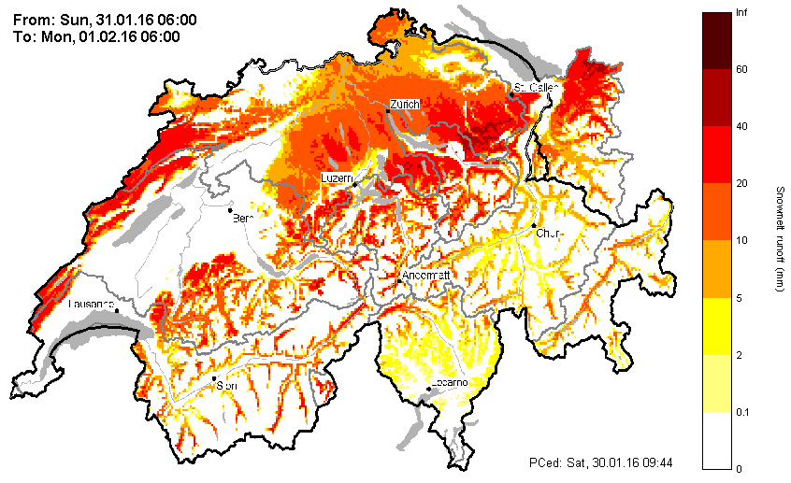
Motivation
We deal more frequently with complex forecast scenarios
NWP models can provide input data to EB snowmelt models but these need to be post-processed
Here an example of a rain-on-snow situation in Jan/Feb 2016
intro ► data assimilation ► debiasing ► downscaling ► terrain corrections ► fusion of datasets ► summary

Slide 4
Operational snowmelt modelling in Switzerland
SWE Monitoring
MWP (Forecast)
Meteo Observations
Data Assimilation
NWP (Analysis)
Reanalysis Products
Met Data Postprocessing
Data assimilation to update precipitation input
Debiasing of forcing fields
Downscaling of forcing fields
Terrain corrections (wind, radiation, …)
Fusion of Reanalysis and NWP data
intro ► data assimilation ► debiasing ► downscaling ► terrain corrections ► fusion of datasets ► summary

Slide 5
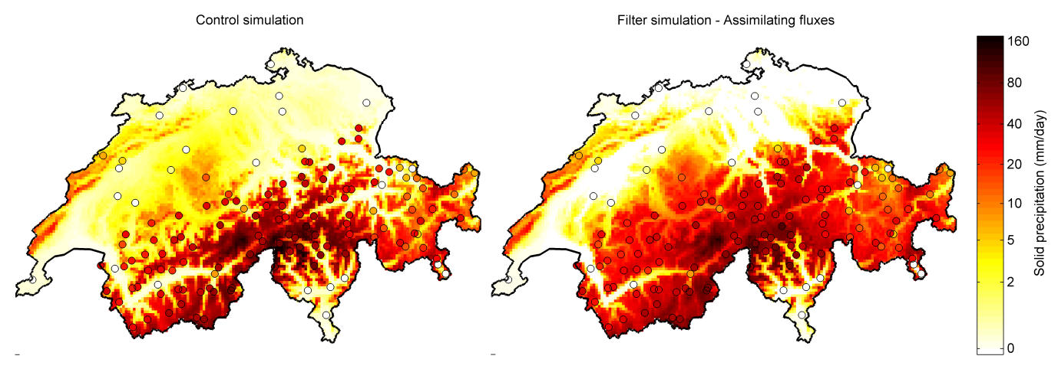
Data assimilation to update precipitation input fields
• Calculate precipitation and phase from meteo input (control simulation)
Rerun control simulation with disturbed meteo input fields
Assume the disturbances (input errors) to be spatially correlated
Optimize to match observed data (allow observational errors as well)
intro ► data assimilation ► debiasing ► downscaling ► terrain corrections ► fusion of datasets ► summary

Slide 6
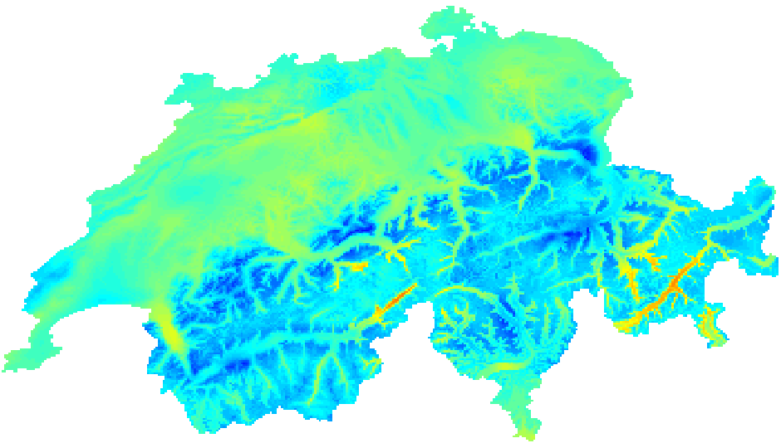
Debiasing input fields
• Example: air temperature of COSMO-2 forecast
Issue: systematic cold bias, particularly in winter at high elevation
+3
+2
+1
0
-1
-2
-3
Bias (K)
intro ► data assimilation ► debiasing ► downscaling ► terrain corrections ► fusion of datasets ► summary

Slide 7
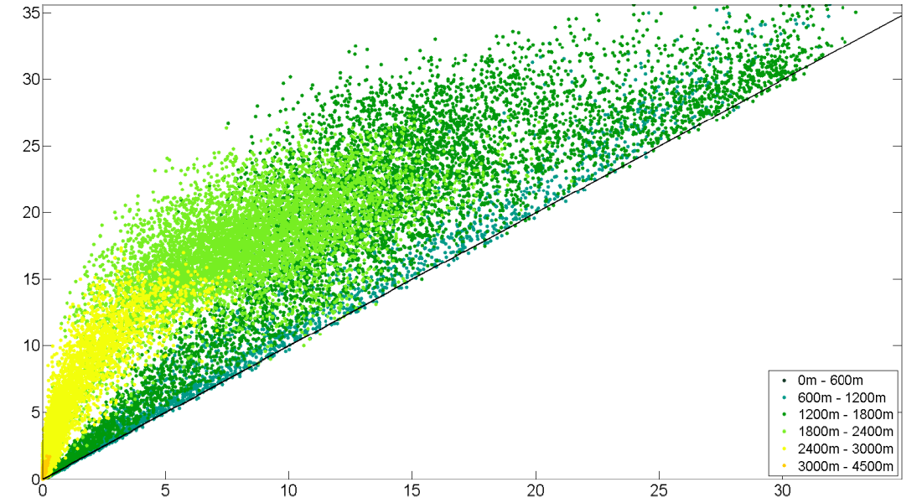
Debiasing input fields
• Example: air temperature of COSMO-2 forecast
Issue: systematic cold bias, particularly in winter at high elevation
Snowmelt Hindcast (mm/day)
16. April 2013
Snowmelt Forecast (mm/day)
intro ► data assimilation ► debiasing ► downscaling ► terrain corrections ► fusion of datasets ► summary

Slide 8
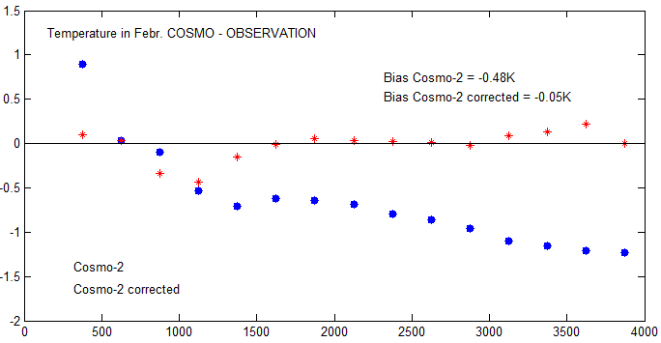
Debiasing input fields
• Example: air temperature of COSMO-2 forecast
Issue: systematic cold bias, particularly in winter at high elevation
Method: Stochastic debiasing using temperature data (mean and stdev), elevation, month
COSMO – Observation (K)
Altitude (m asl.)
intro ► data assimilation ► debiasing ► downscaling ► terrain corrections ► fusion of datasets ► summary

Slide 9
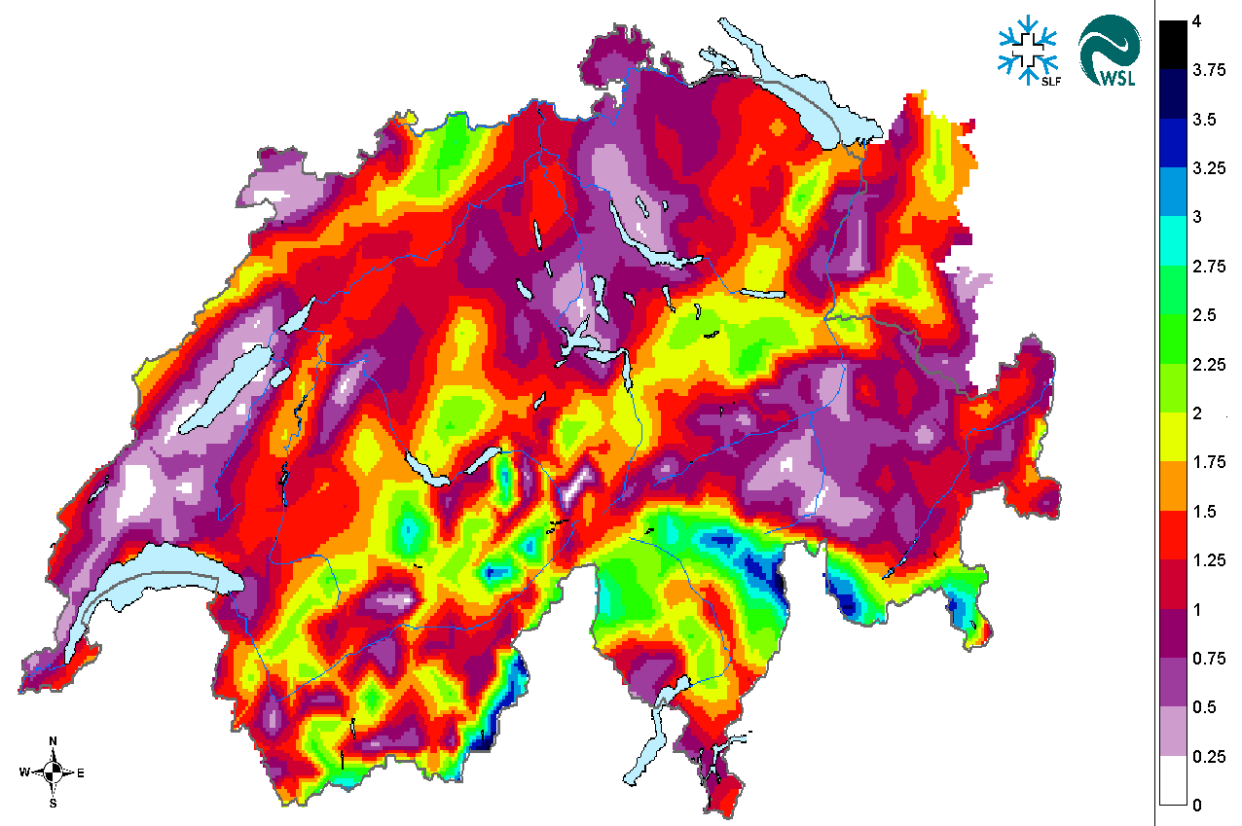
Combined debiasing and downscaling of forcing fields
Example: wind fields of COSMO-7
Issues: coarse resolution, systematic biases with exposure, skewed PDFs
Wind Speed (m/s)
intro ► data assimilation ► debiasing ► downscaling ► terrain corrections ► fusion of datasets ► summary

Slide 10
Combined debiasing and downscaling of forcing fields
Example: wind fields of COSMO
Issues: coarse resolution, systematic biases with exposure, skewed PDFs
intro ► data assimilation ► debiasing ► downscaling ► terrain corrections ► fusion of datasets ► summary

Slide 11
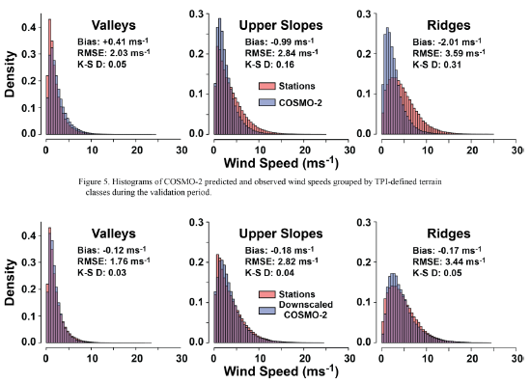
Combined debiasing and downscaling of forcing fields
Example: wind fields of COSMO
Issues: coarse resolution, systematic biases with exposure, skewed PDFs
Corrected Uncorrected
intro ► data assimilation ► debiasing ► downscaling ► terrain corrections ► fusion of datasets ► summary

Slide 12
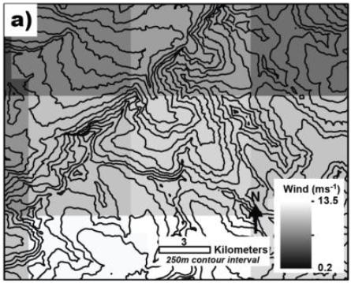
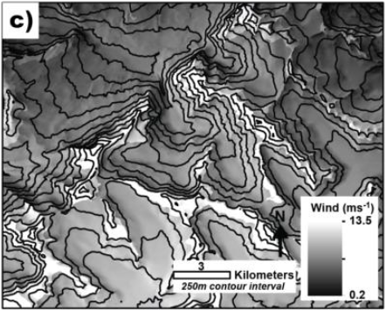
Combined debiasing and downscaling of forcing fields
Example: wind fields of COSMO
Issues: coarse resolution, systematic biases with exposure, skewed PDFs
Method: Scaling using the wind-direction depended Sx exposure index improving both bias, PDF, and resolution
Uncorrected Corrected
Wind direction
intro ► data assimilation ► debiasing ► downscaling ► terrain corrections ► fusion of datasets ► summary

Slide 13
Fusion of Reanalysis and NWP data
Example: precipitation (COSMO-analysis and RhiresD-reanalysis)
Issue: reanalysis data is better but only available at daily resolution
MWP (Forecast)
Meteo Observations
NWP (Analysis)
Reanalysis Products
1h
24h
Fusion
Model Forecast + Update
intro ► data assimilation ► debiasing ► downscaling ► terrain corrections ► fusion of datasets ► summary

Slide 14
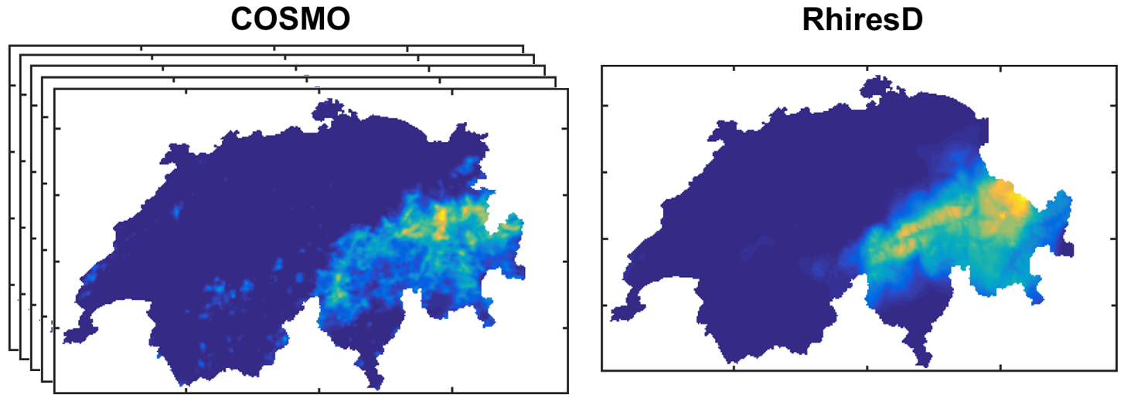
Fusion of Reanalysis and NWP data
Example: precipitation (COSMO-analysis and RhiresD-reanalysis)
Issue: reanalysis data is better but only available at daily resolution
Method: force 24h-sum of hourly COSMO grids to match RhiresD data Disaggregation using weighted 20km/50km window
intro ► data assimilation ► debiasing ► downscaling ► terrain corrections ► fusion of datasets ► summary

Slide 15
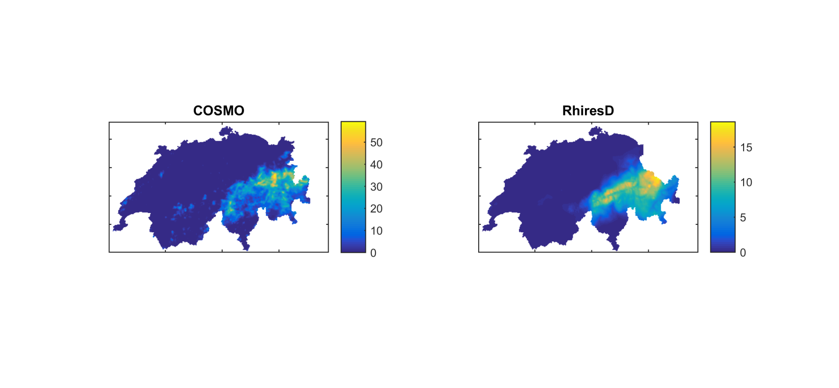

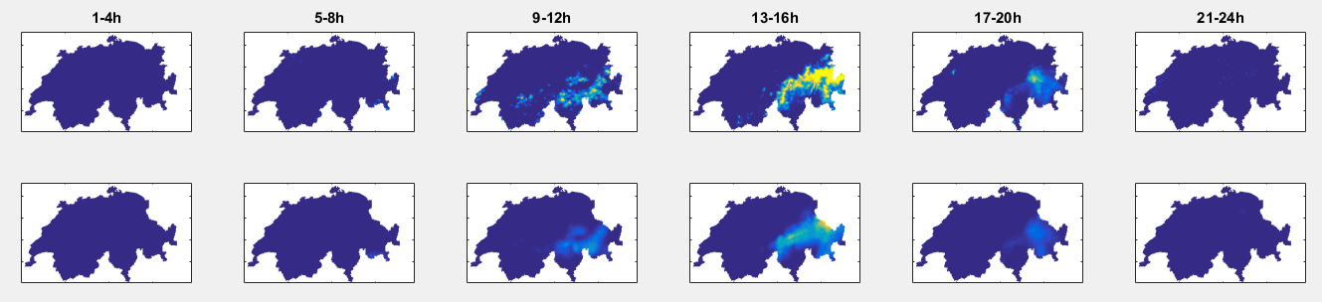
Fusion of Reanalysis and NWP data
Example: precipitation (COSMO-analysis and RhiresD-reanalysis)
Issue: reanalysis data is better but only available at daily resolution
Method: force 24h-sum of hourly COSMO grids to match RhiresD data Disaggregation using weighted 20km/50km window
COSMO
raw
COSMO
forced
intro ► data assimilation ► debiasing ► downscaling ► terrain corrections ► fusion of datasets ► summary

Slide 16
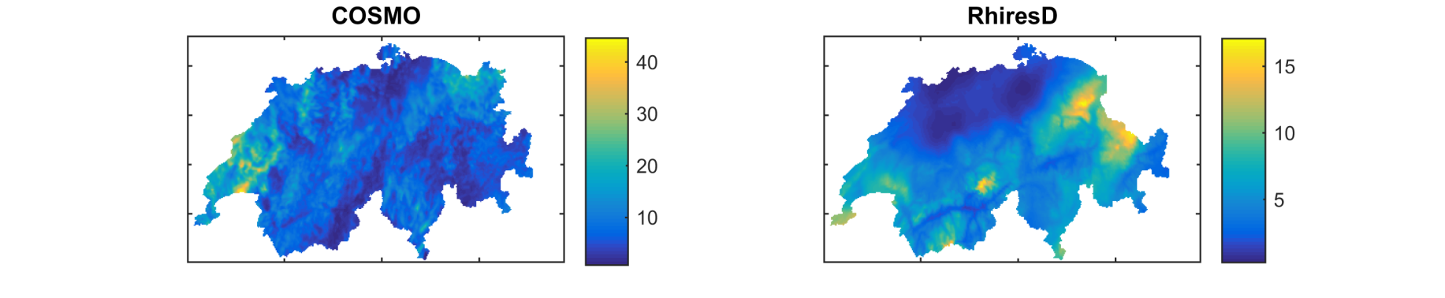
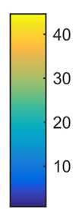
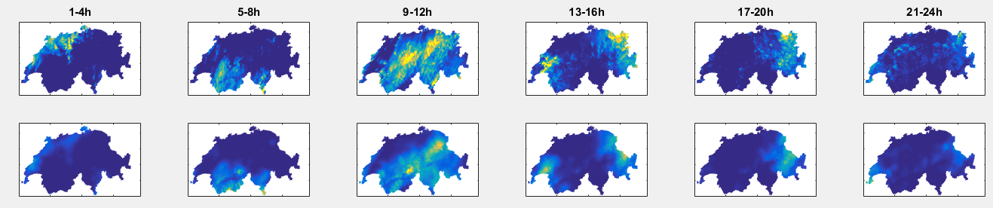
Fusion of Reanalysis and NWP data
Example: precipitation (COSMO-analysis and RhiresD-reanalysis)
Issue: reanalysis data is better but only available at daily resolution
Method: force 24h-sum of hourly COSMO grids to match RhiresD data Disaggregation using weighted 20km/50km window
COSMO
raw
COSMO
forced
intro ► data assimilation ► debiasing ► downscaling ► terrain corrections ► fusion of datasets ► summary

Slide 17
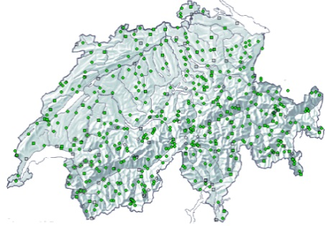

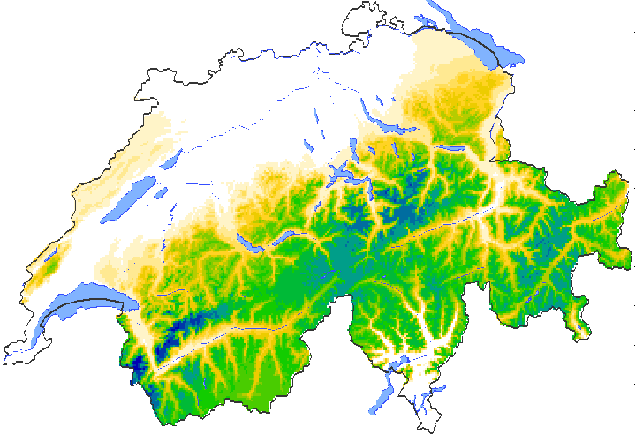
Take home message
Forecast situations such as ROS require more complex snowmelt models
EB snowmelt models require input fields that are difficult to produce but typically available from NWP models
NWP model data need to be post-processed before using as input for subsequent EB snowmelt models
Problems to deal with are: systematic bias, skewed PDFs, too coarse resolution, mismatch with reanalysis products
Enhancing met data input requires a LOT of effort, data, and specific methodology for each variable/problem
intro ► data assimilation ► debiasing ► downscaling ► terrain corrections ► fusion of datasets ► summary

