Slide 1

Addressing Water Security through Better Understanding and Predicting Mountain Snow Water Resources under Climate Change
John Pomeroy
Global Institute for Water Security & Centre for Hydrology,
University of Saskatchewan, Saskatoon, Canada,
Notes:
1

Slide 2
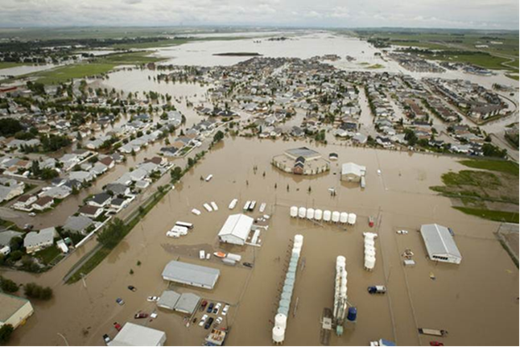
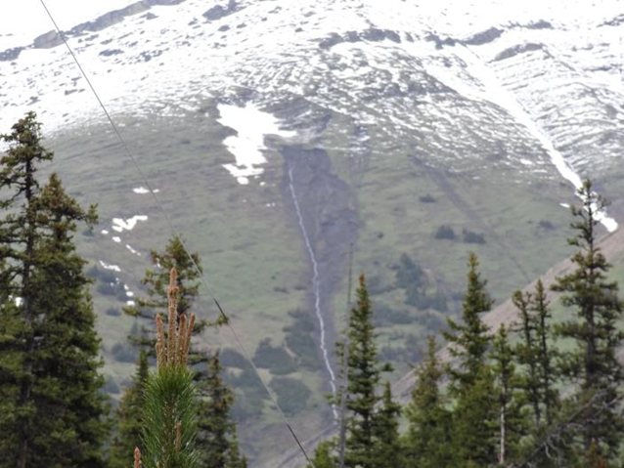
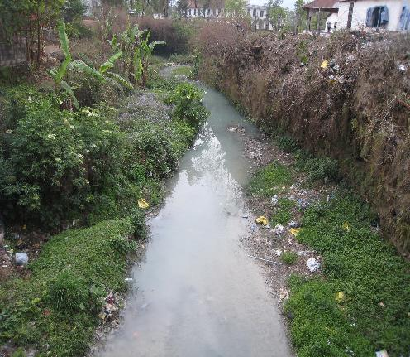
Global Water Security Challenges:
unsustainable use of water – food, energy, industry, drinking
increasing competition for water resources – transboundary issues
degradation of water quality – agricultural runoff, industry, sewage
increasing risk from extreme events – heavy rainfall and snowfalls
unprecedented environmental change,
  especially in high mountains – rapidly glacier melt, declining snow, heavy rainfall

Slide 3
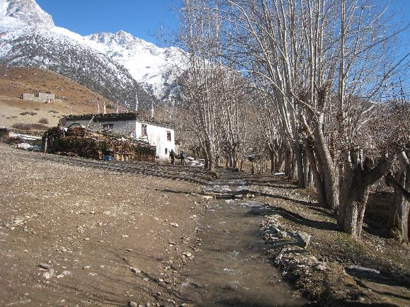
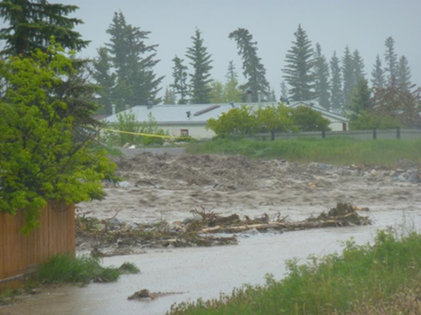
Water Security Impacts from Mountain Catchments
Mountains provide water supply for over half of humanity.
  Diminishing supplies due to climate change and consumption, both in mountains and downstream
Recent mountain flood deaths and damage from unprecedented precipitation - examples
  Pakistan, Afghanistan, Nepal, India - since 2010 ~8225 deaths reported from heavy mountain rains.
  Bosnia, Serbia – May 2014, 62 deaths reported, 1.6 million affected
  Western Canada – June 2013, 4 deaths reported, $6 billion in damages
  Colorado, USA – Sept 2013, 10 deaths, 2000 homes damaged

Slide 4
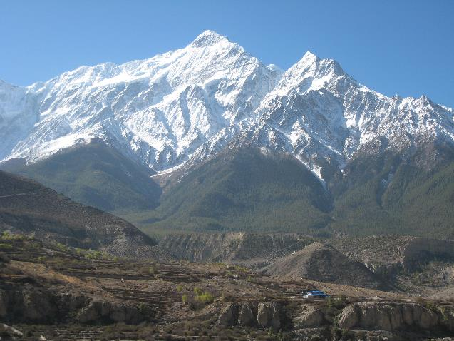
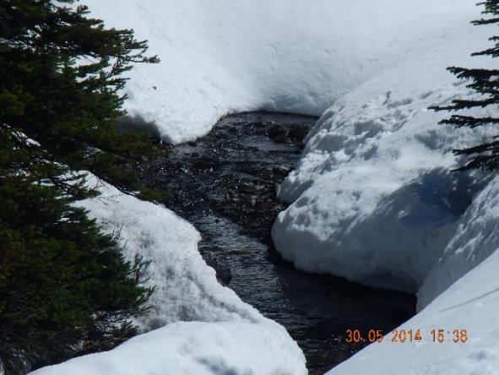
Urgency
to IPCC (2014) WG II report – “In many regions, changing precipitation or melting snow and ice are altering hydrological systems, affecting water resources in terms of quantity and quality”
Alpine catchments receive and produce a disproportionately large fraction of global precipitation and runoff including contributions to floods and water supply and drought protection for vast downstream areas.
Snow, ice, and precipitation phase change dominate the behaviour of alpine hydrology – therefore especially sensitive to climate warming.

Slide 5
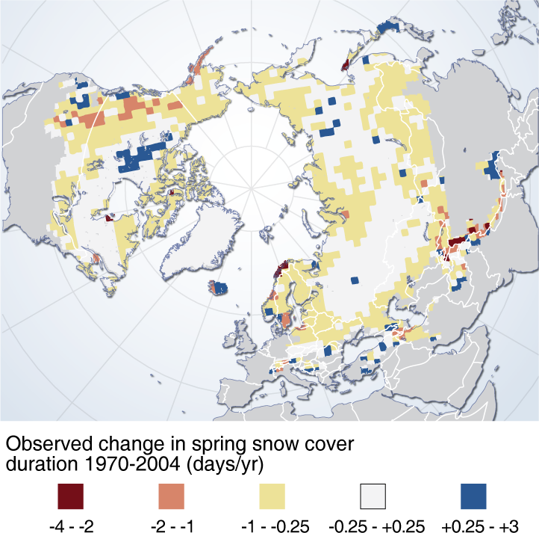
Declining Spring Snowcovered Area
Ross Brown,
Environment Canada

Slide 6
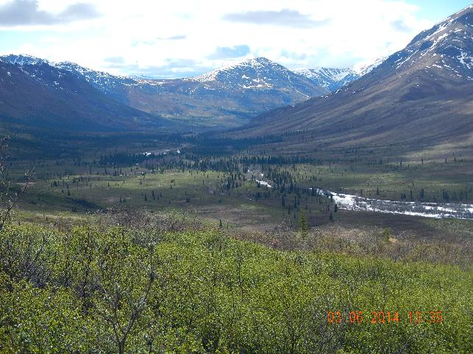
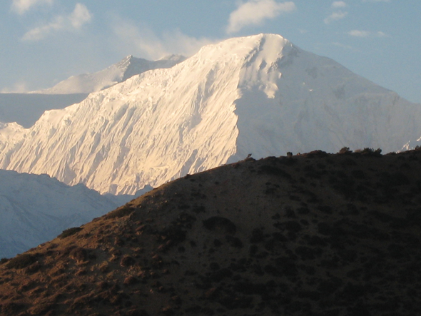
Significance
Understanding the sensitivity of alpine hydrological processes to changing high elevation climate is of disproportionate importance to global water and energy exchange and downstream water resources.
Ongoing change in climate has already resulted in shorter seasonal snowcover duration, earlier spring hydrographs, greater rainfall fraction of total precipitation, glacier volume decline, ground thaw and woody vegetation increase in many alpine catchments.
Some alpine catchments are contributing to higher frequency of floods and/or droughts.

Slide 7
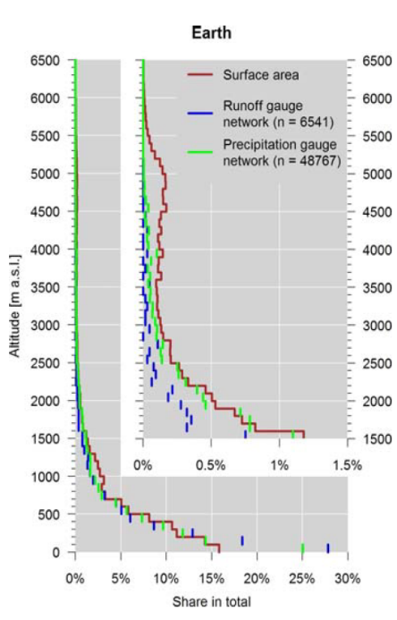
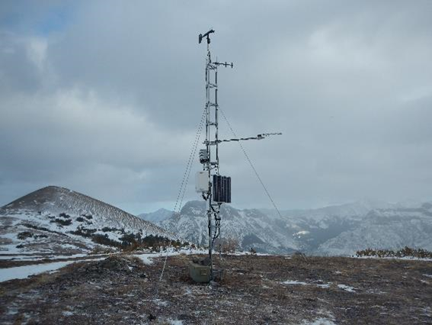
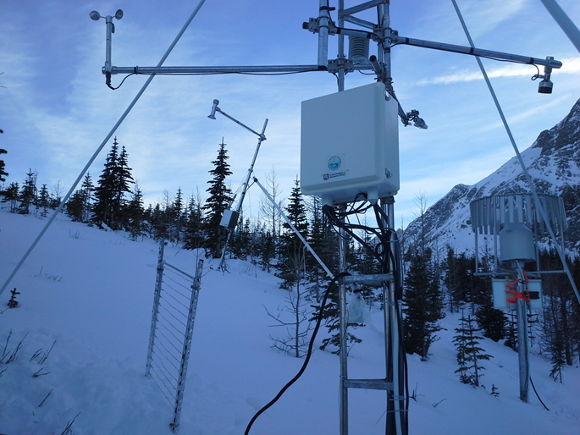
Alpine Regions are Data Scarce
Altitudinal distribution of global runoff stations represented in the GRDC archive and global precipitation station network represented in the GPCC archive compared to global hypsography of the land surface area (without Greenland and Antarctica). The inset shows a magnification for altitudes above 1500ma.s.l. (Viviroli et al. 2011).

Slide 8
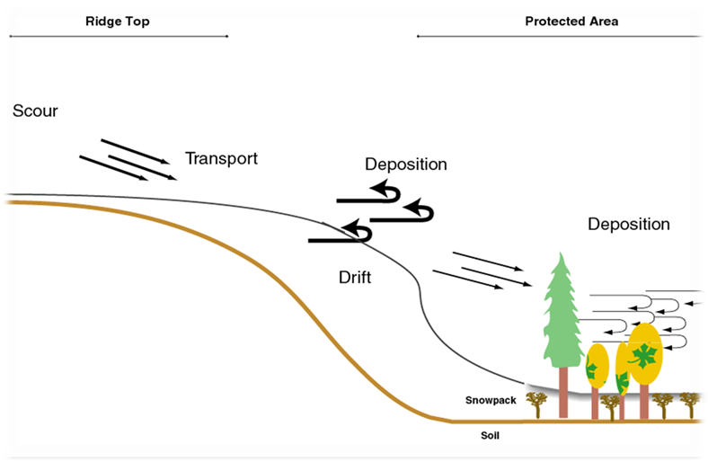
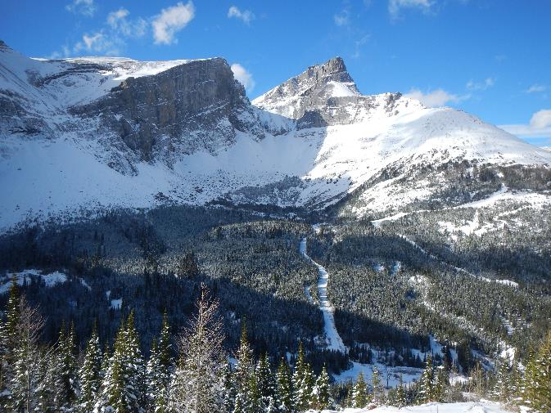
Research Need
A concerted global effort is needed to address how changing high mountain hydrological processes will mediate the influence of atmospheric change in alpine catchments.

Slide 9
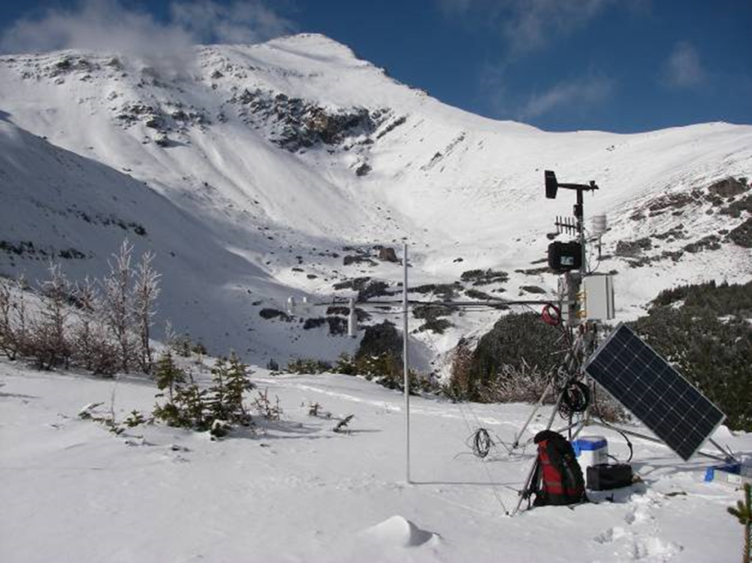
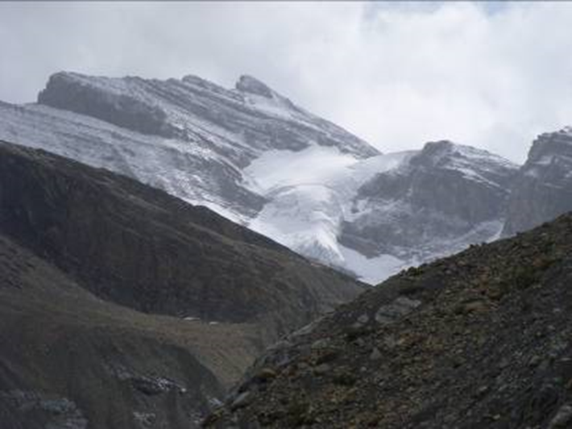
Objectives
Overall: to better understand alpine cold regions hydrological processes, improve their prediction and find consistent measurement strategies.
To achieve this objective it is necessary to develop transferable and validated hydrological model schemes of different complexity that can support research in data sparse mountain areas dominated by elements of snow, permafrost and glacier cover.

Slide 10
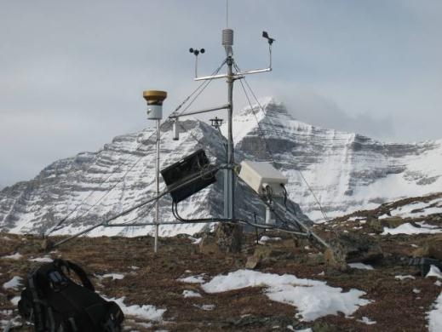
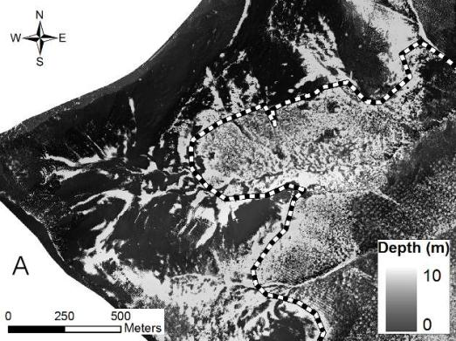
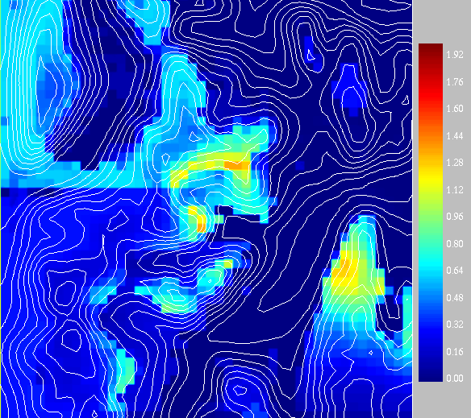
Integrated Alpine Observing & Predicting Systems
Instrumented alpine catchments with, remote sensing, modelling, downscaling, data assimilation in order to better evaluate mountain water and energy exchange.

Slide 11
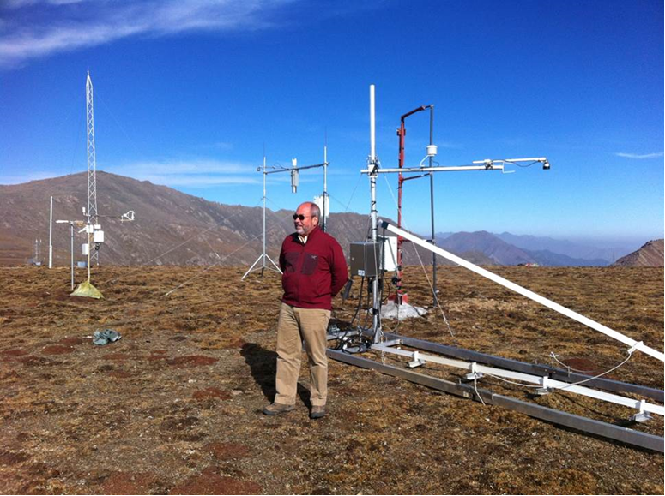
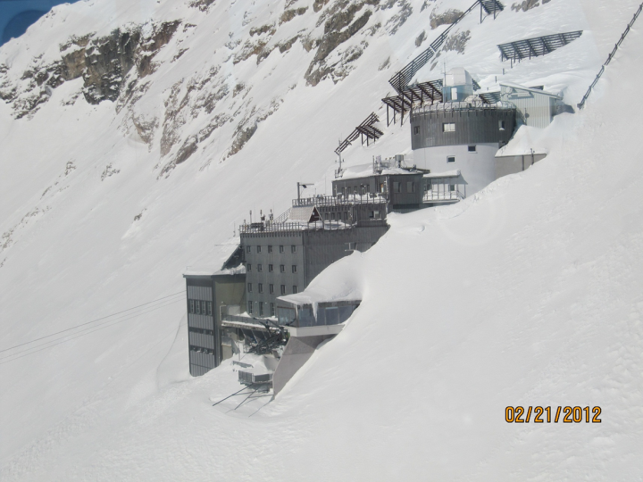
International Collaboration through Field & Model Experiments
Upper Heihe River Basin, 4150 m China
Schneefernerhaus, Zugspitze, 2650 m Germany

Slide 12
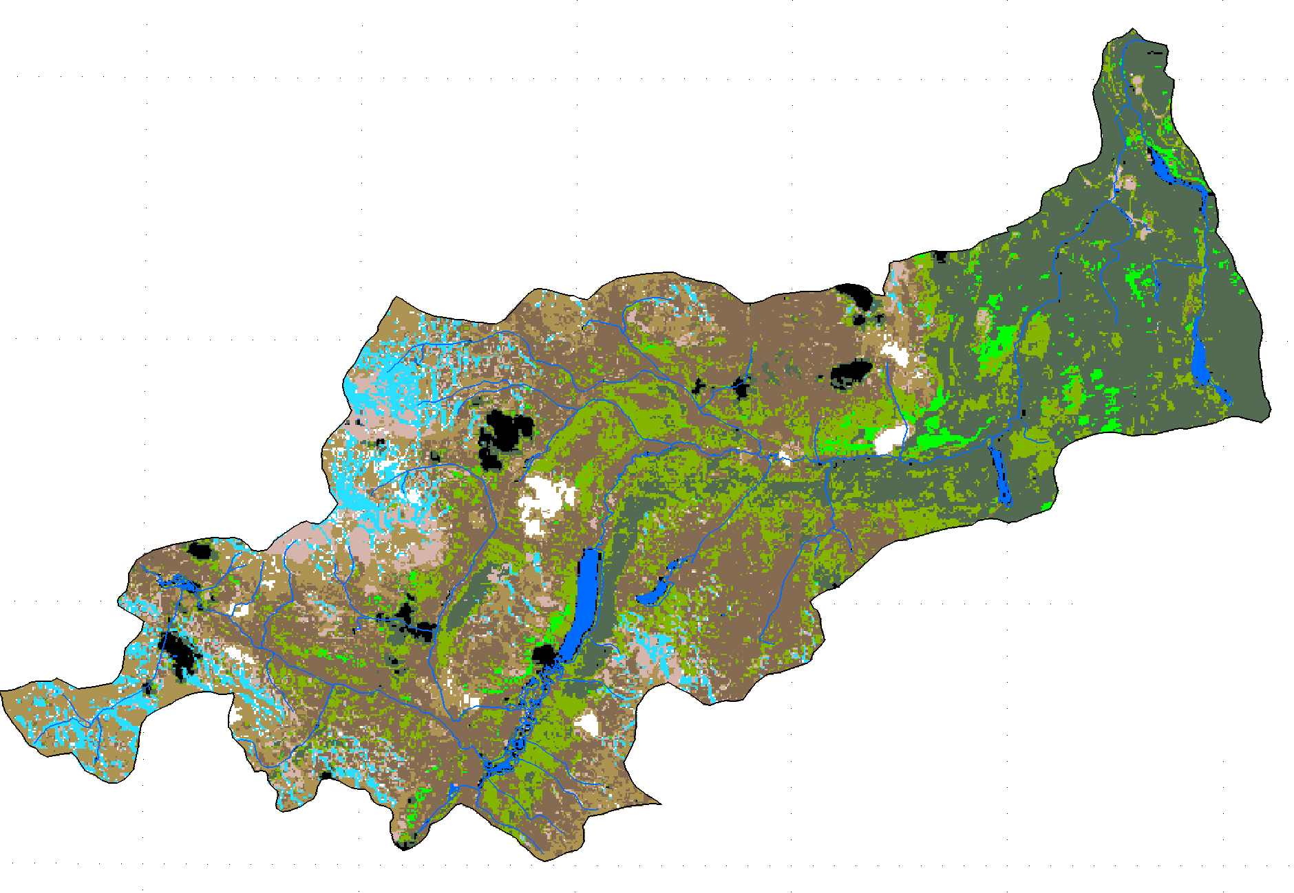
Wolf Creek, Yukon, Canada
Ecozone Effects
Alpine
ShrubTundra
Forest
Rasouli et al., 2014
12
Notes:
Peak annual snowpacks show a pronounced sensitivity to warming in wet years and a smaller sensitivity in drier years.

Slide 13
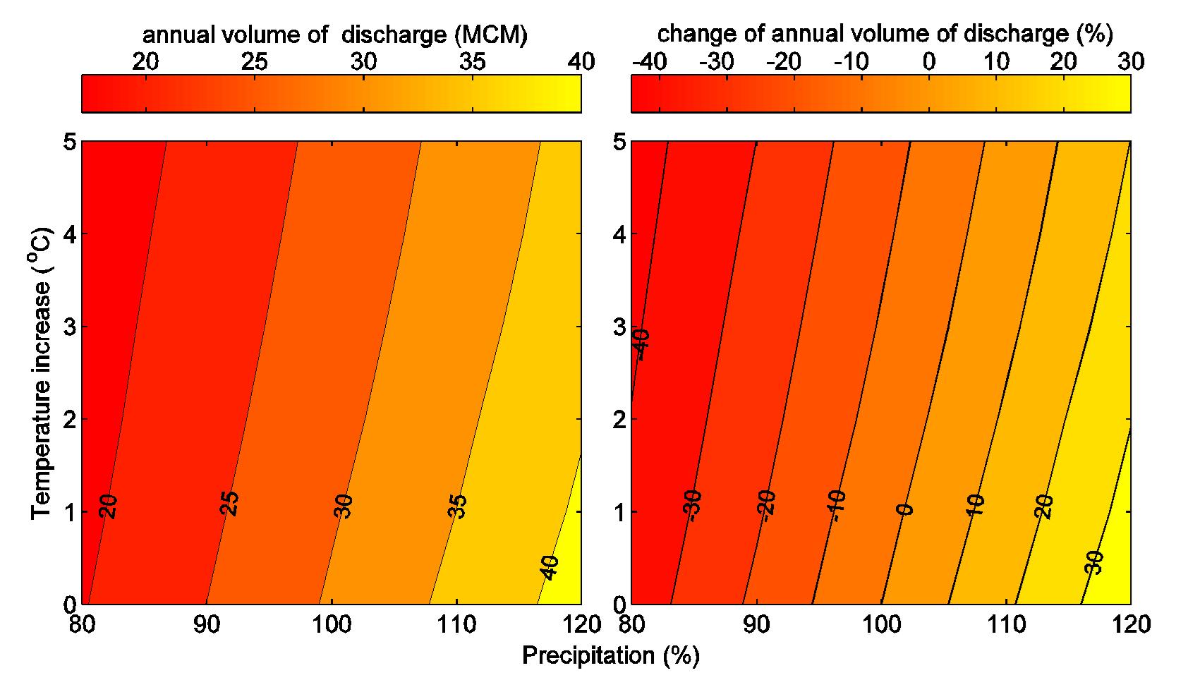
Wolf Creek, Yukon, Canada
Streamflow Impact
Alpine
ShrubTundra
Forest
Rasouli et al., 2014
13
Notes:
Peak annual snowpacks show a pronounced sensitivity to warming in wet years and a smaller sensitivity in drier years.

Slide 14
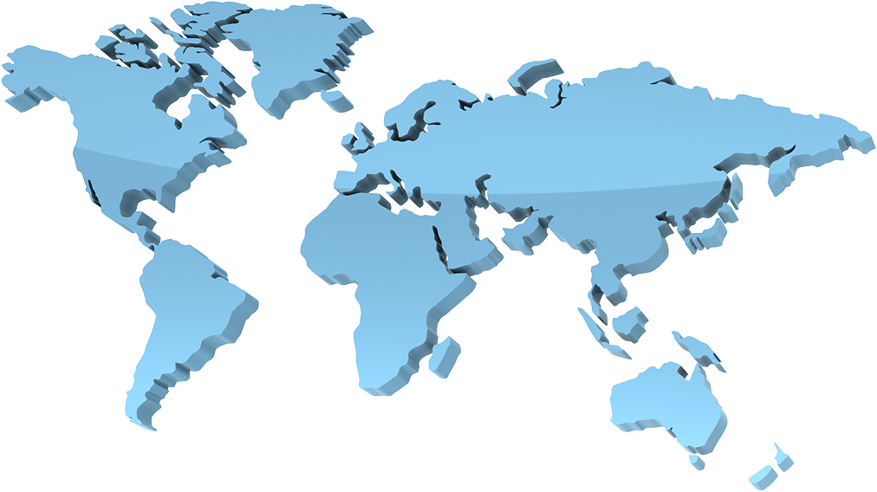

INARCH: International Network for Alpine Research Catchment Hydrology
Canada – Canadian Rockies & Yukon;
USA – Reynolds Creek, Idaho; Senator Beck
Basin, Colorado.
Chile - Upper Maipo & Upper Diguillín River Basins, Andes,
Germany – Schneefernerhaus & Zugspitze;
France – Arve Catchement, Col de Porte & Col du Lac Blanc;
Switzerland – Dischma & Weissfluhjoch;
Austria - OpAL Open Air Laboratory, Rofental
Spain – Izas, Pyrenees;
China – Upper Heihe River, Tibetan Plateau,
Nepal – Langtang Catchment, Himalayas
Integrated Alpine Observing and Predicting Systems (IAOPS),
initial sites to be considered

Slide 15

INARCH Collaborators
Lugwig Braun, Bavarian Academy of Sciences & Humanities, Germany
Karsten Schulz, BOKU, Vienna, Austria
Matthias Bernhardt, BOKU, Vienna, Austria
Xin Li, CAREERI, Chinese Academy of Sciences, Lanzhou, China
Richard Harding, Centre for Ecology & Hydrology, Wallingford, England
James McPhee, Dept. of Civil Engineering, University of Chile, Santiago, Chile
Nick Rutter, Dept. of Geography, University of Northumbria, Newcastle, England
Peter Jansson, Dept. of Physical Geography, Stockholm University, Sweden
Joseph Shea, ICIMOD, Nepal
Ignacio Lopez Moreno – CSIC, Institute for Pyrenean Ecology, Zaragoza, Spain
Yaoming Ma, Institute for Tibetan Plateau, Chinese Academy of Sciences, Beijing, China
Vincenzo Levizzani, Institute of Atmospheric Sciences & Climate, Bologna, Italy
Ulrich Strasser, Institute of Geography, University of Innsbruck, Austria
Georg Kaser, Institute of Meteorology & Geophysics, University of Innsbruck, Austria
Anil Mishra, International Hydrological Programme, UNESCO, Paris, France
Isabella Zin, LTHE, Grenoble, France
Vincent Vionnet, Meteo France, Grenoble, France
Martyn Clark, NCAR, Boulder, USA
Roy Rasmussen, NCAR, Boulder, USA
Richard Essery, School of Geosciences, University of Edinburgh, Scotland
Tobias Jonas, SLF, Davos, Switzerland
Walter Immerzeel, Universiteit Utrecht, Netherlands
Danny Marks, USDA ARS, Boise, USA
Alain Pietroniro, Water Survey of Canada, Environment Canada
Rick Janowicz, Yukon Environment, Canada
Thomas Painter, NASA JPL, Pasadena, USA

Slide 16

INARCH accepted by GEWEX Hydrometeorology Panel as a “Project” in December 2014
GEWEX = Global Energy and Water Exchanges project of World Climate Research Programme
Core funding to INARCH is needed to facilitate collaboration and central project operation through:
Travel funding support for workshops, scientific exchanges, joint field and modelling experiments,
User support for and central modelling development of Modelling and Downscaling Toolboxes
Data management of the data repository and model outputs for intercomparison experiments
Outreach and training activities.

Slide 17
UNESCO and INARCH
Contribution to Water Security
UN Year of Snow and Ice (?)

Slide 18
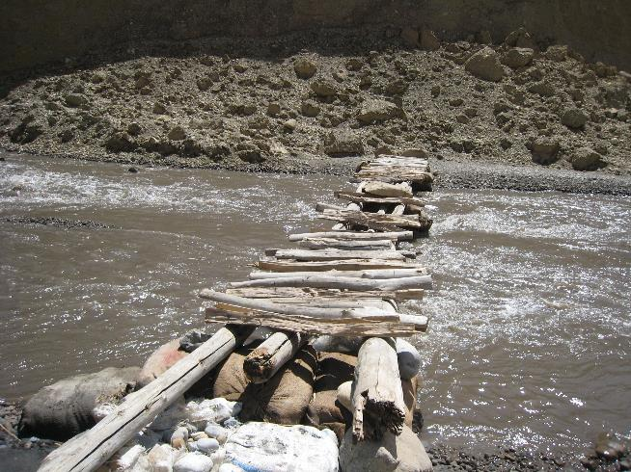
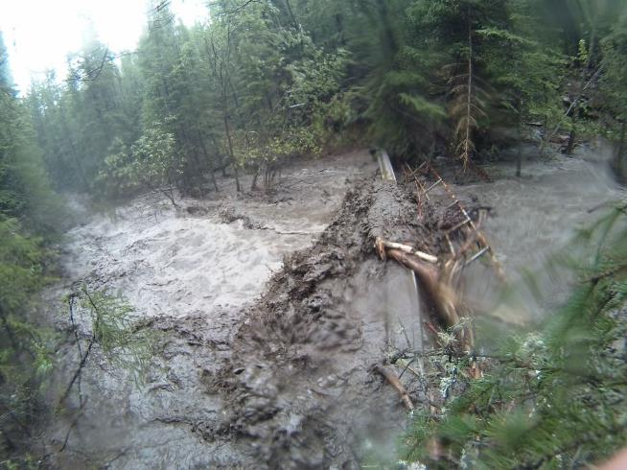
Conclusions
Global need for improving predictive models and observations of mountain snow hydrology for water security assessments through collaboration
Mountain snowpacks show extreme sensitivity to warming with important variations by region, altitude, ecosystem. This results in reduced streamflow volumes after snowmelt
Increased frequency of mountain flooding has been concomitant with reduced warm-season streamflows

