Slide 1
Catchment Hydrology of Permafrost Basins
or more accurately…..
Soil and runoff processes and parameterization research in Wolf Creek (mostly)

Slide 2
IP3 Team (those were the days….)
Sean K. Carey¹, Yinsuo Zhang, Celina Ziegler,
Michael Treberg, Jessica Boucher
Dept. Geography & Environmental Studies
Carleton University, Ottawa
¹ Now at School of Geography & Earth Sciences, McMaster University
With considerable contributions from:
William Quinton, John Pomeroy, Ric Janowicz
And there were quite a few others!!!

Slide 3
IP3 Research
Process Research
Runoff and soil hydrological processes in a discontinuous permafrost catchment (Jessica Boucher, Celina Zeilger, Dr. Michael Treberg)
Parameterization Research
Soil freezing and infiltration/redistribution algorithms (Dr. Yinsuo Zhang)

Slide 4
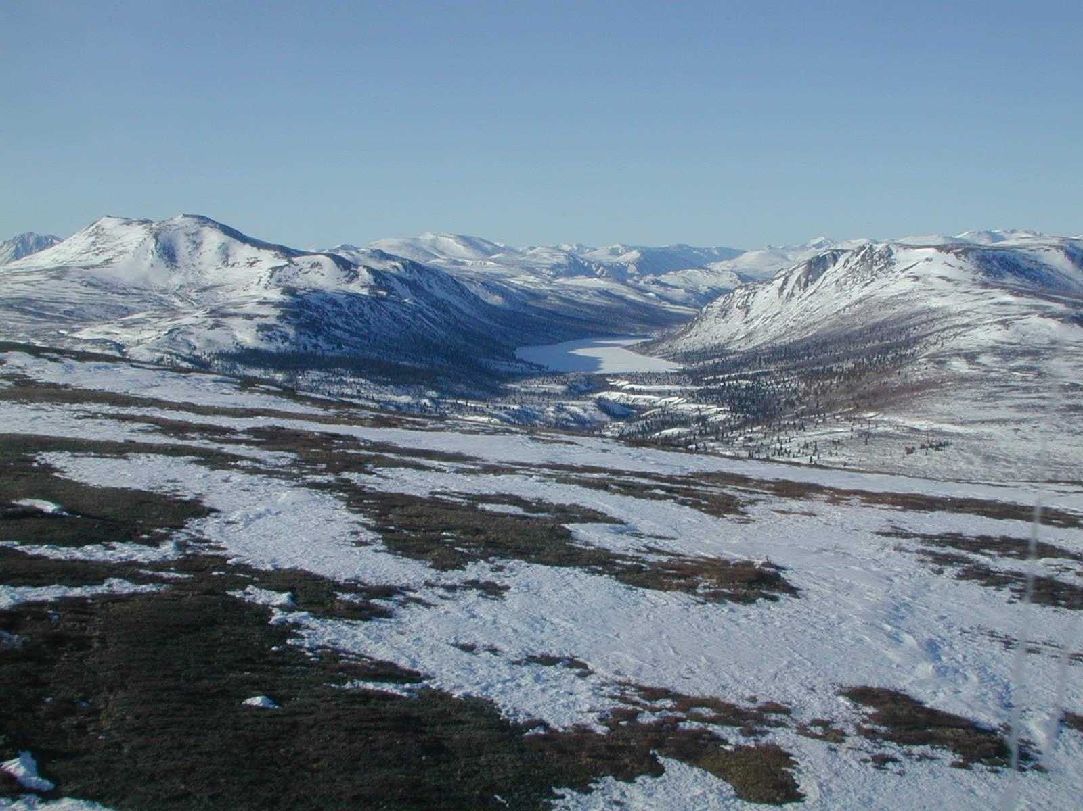
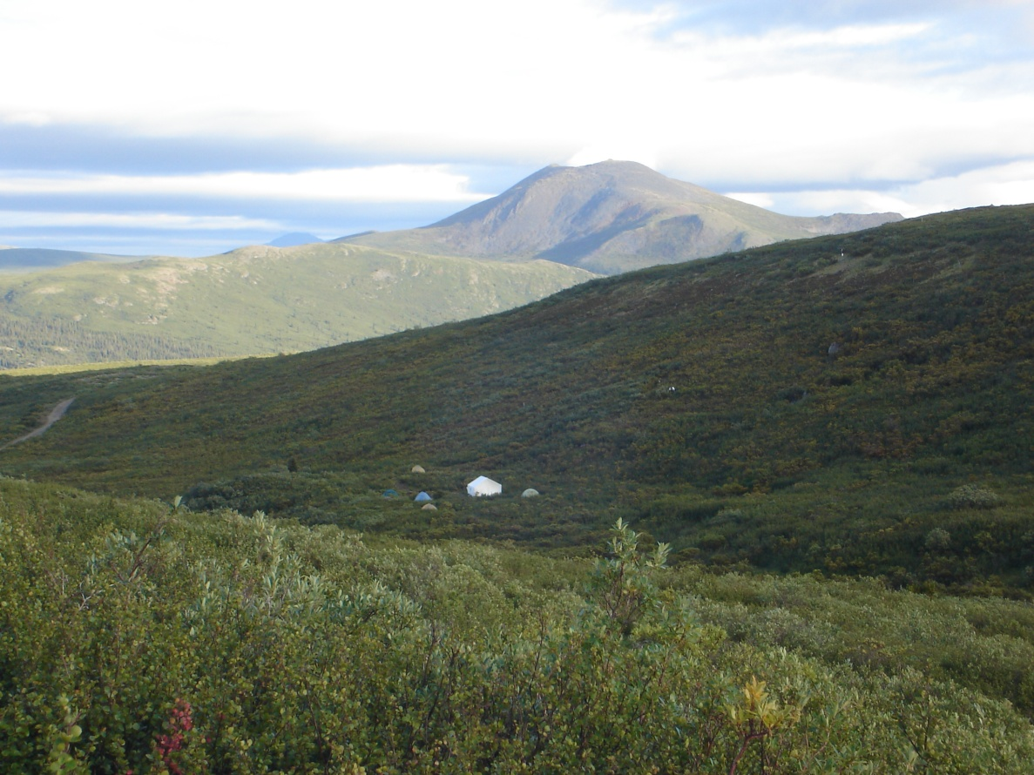
The Wolf Creek Research Basin
Location:
60º31 N, 135º 31’ W
Area:
Approx. 200 km²
Elevation Range:
800 to 2250 m a.s.l.
(3 ecozones)
Mean Annual Precipitation:
300 to 400 mm (40% snow)
Mean Annual Temperature:
-3 ºC

Slide 5
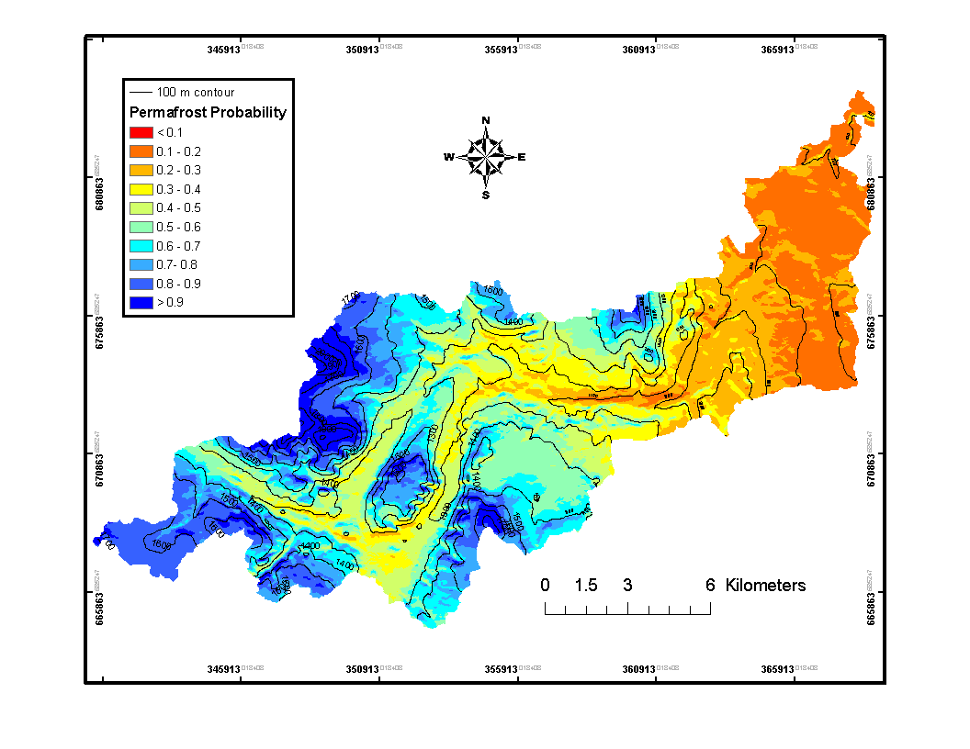
Permafrost Distribution within Wolf Creek
Map Courtesy Antoni Lewkowicz, U. of Ottawa

Slide 6
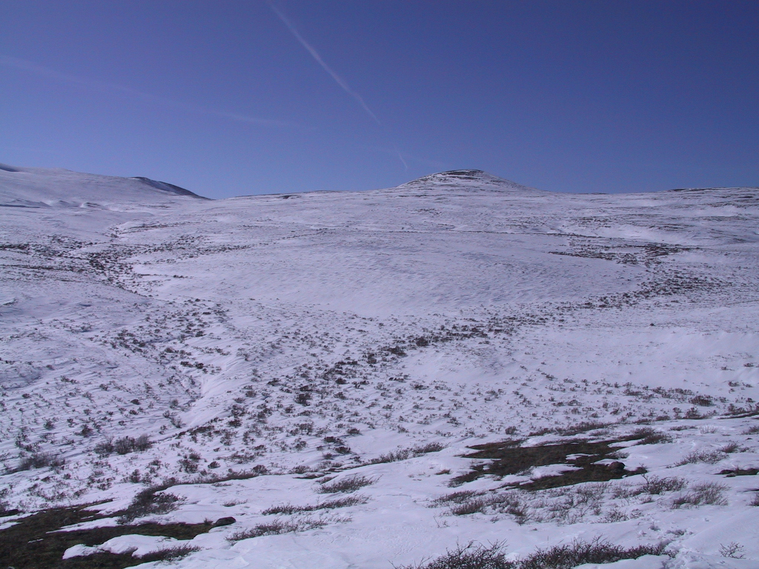
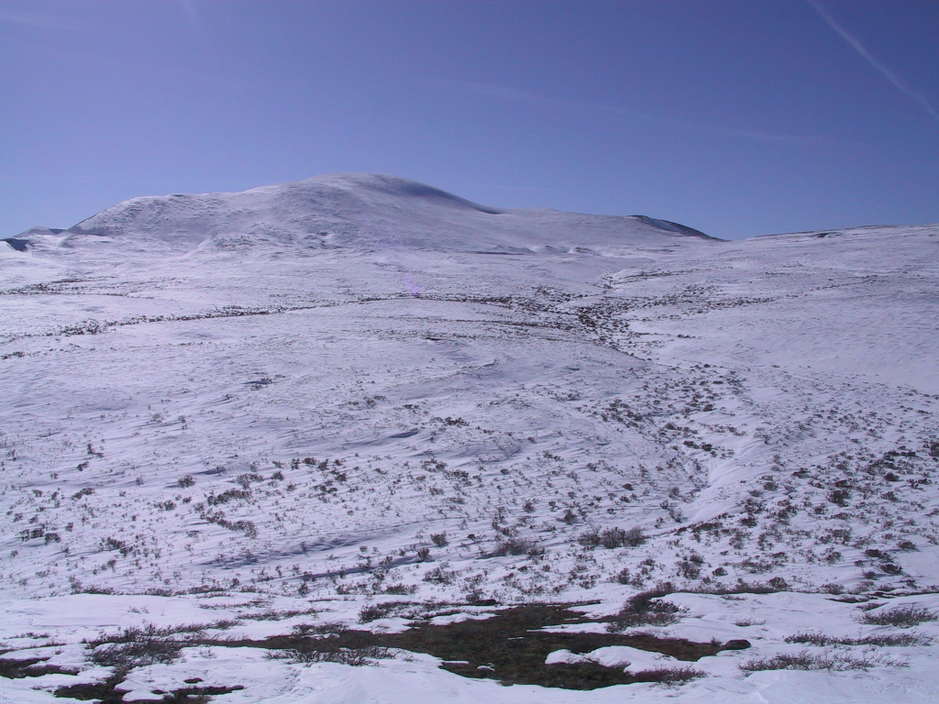
Granger sub-basin
8 km²
largely above tree-line
>75% underlain with permafrost

Slide 7
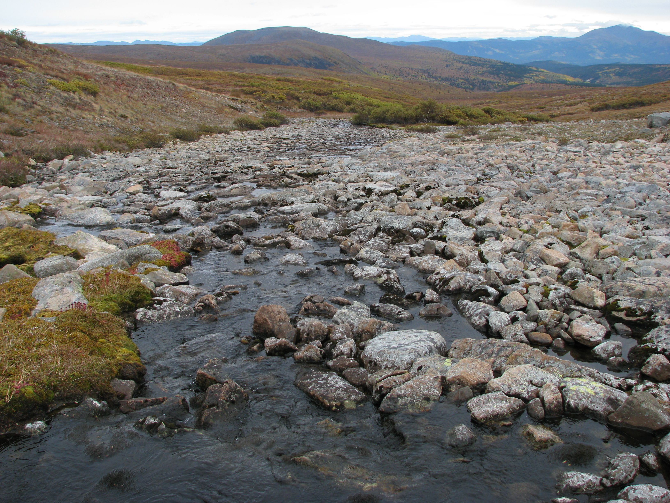
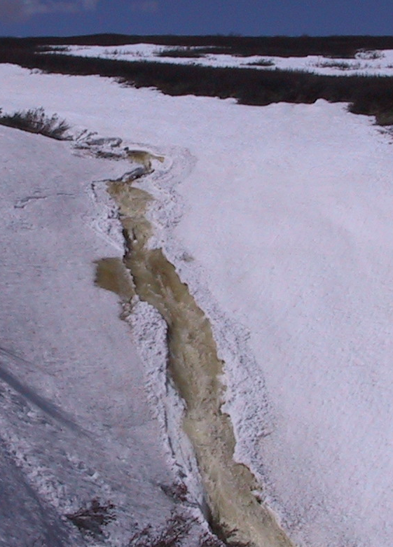
The big (and old...) questions
Where does the water come from?
How does it get to the stream?
What are we missing here?

Slide 8
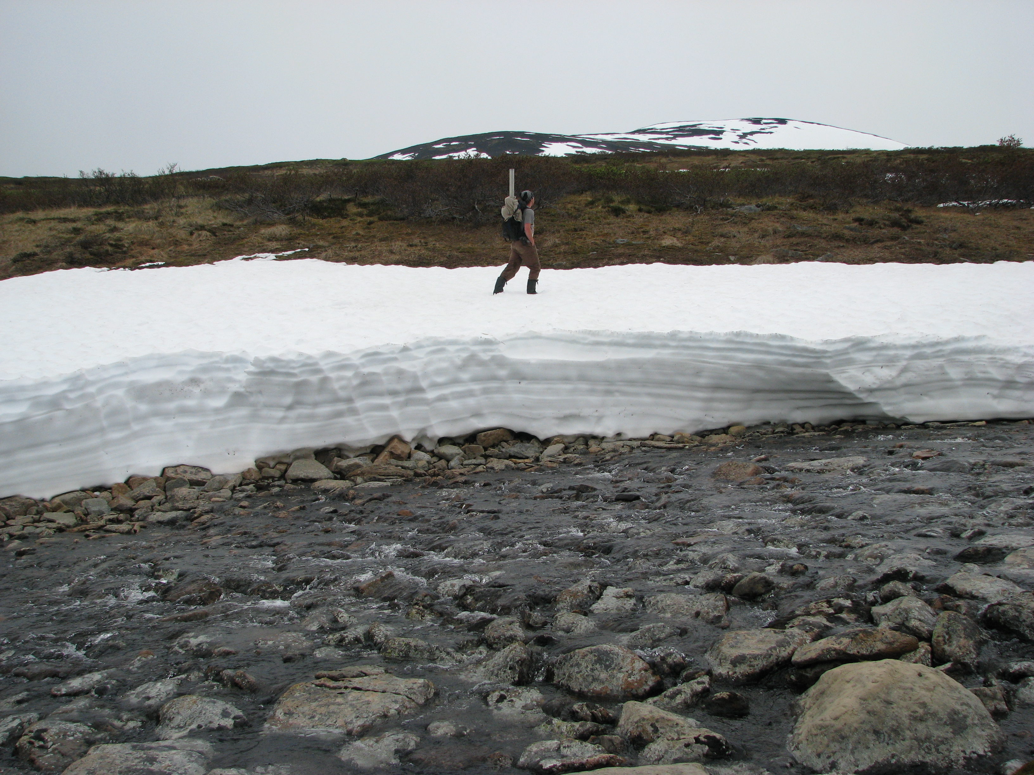
Process Hits and Misses

Slide 9
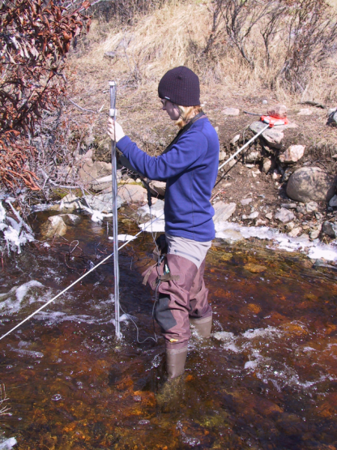
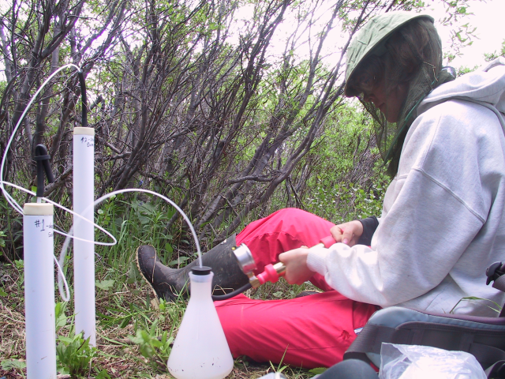
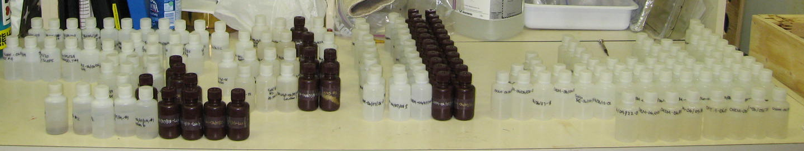
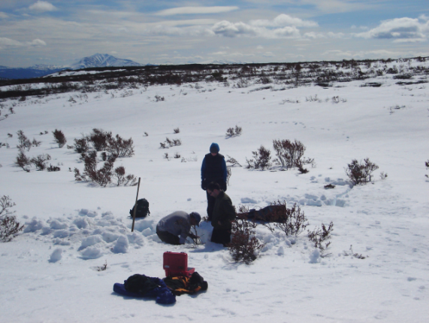
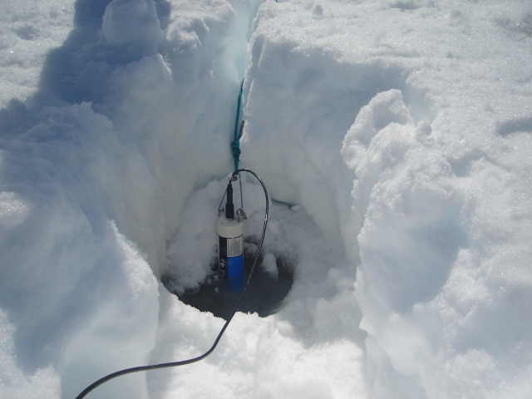
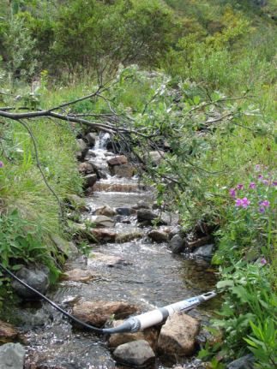
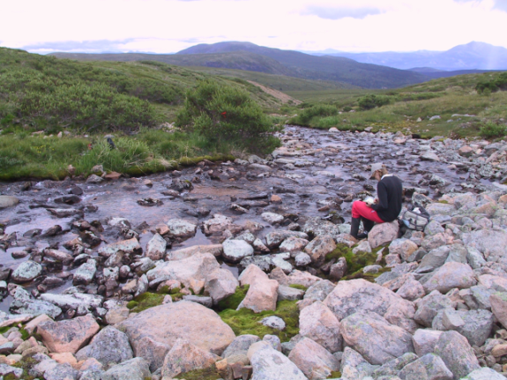
Techniques
High-frequency Sampling
Synoptic Sampling
Hydrometric
Hydrochemical

Slide 10
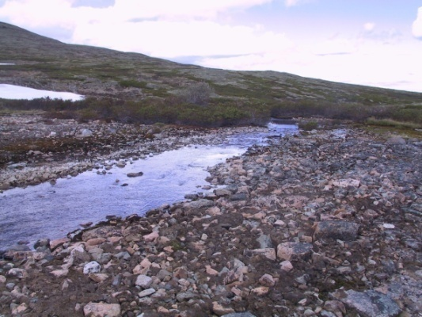
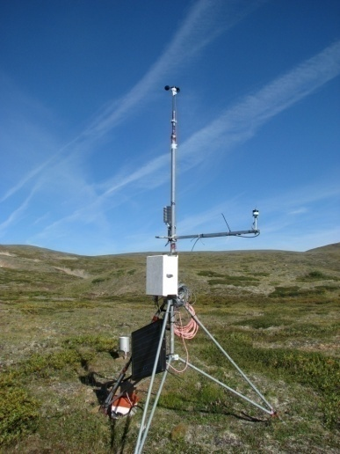
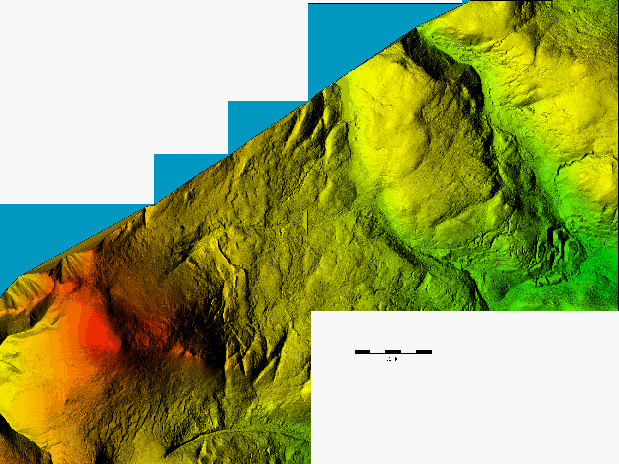
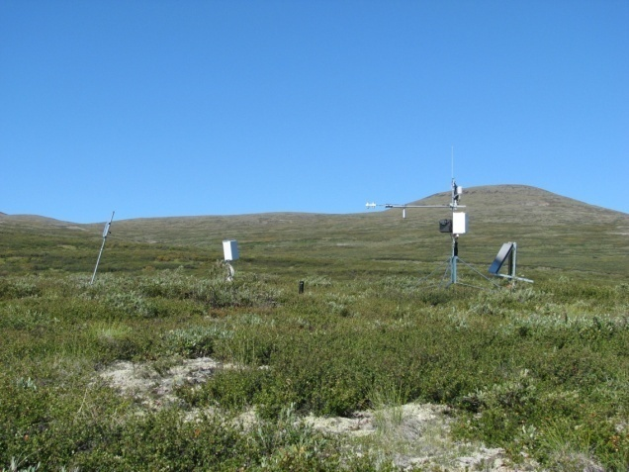
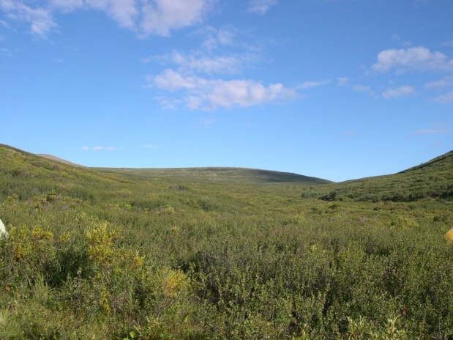
GB_04 2.1 km²
Stony soils, some lichen
GB_03 1.5 km²
Tundra vegetation
GB_02
GB_03
GB_01
GB_04
GB_02 2.9 km²
Birch dominated
GB_01 1.1 km²
Willow dominated

Slide 11
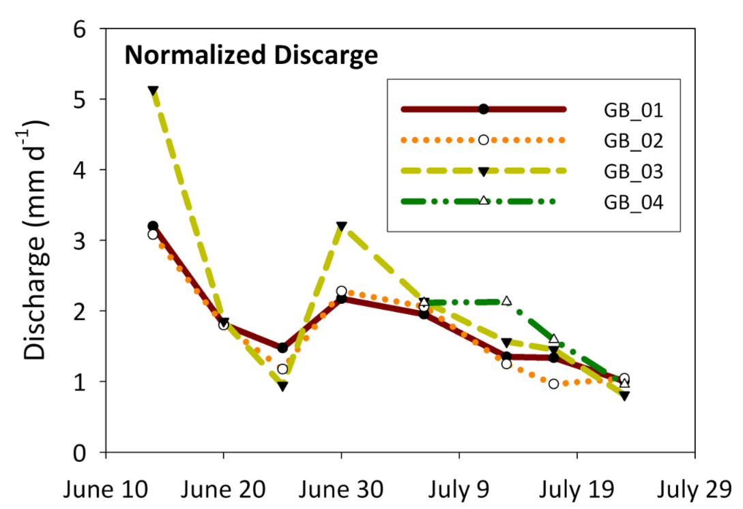
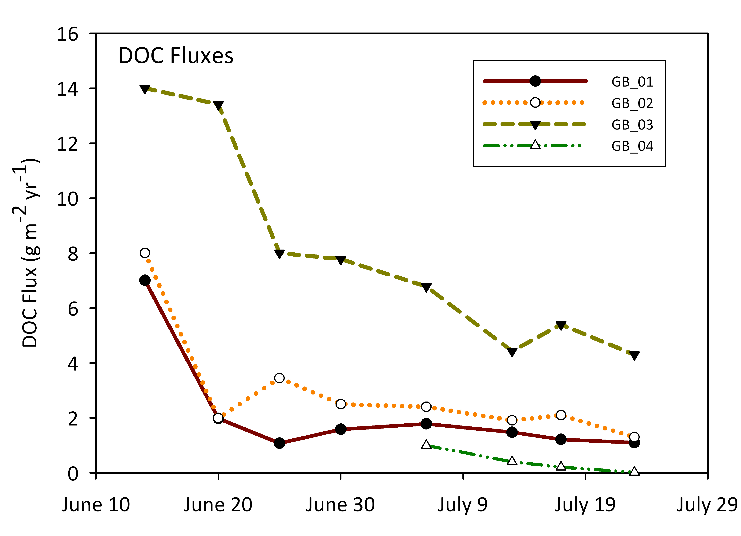
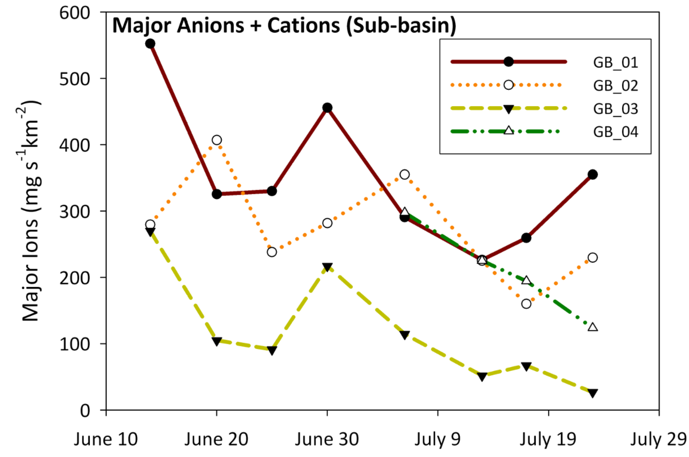
All HRUs contribute water to the stream in approximately equal volume.
Much greater deep groundwater flow than previously reported or anticipated.
Role of channel ice/snow to be investigated

Slide 12
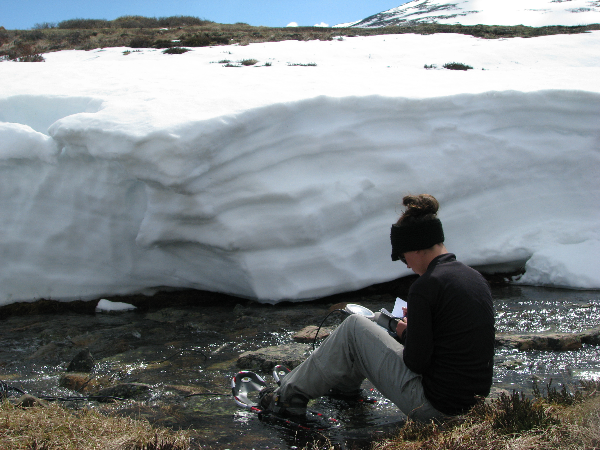
How can we get a handle on channel processes?

Slide 13
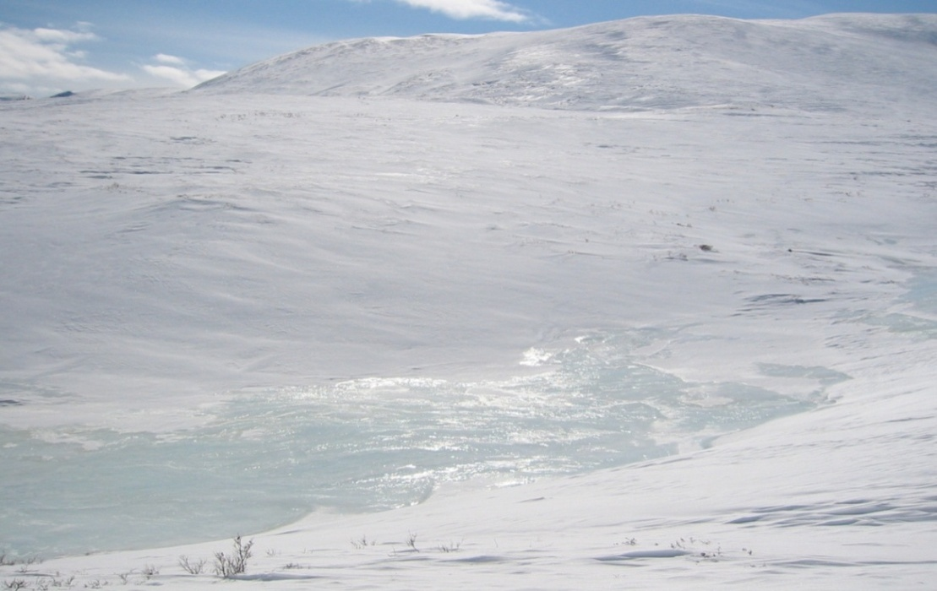

Slide 14
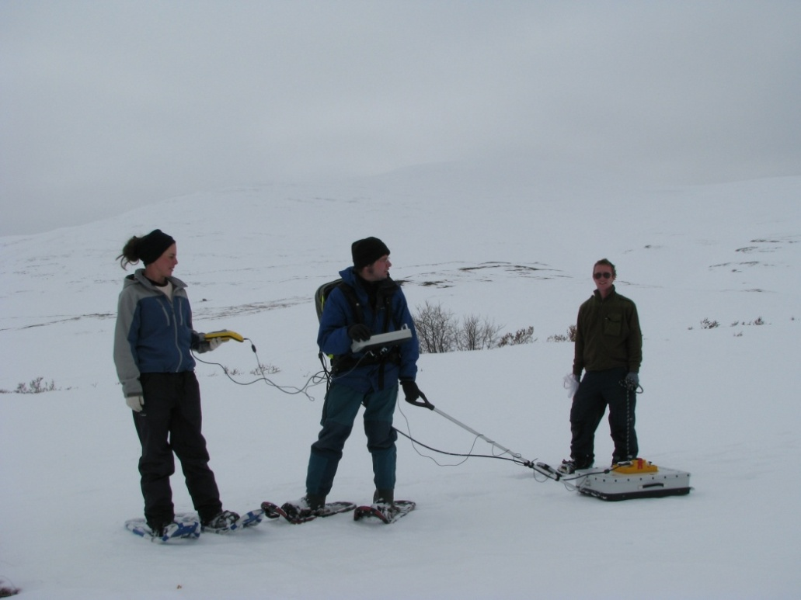
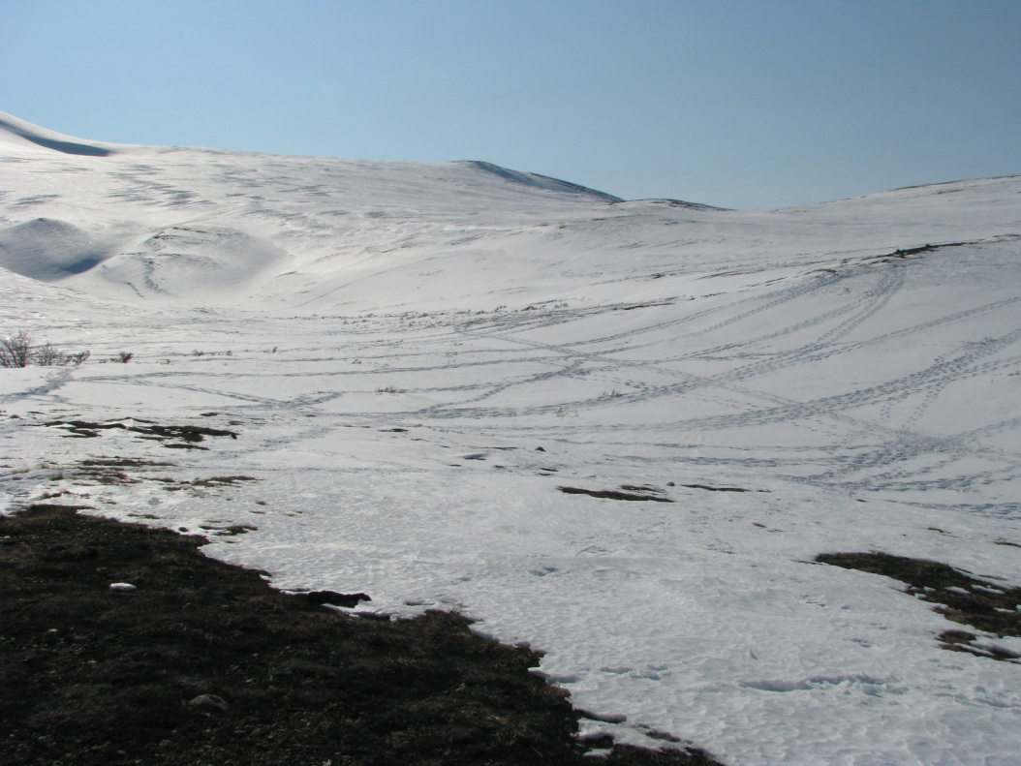
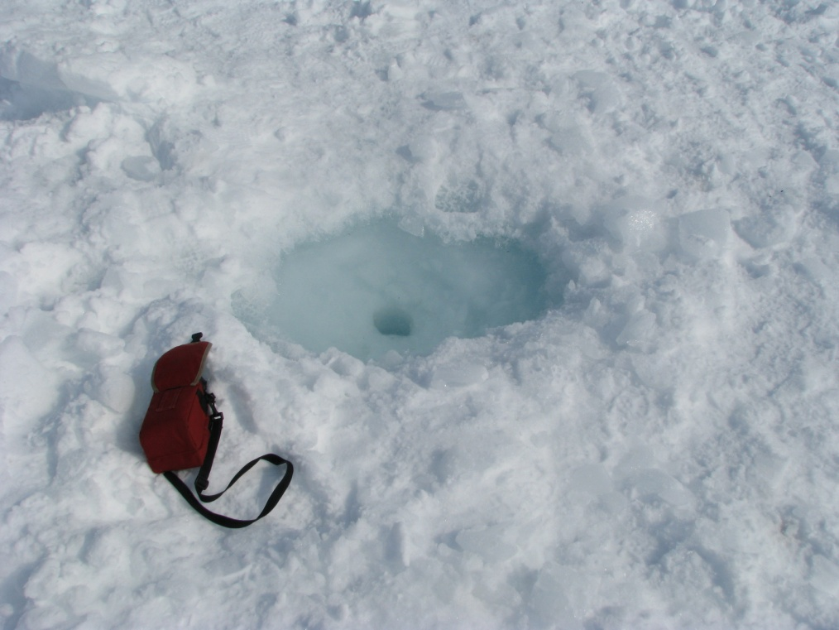
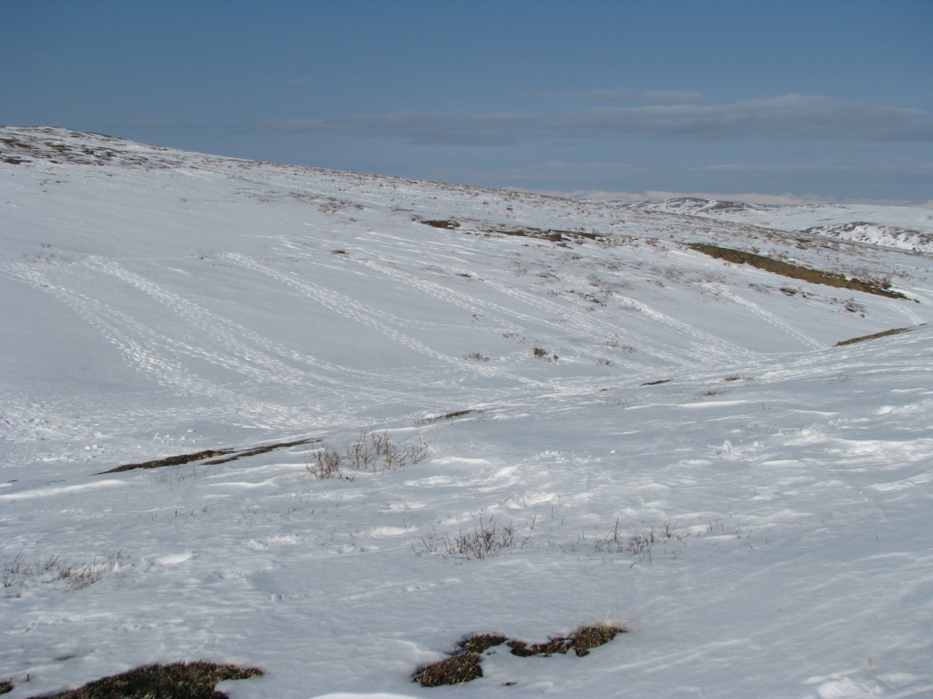
Adventures in GPR

Slide 15
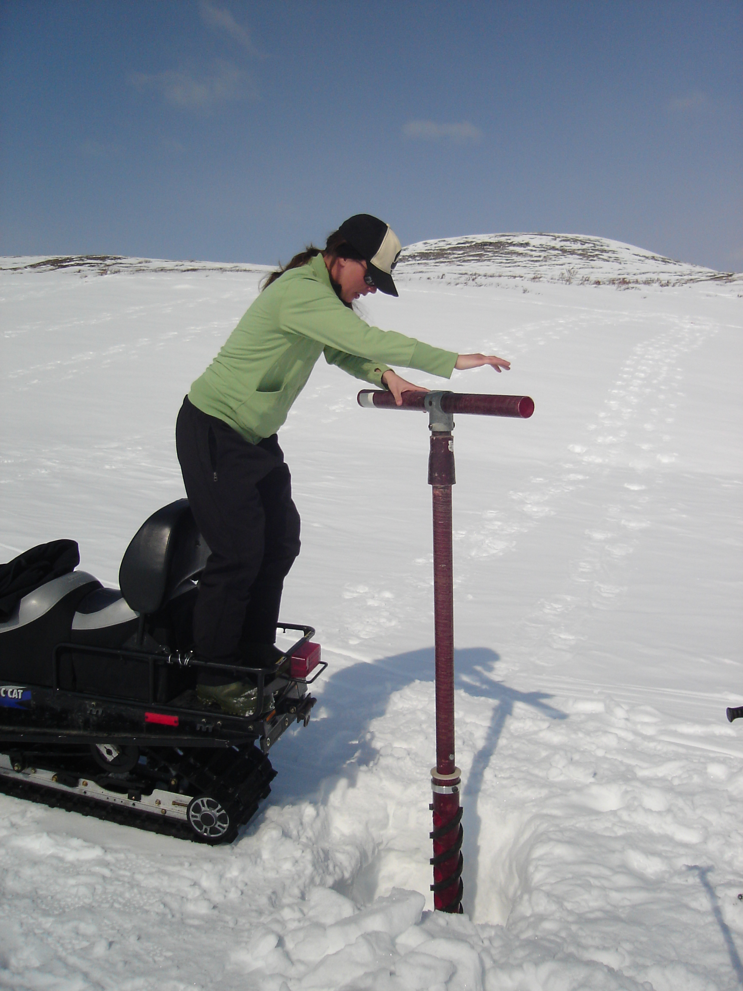
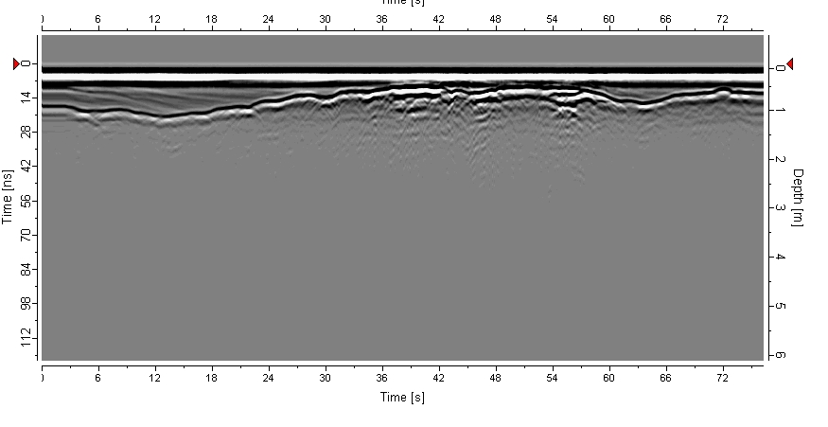

Slide 16
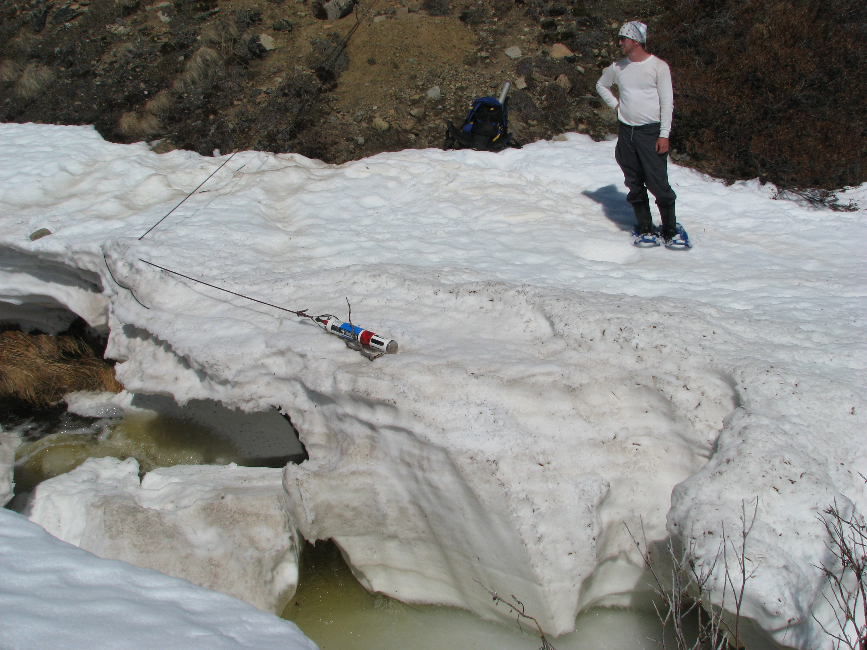

Slide 17
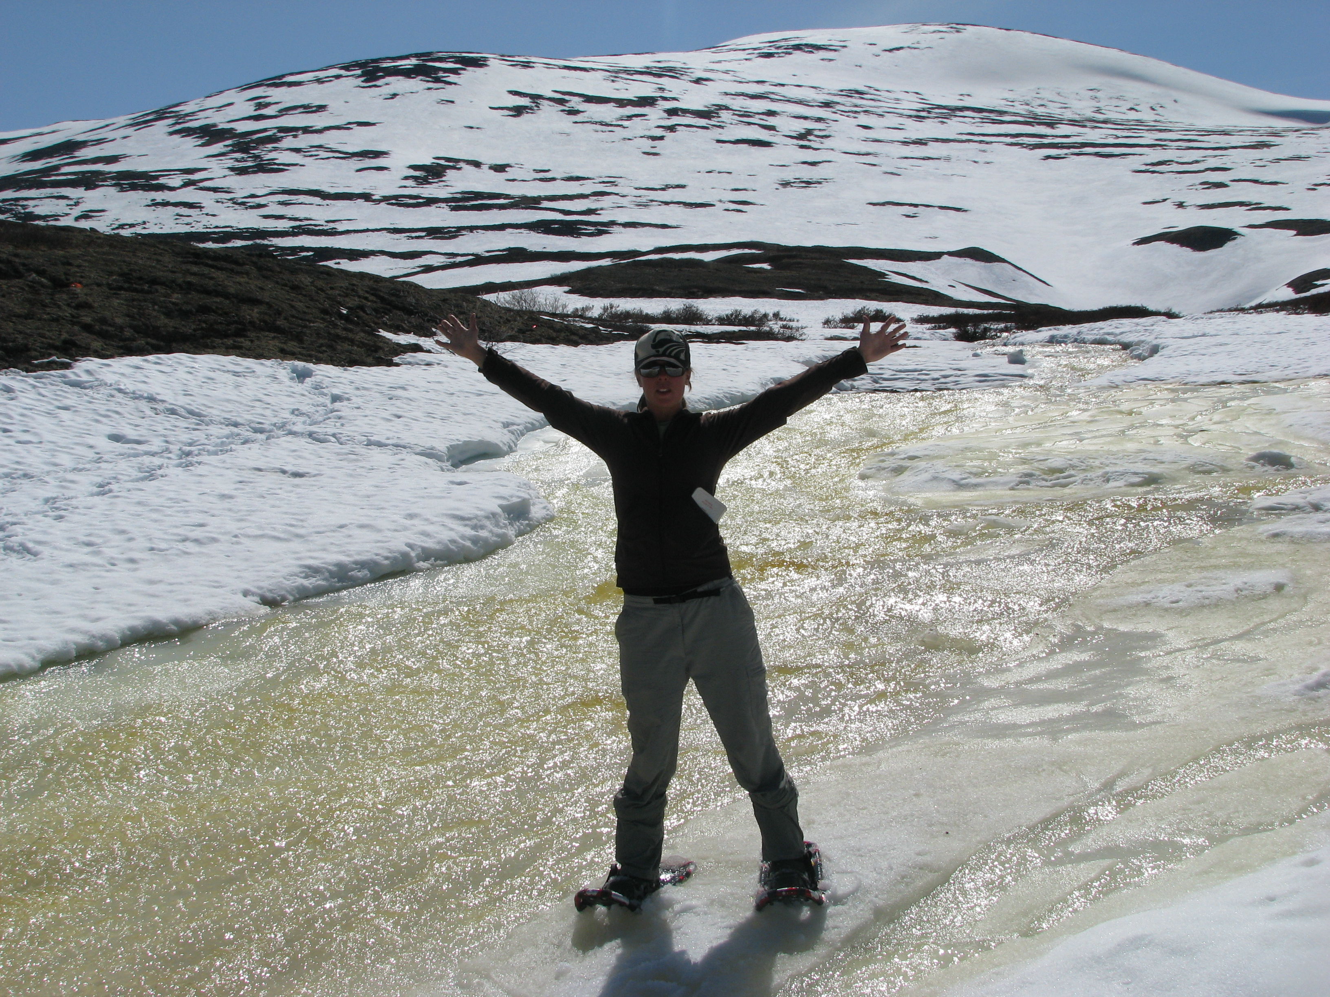

Slide 18
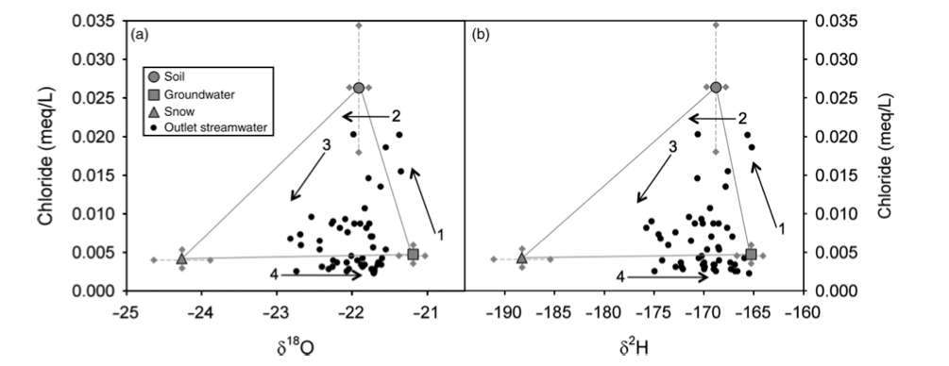
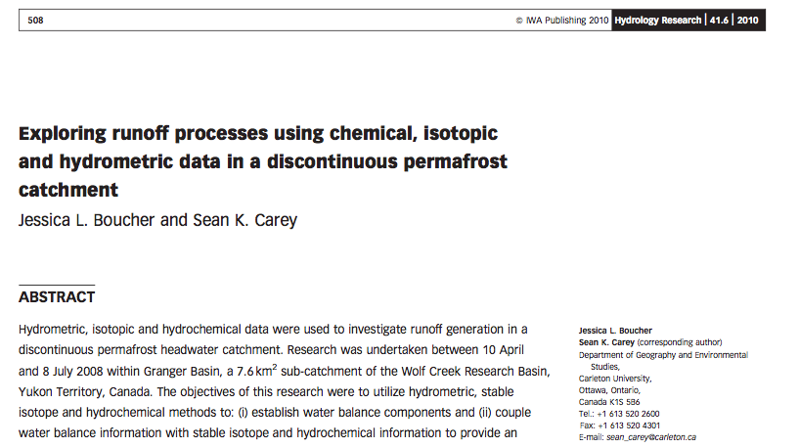
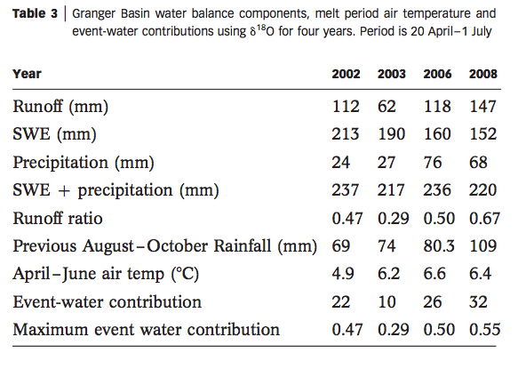

Slide 19
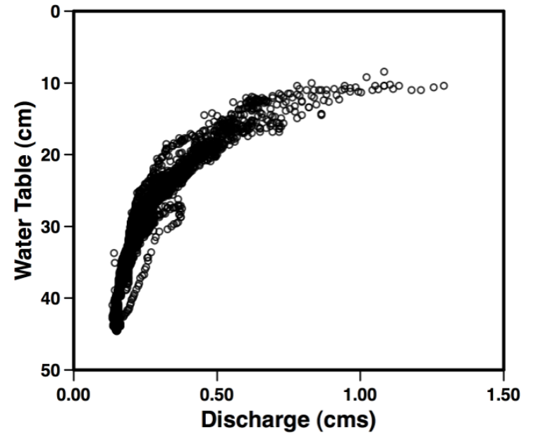
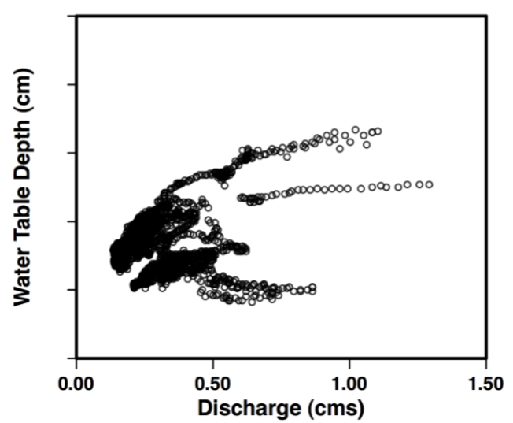
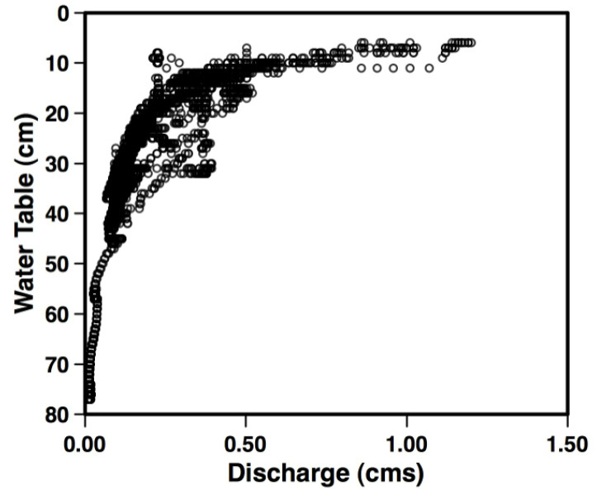
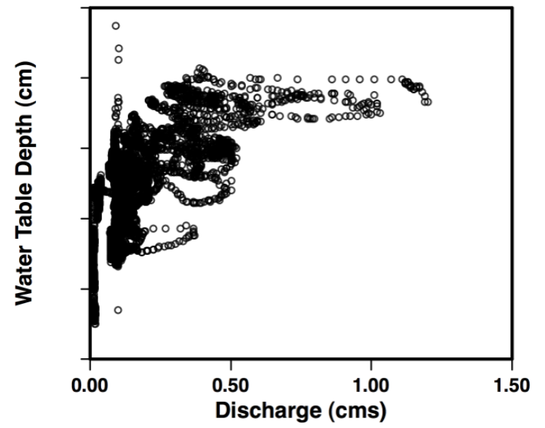
Water table – discharge patterns
Near-stream
Away from stream

Slide 20
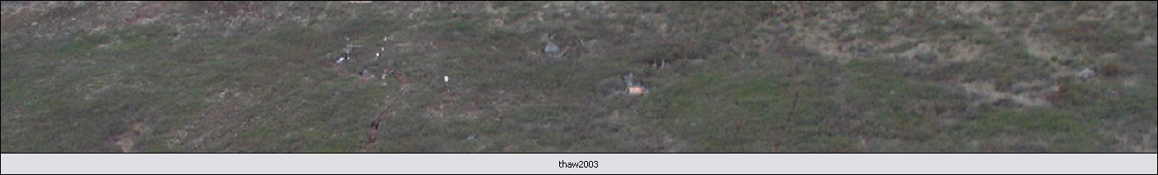
Thermal energy controls on active layer development
Notes:
FT depth also varies over time (documented with daily photos over a 6 week period)
Larger scale - ~200 m * 40 m. – daily photographs of a NFS from the opposing slope.
Done at Wolf Creek – cannot be done at Scotty without aircraft.
Shows FT development as a function of time since snow-free condition starts (clock starts)
Applied the TONE model to thaw the ground (FT depth for a single date shown at bottom).

Slide 21
Hillslope-scale hydraulic conductivity determined via frost table topography

Slide 22
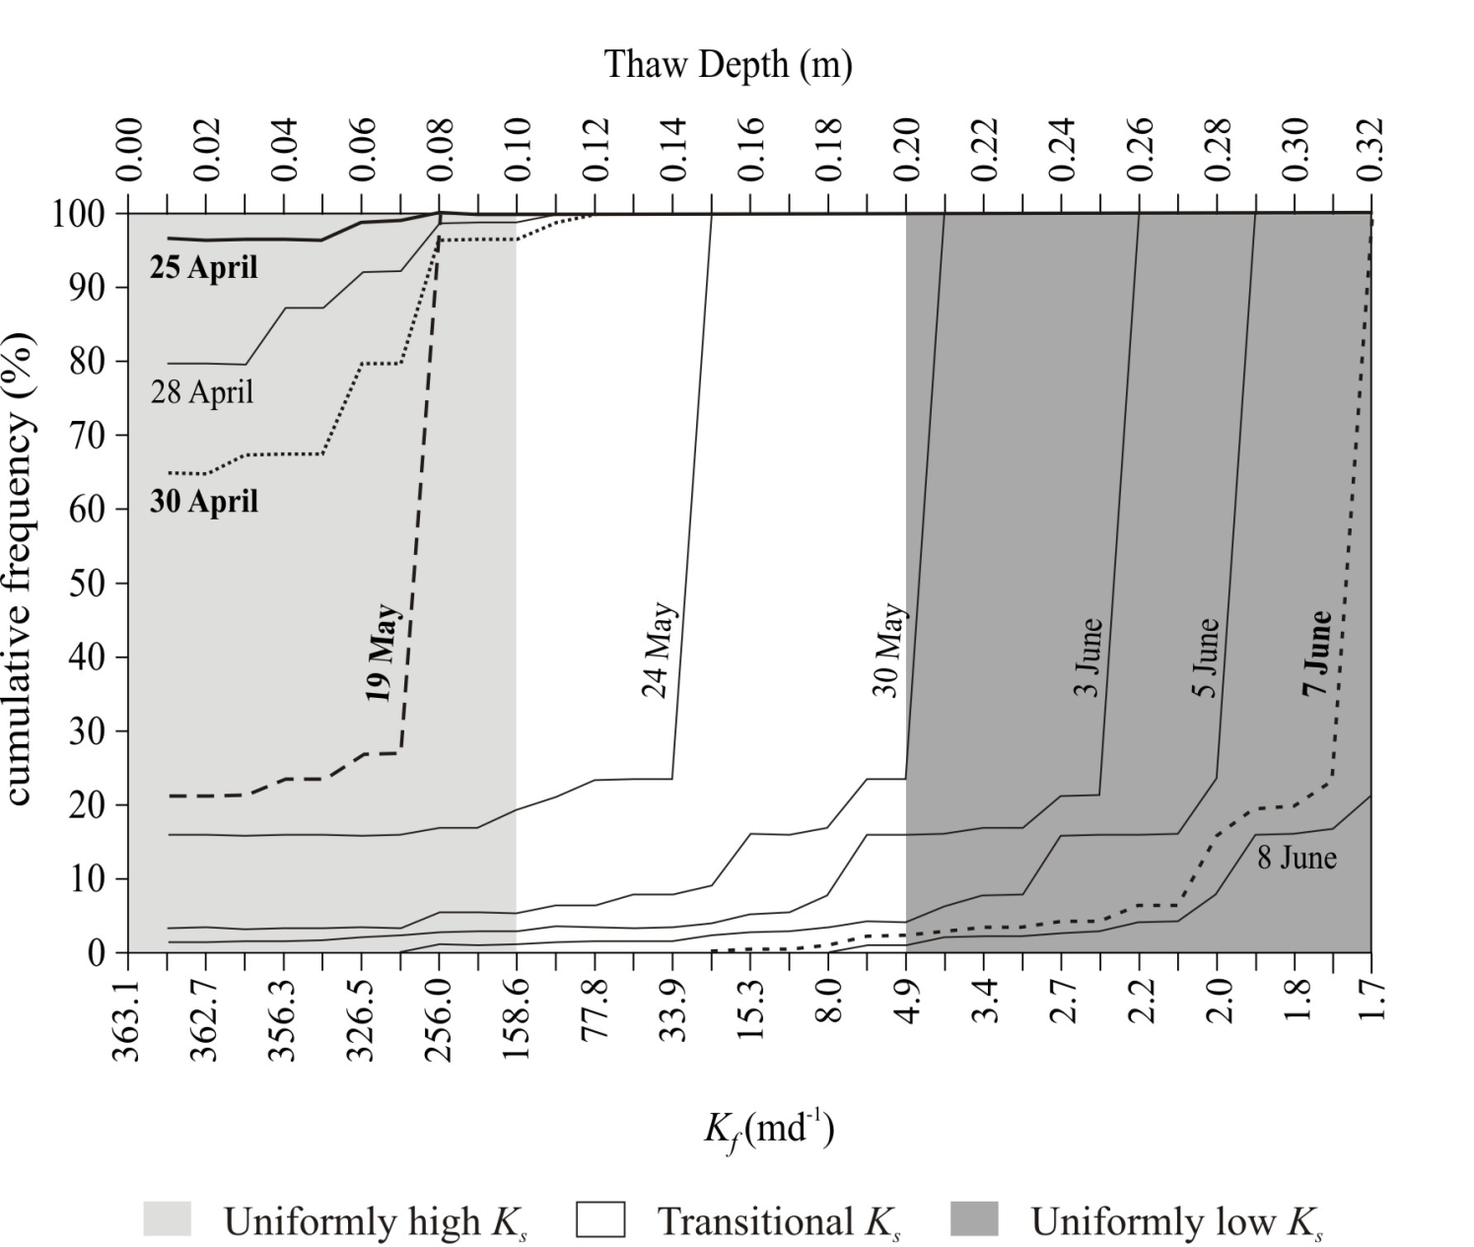

Slide 23
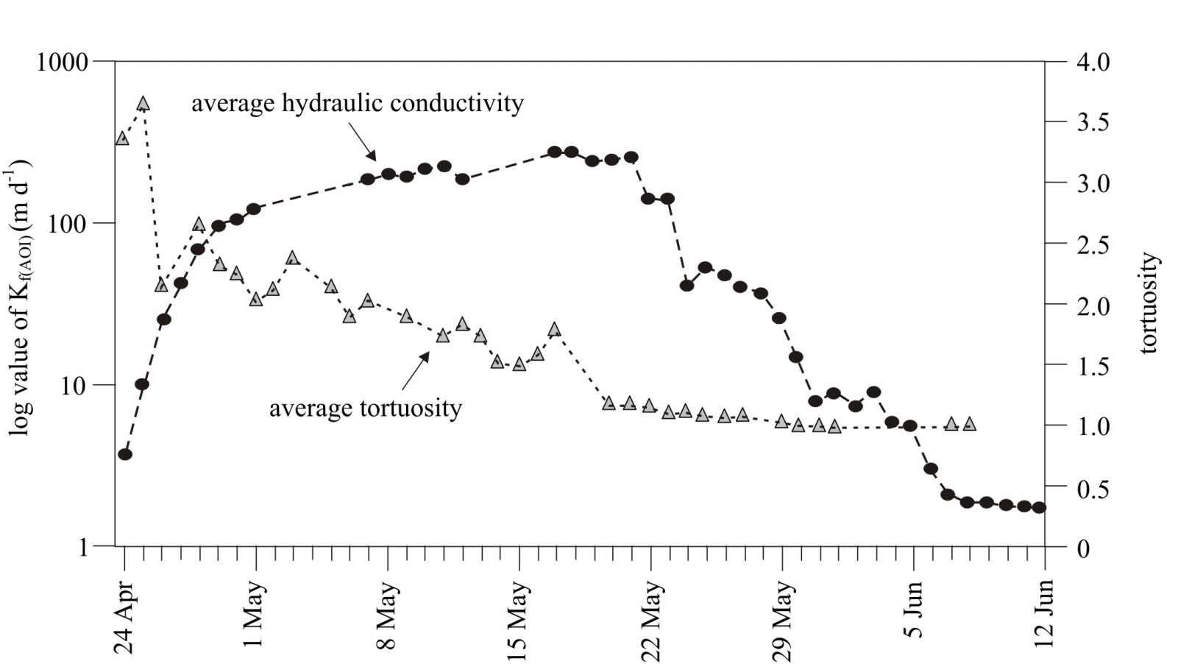

Slide 24
How has IP3 influenced catchment hydrological thinking?

Slide 25
Parameterization!

Slide 26
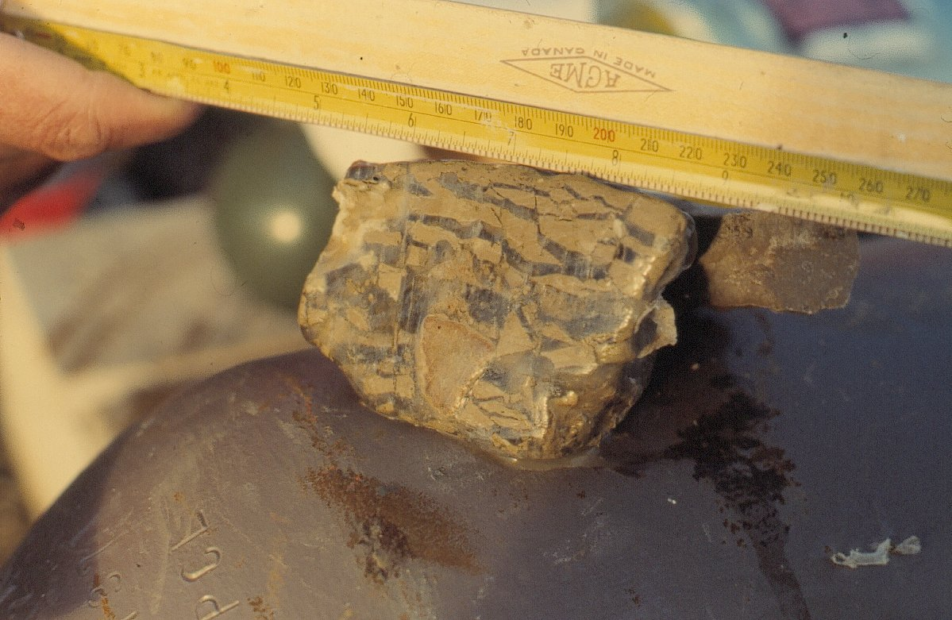
Soil Freezing and Infiltration: Two Key Cold Processes
Frozen ground status exerts a dominant control on infiltration, subsurface redistribution and runoff
Most land-surface and hydrological models have not been evaluated against field data in cold regions
What are the right choices and why?

Slide 27
Sites
Scotty Creek Peat Plateau
61°18’N, 121°18’W, 280 m
Wolf Creek Forest Site
60°36’N; 134°57’W, 750 m
Wolf Creek Alpine Site
60°34’N; 134°09’W, 1615 m
Organic layer Depth: ~3 m
Permafrost Table: >0.7 m
Organic layer Depth: ~0.1 m
Permafrost Table: N.A.
Organic layer Depth: ~0.03 m
Permafrost Table: >0.2 m
Granger Creek North Facing Slope
60°33’N, 135°11’W, 1338 m
Wolf Creek North Facing Slope
61°31’N, 135°31’W, 1175 m
Wolf Creek South Facing Slope
61°18’N, 121°18’W, 280 m
Organic layer Depth: ~0.35 m
Permafrost Table: >0.4 m
Organic layer Depth: ~0.23 m
Permafrost Table: N.A.
Organic layer Depth: 0.0 m
Permafrost Table: N.A.
Notes:
Show the variations of site condition, especially the organic layer depth and permafrost table depth.

Slide 28
Soil Freezing and Infiltration: Two Key Cold Processes
Thaw/Freeze
Abbreviations
ATIA | Accumulated Thermal Index Algorithm
TDSA | Two Directional Stefan Algorithm
HMSA | Hayashi’s Modified Stefan Algorithm
FD-DECP | Finite difference numerical scheme with the Decoupled Energy Conservation Parameterization
FD-AHCP | Finite difference numerical scheme with the Apparent Heat Capacity Parameterization
GA-SHAW | Modified Green and Ampt algorithm for non-uniform soils
ML-CLASS | Modified Mein and Larson algorithm for non-uniform soils
IT-TOPO | Instantaneous infiltration algorithm in Topoflow
GRAY-IN | Gray’s empirical infiltration algorithm
ZHAO-IN | Zhao and Gray’s parametric infiltration algorithm
ATIA
TDSA
HMSA
FD-DECP
FD-AHCP
Infiltration
GA-SHAW
ML-CLASS
IT-TOPO
GRAY-IN
ZHAO-IN

Slide 29
Soil Parameterizations Examined
Soil thermal conductivity
Soil hydraulic conductivity and retention curves
Complete-Johansen
Common-Johansen
De Vries’s Method
Clapp and Hornberger (CH-Para)
Brooks and Corey (BC-Para)
van Genuchten (VG-Para)
Unfrozen water content
Ice impedance factors
Power function (UFW-PF)
Segmented linear function (UFW-SL)
Water potential-freezing point
depression function (UFW-WP)
Exponential function (EP-Ice)
Squared function (SQ-Ice)
Linear function (LN-Ice)
None
Notes:
Those are most frequently found paramterisations in current LSMs and HMs.

Slide 30
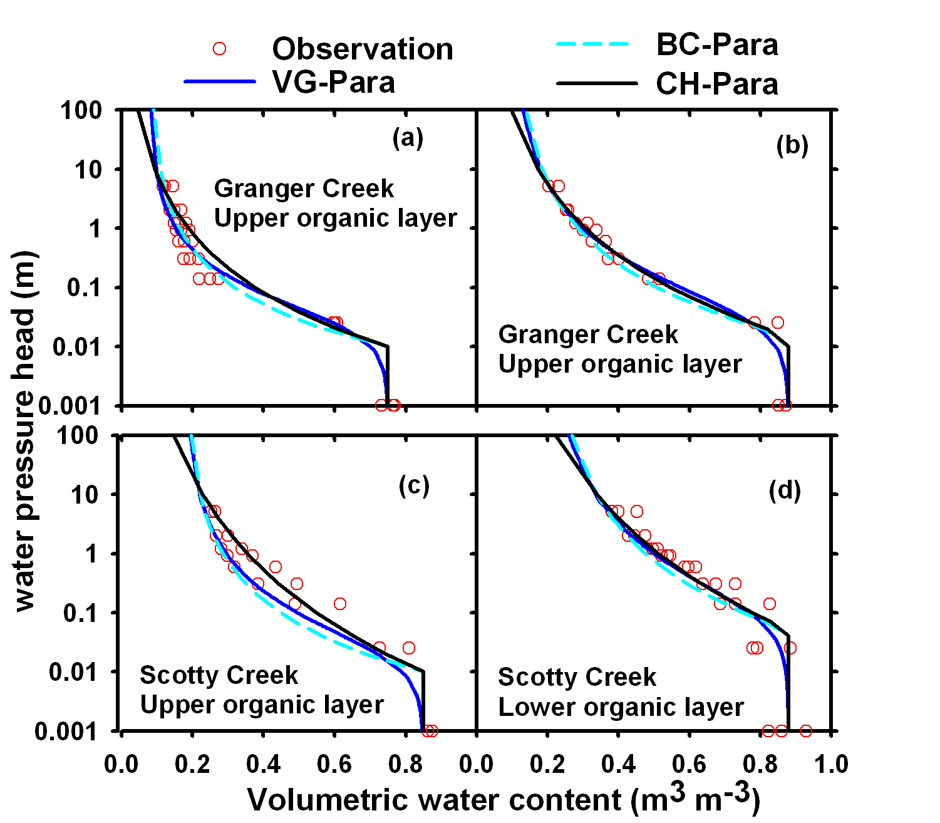
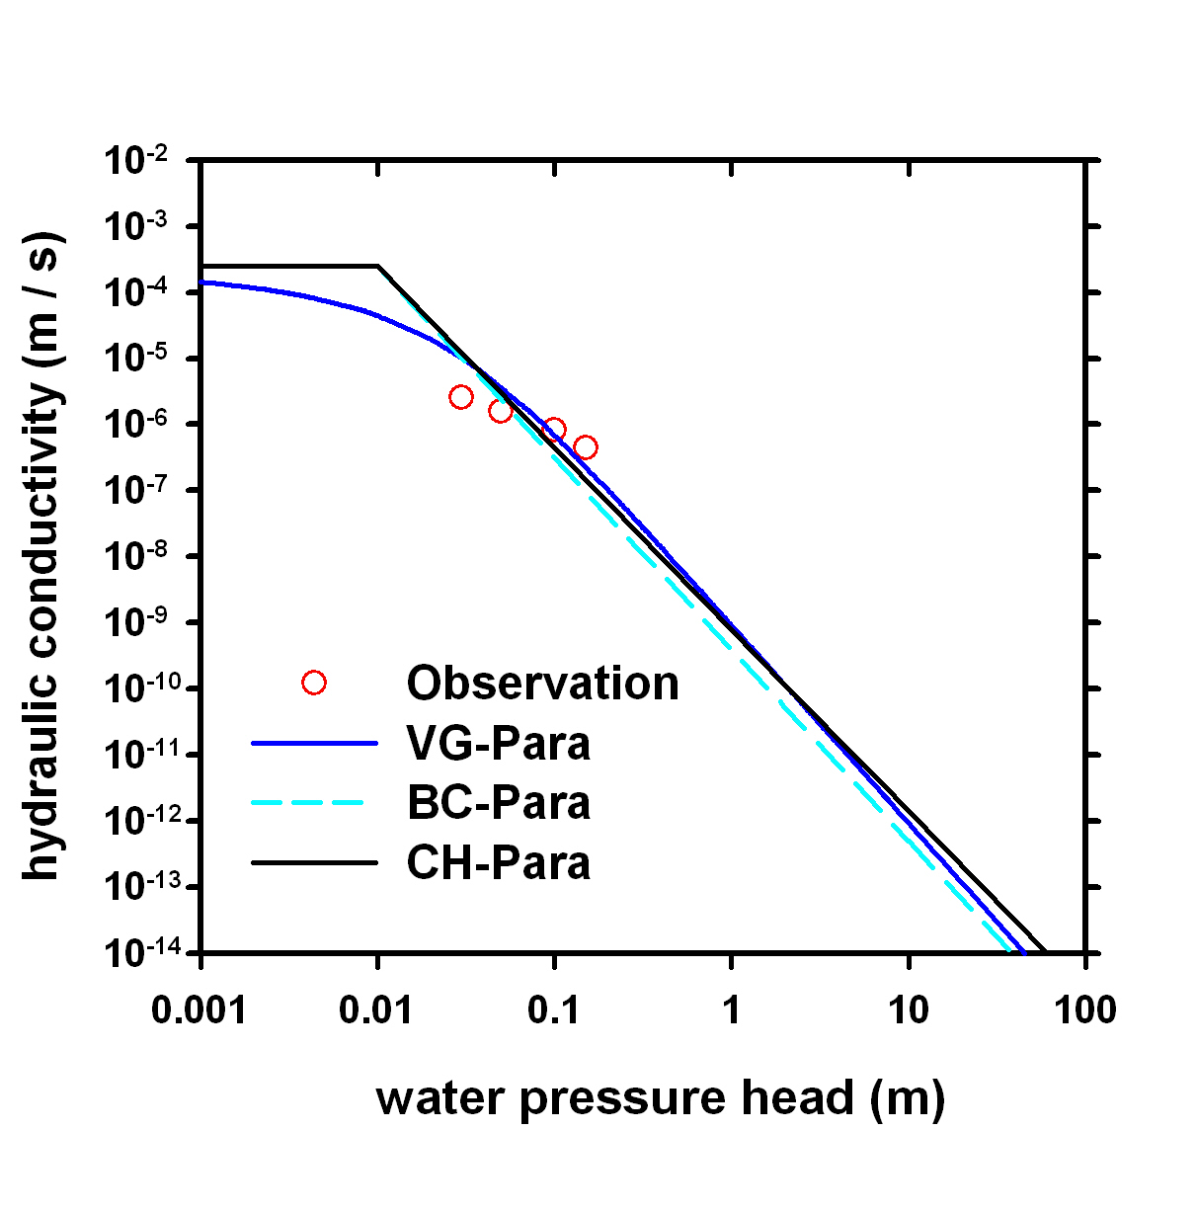
Results-soil hydraulic property parameterization
Comparison of three parameterisations for soil water retention curves
Comparison of three parameterisations for soil hydraulic conductivity
Notes:
Left figure: similar in the mid-moisture range, differences were exhibited during very dry (frozen) or saturated conditions.
Right figure: same as above, validation data (Sean et al., 2007) only available in a very small moisture range.

Slide 31
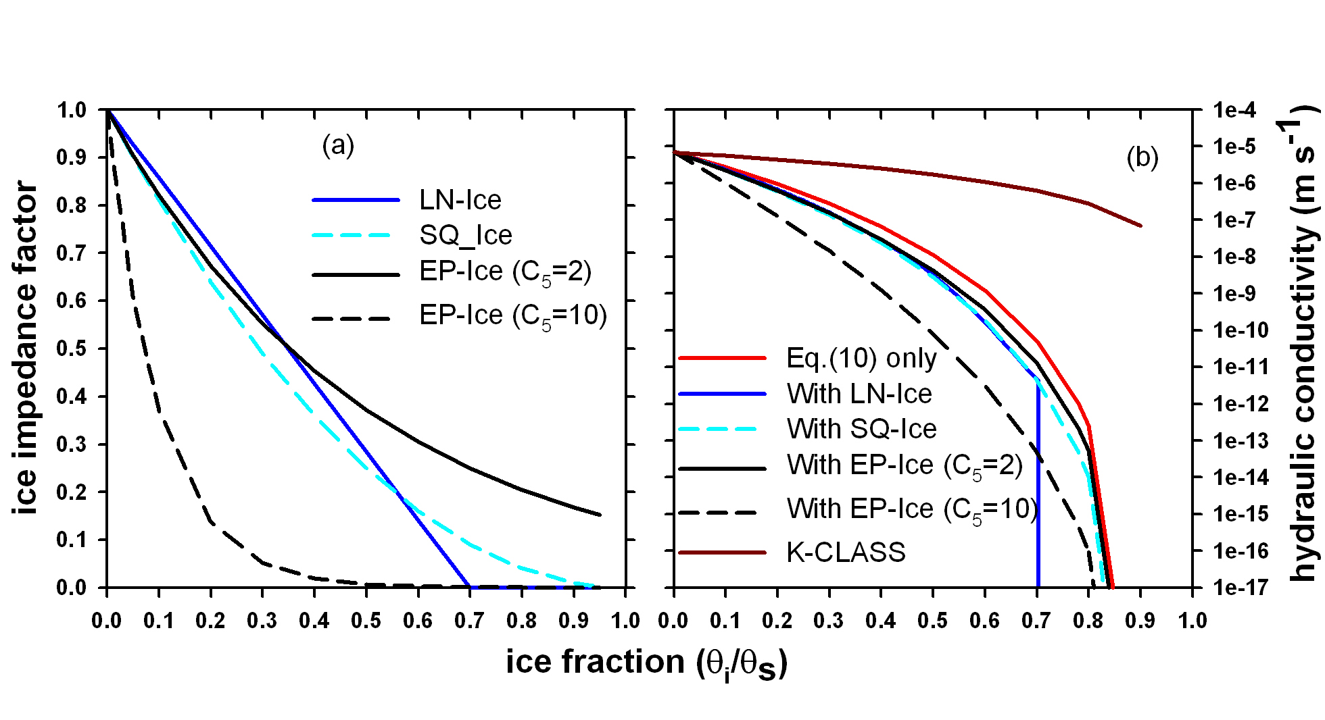
Results-ice impedance to hydraulic conductivity
0°C
Fine sand
-0.3°C
Reported frozen soil K reduction (Burt and Williams, 1976)
Equations and Applications
K-ψ relation (Eq. 10) |  | CLASS;SHAW
EP-Ice |  | CHRM
SQ-Ice |  | CLASS
LN-Ice |  | SHAW
Notes:
Left figure shows the reduction ratio of f_{imp} to K, the right gives the actual K values after apply those relation upon the K-ψ relation (Eq. 10).
Note that although the f_{imp} differences in left is obvious, it generally only within one order of magnitude while the K reduction caused by Eq. (10) alone was much more profound. Implication: f_{imp} might not be necessary once Eq. (10) applied.
The real separation between CLASS frozen K parameterisation and others is the treatment of effective porosity. CLASS treat ice portion as soil solid and is deducted from actual porosity. This treatment set S_{e} to 1 for Saturated frozen soil and nulled the drying effects in Eq. 10.
The right most figure showed some lab reported K-reduction due to freezing, it suggests K-CLASS may underestimated the reduction effects by ice.

Slide 32
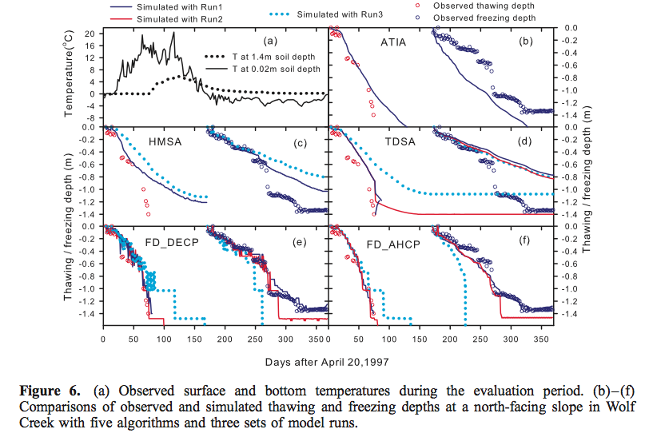
Thermal Modelling
Notes:
In the left figure, De Vries’s method is slightly better than other two in all sites and all conditions, thus recommended.
In the left figure, the results are similar, but Linear function is the easiest to parameterise, while the UFW-WP is recommended for the coupled thermal and water modelling as the parameters could be obtained from either drying or freezing curves.

Slide 33
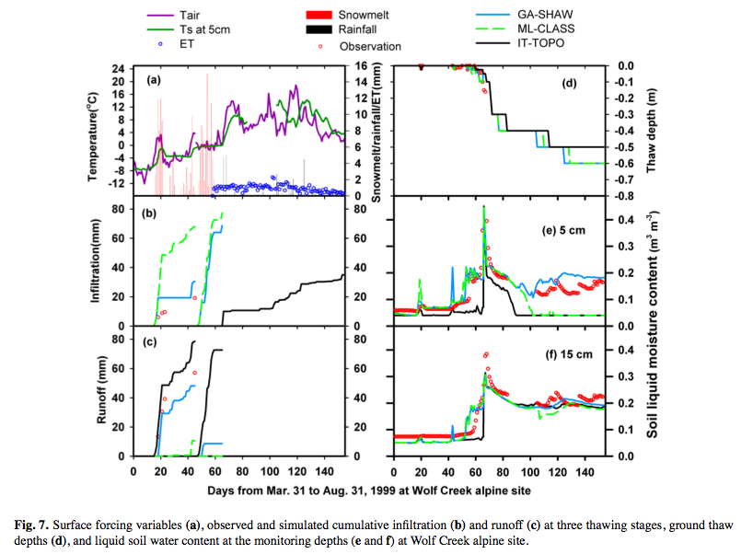
Infiltration/Percolation Modelling
Notes:
Those are infiltration test at two of the three sites, generally GA-SHAW performed better on all sites, but differences are small with CLASS.
The problem in soil water simulation in Wolf Creek Forest site is mainly caused by the thaw-depth simulation in early stages. Those observed thaws are under snow cover, no way for a 1D model to handle!

Slide 34
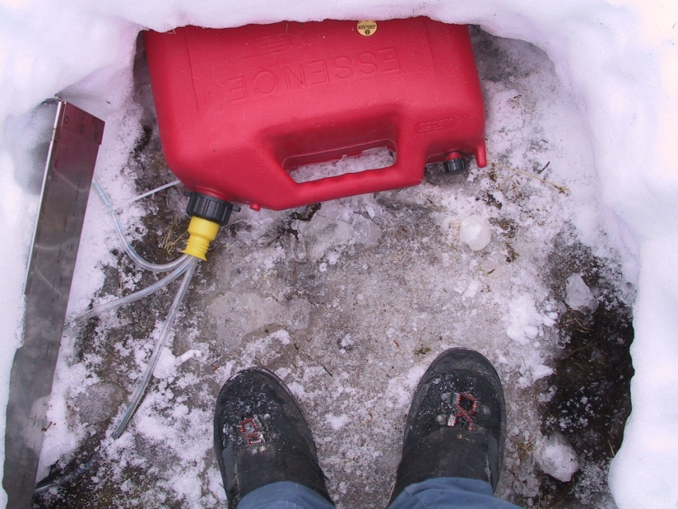
What were we able to do?
Assess ALL common algorithms against each other with high-quality data set.
Provide list of ‘best practices’ based on different levels of data availability

Slide 35



Slide 36


But…. We could never measure all of what we were modelling…… so we needed to build something….
Multi-Function Heat-Pulse Probes (MFHPP)
Design a sensor that is able, real time, to measure all water components (solid, liquid) below zero.

Slide 37


Multi-Function Heat-Pulse Probes (MFHPP)

Slide 38

What is Heat Pulse Probe (HPP)
40 mm
Heater
6 mm
6 mm
Temperature sensors
∆T = f (C, q, t₀, t, r)
Determines C
C = Σ (C_{m}θ_{m} + C_{o}θ_{o} + C_{l}θ_{l} + C_{i}θ_{i} )
Determines θ_{l} , θ_{i}

Slide 39
Mathematical solutions…. never meant for freezing conditions
1. Instantaneous Infinite Line Source (IILS)
2. Pulsed Infinite Line Source (PILS)
3. Finite Difference Numerical Model (FDNM)

Slide 40

Bottom line: we (mostly) figured it out!

Slide 41

Bottom line: we (mostly) figured it out!
Measurement errors of total moisture content (θ_{T}) as determined by the HPP using the numerical model FDNM under different initial soil temperature (T_{ini}) and heating pulse durations (t₀).

Slide 42


Slide 43








And the work goes on…….Thank You CFCAS

