Slide 1
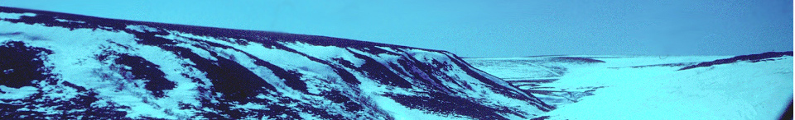




Cold Regions Hydrology in the Western Canadian Arctic
Philip Marsh¹
Stefano Endrizzi², Stefan Pohl³, Bill Quinton⁴, Mark Russell¹, and Cuyler Onclin¹
1. Env. Canada, National Hydrology Research Centre
2. University of Zurich, Switzerland
3. University of Freiburg, Germany
4. Wilfred Laurier University
Notes:
- Good morning and thanks
I struggled for a while on how best to summarize 4+ yrs of work done under IP3, IPY and our ongoing Env Canada research on cold regions hydroloy in the Canadian Arctic in only 15 min and for an audience where some of you may not be familiar with some of this work, while others of you have heard it too many times already!
eventually decided I would give a brief overview of our study sites and an overview of some of our process studies for those of you who have not been to previous IP3 meetings, and to give a bit more detail on some recent Process/Paramaterization work with Stefano and Bill focused on considering the important processes controlling frost table spatial variability, and the Prediction work that Stefan Pohl has done with MESH

Slide 2
1. Objectives
- Better understand the processes controlling the spatial variability in surface energy fluxes, snow water equivalent, snowmelt, soil moisture, and frozen soil, and use this to further develop our predictive ability
- Processes:
- end of winter snow accumulation (influence of terrain and vegetation);
- heat fluxes over dominate vegetation types (shrub tundra, tundra);
- spatial variability in radiation and turbulent fluxes over an area of 100 km²;
- energy-based framework of runoff generation and spatial
variation of ground thaw in permafrost areas
Parameterization and Prediction
Test and improve a suite of models, including
  CRHM,
  CLASS, and
  MESH will be tested.
Notes:
Eventually decided to

Slide 3
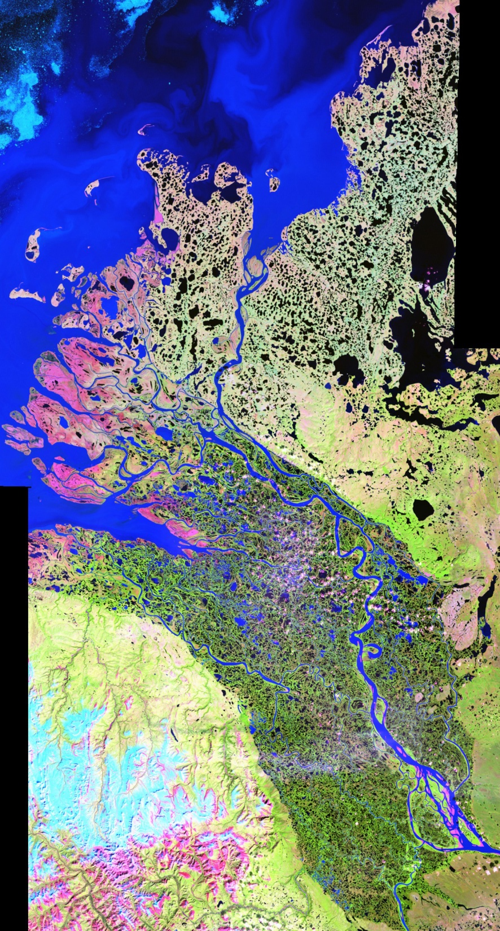
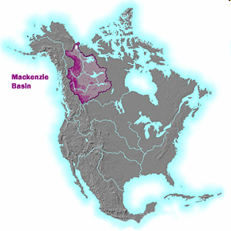
2. Study area and Env. Canada field observations
Beaufort Sea
Tuktoyaktuk
Most northerly IP3 study sites
TVC
Inuvik
Aklavik
TVC – Trail Valley Ck
Tsigehtchic
Ft. McPherson
Notes:
5 communities – food, recreation, tourism, employment
- two major rivers entering the delta - Mackenzie R. Peel Rivers

Slide 4
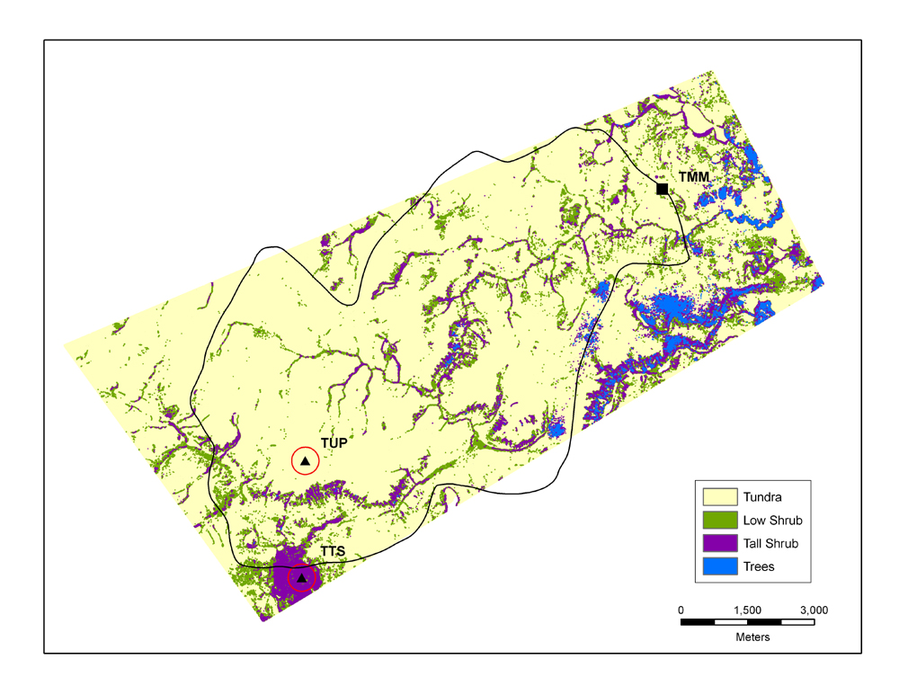
TVC vegetation cover
Tundra (<0.5 m): 83.4%
Low Shrub (<1.25 m): 10.8%
High Shrub (<3.0 m): 5.4%
Trees (>3.0 m): 0.4%
NWRI (TMM) and
MSC station
WSC TVC
discharge
Basin is 55 km²
TUP Lake
Tundra station
Lake basin
discharge
Shrub station
(vegetation height from high resolution LiDAR data)

Slide 5
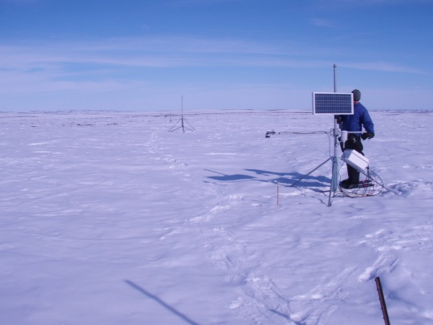
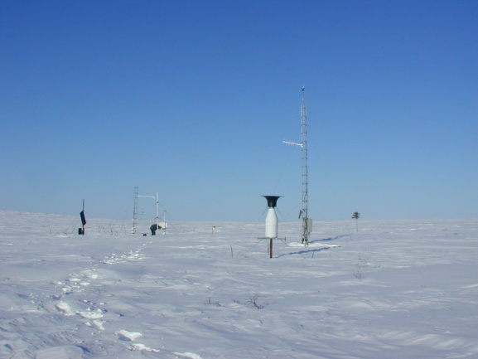
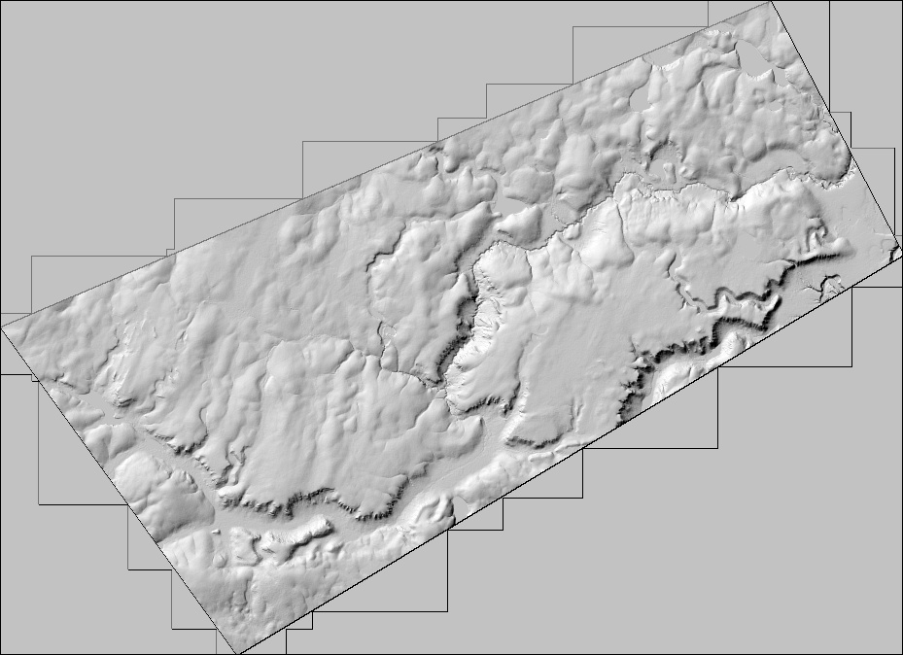
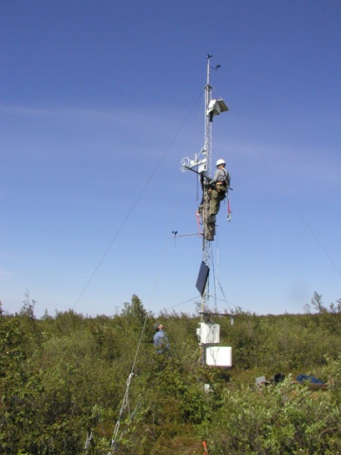
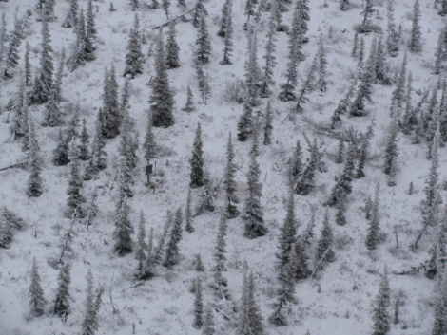
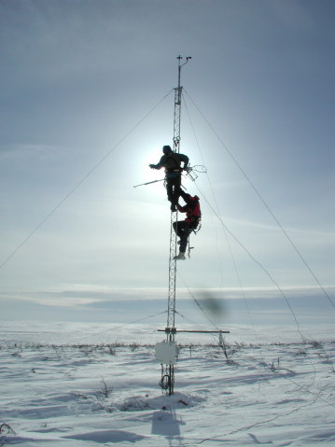
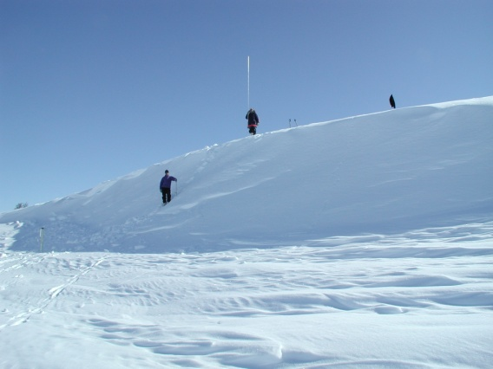
Tundra
Main Met and
MSC station
Trail Valley Creek
Siksik Creek
WSC TVC
discharge
Shrub
Tundra
station
Forest
Shrub
Drift

Slide 6
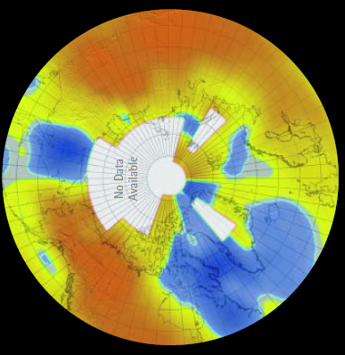
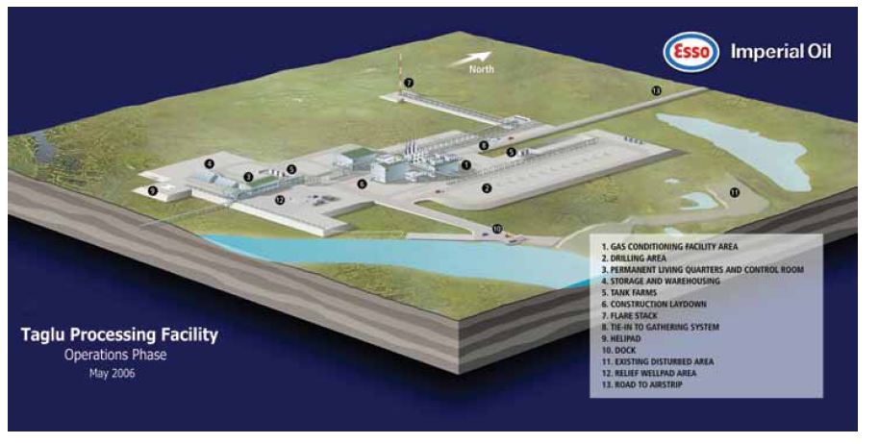
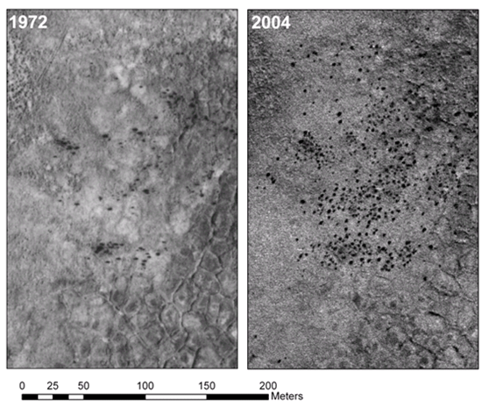
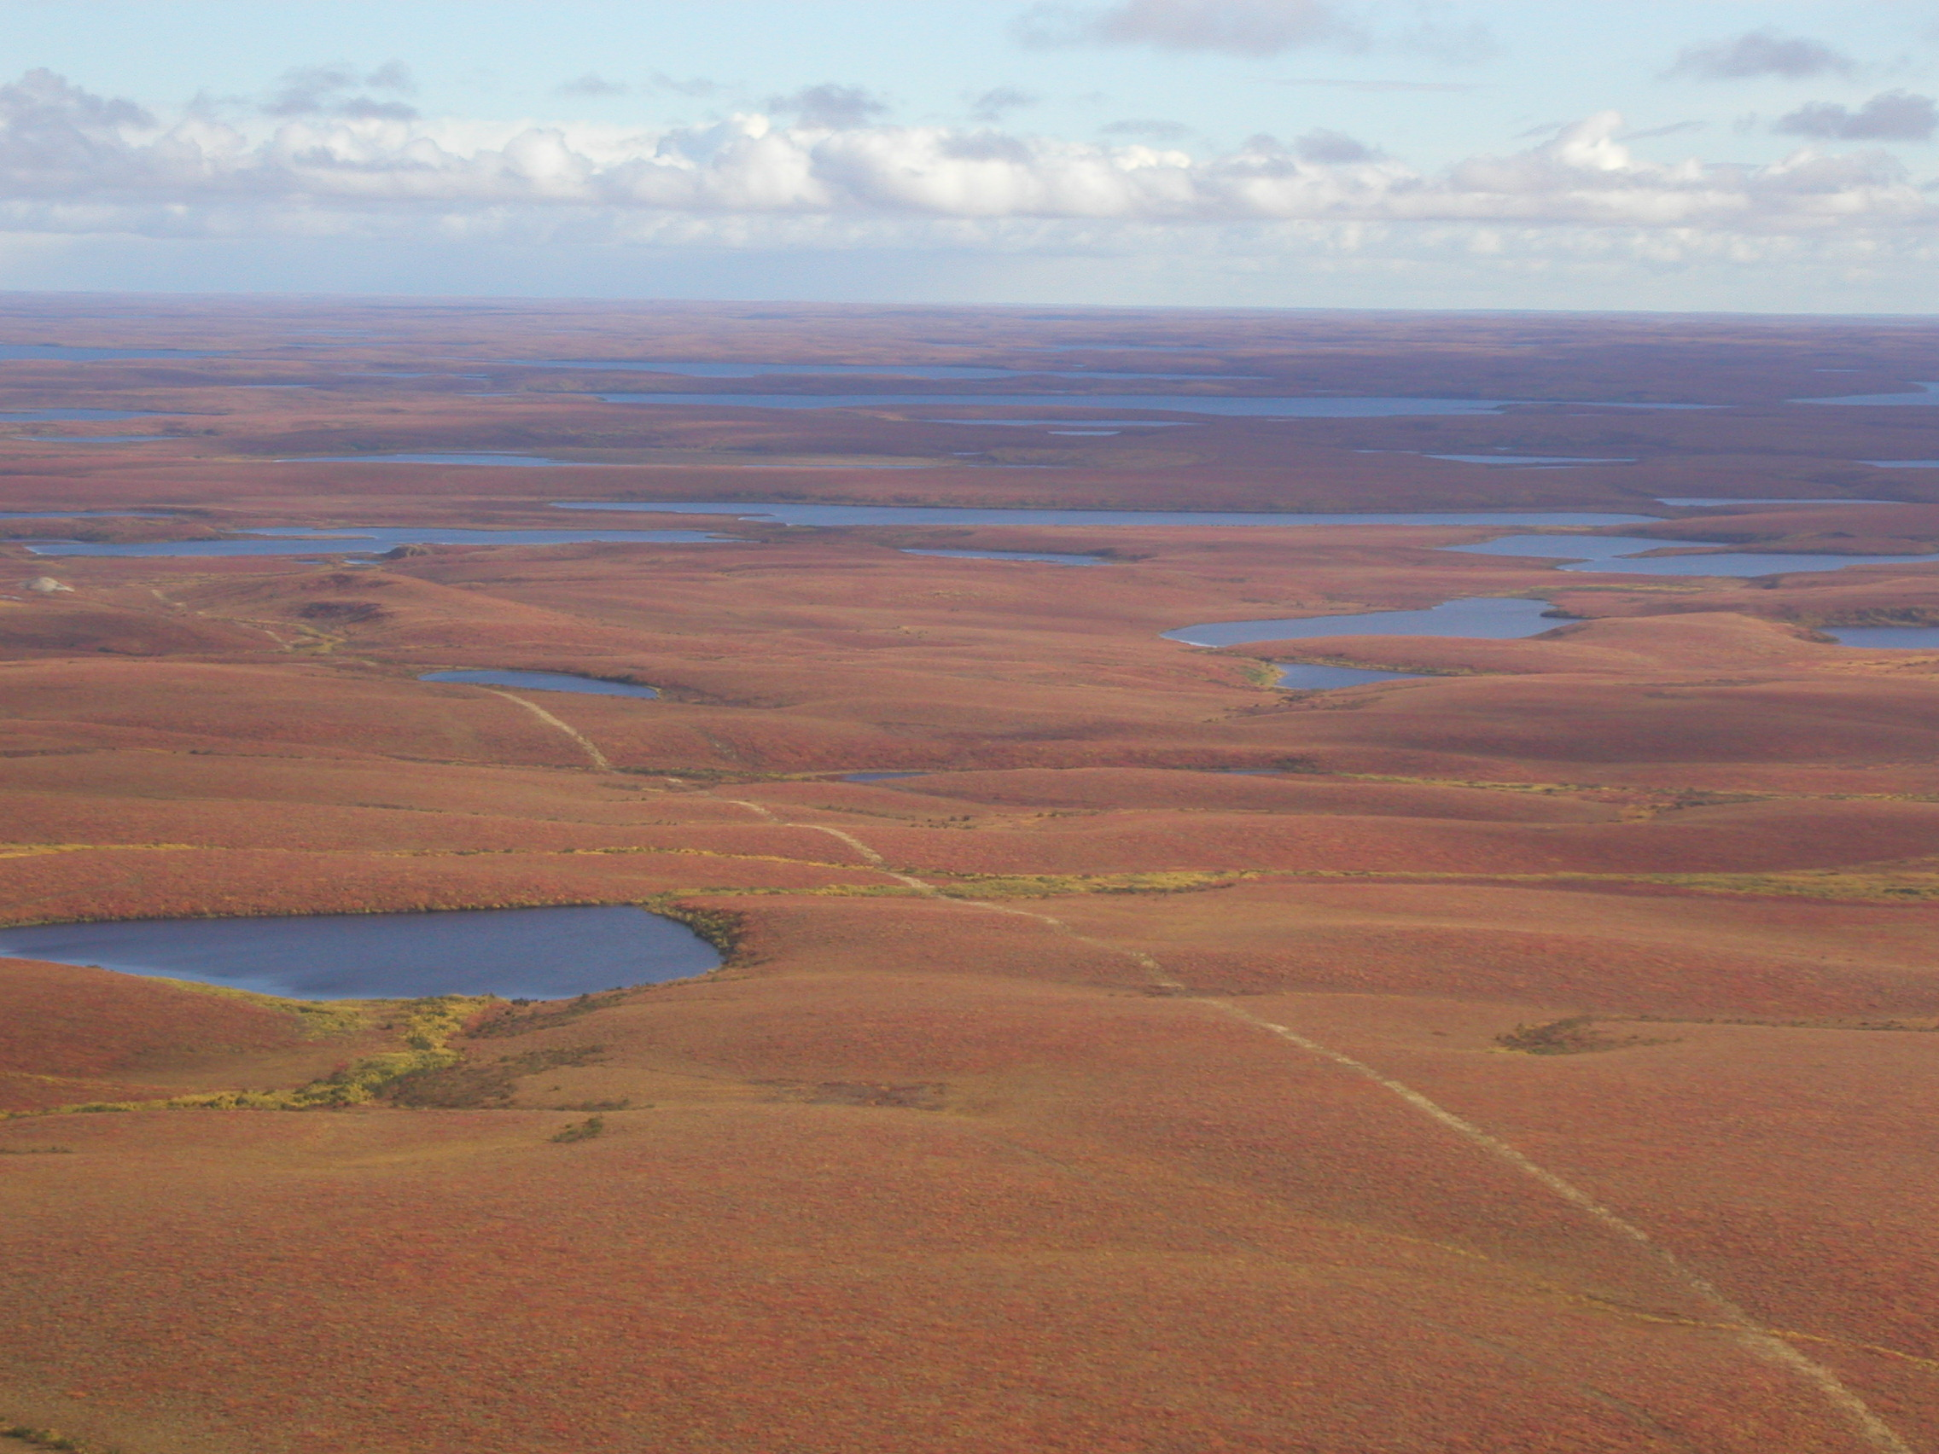
3. Issues requiring an increase in hydrologic knowledge and modelling capacity
Proposed natural gas development
Mackenzie Gas Project and others
Climate Change warming
Impact of exploration, and land access issues
Increasing shrubs in tundra areas
Trevor Lantz, Marsh, Kokelj. 2011. Submitted.

Slide 7
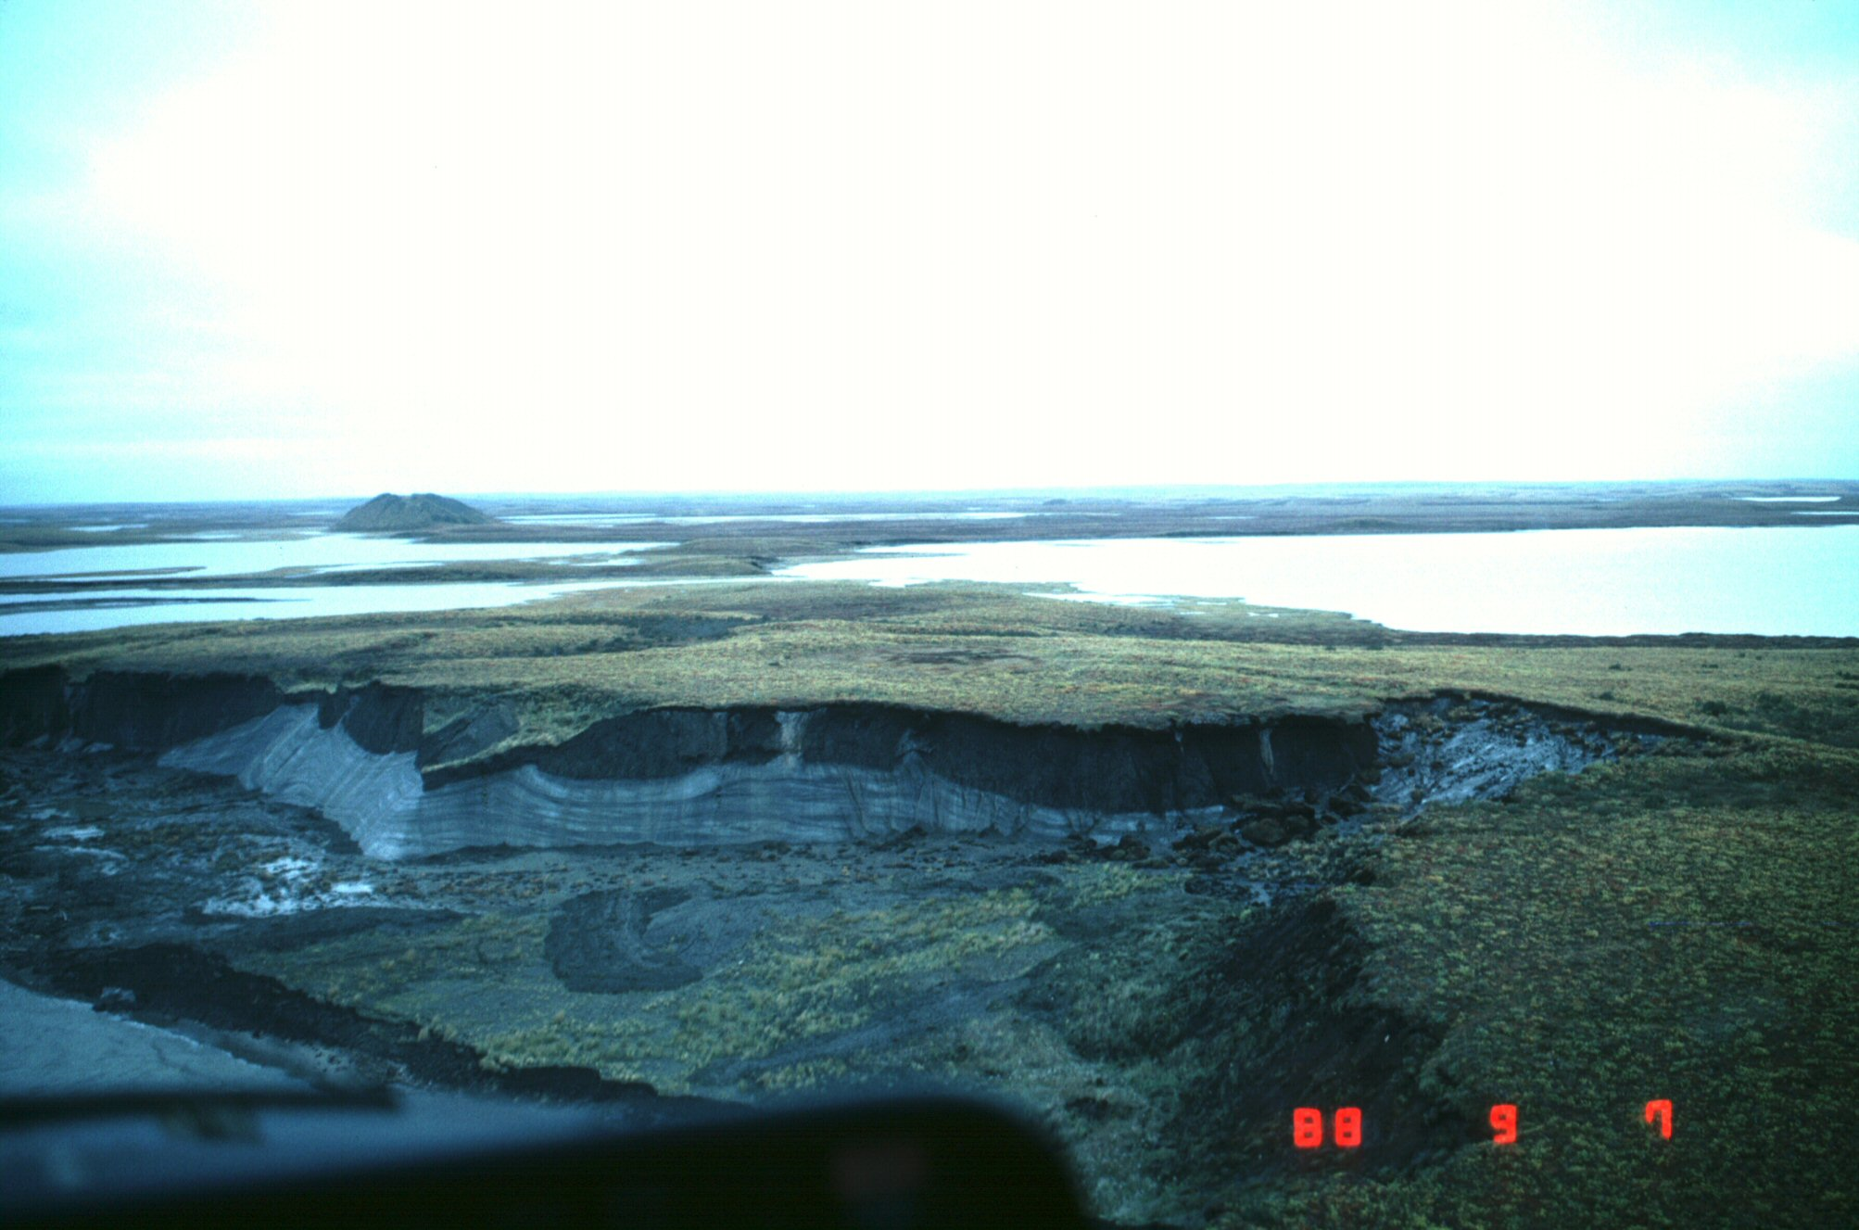
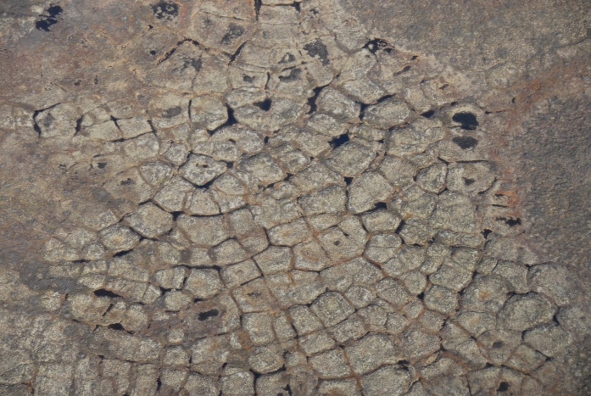
Existence of ice rich permafrost complicates prediction, and results in greater impacts
Pingo
Ice wedge
Tabular ice
North of Inuvik there are many areas with very high volumes of ground ice in the upper portions of the permafrost. Average is greater than 20% by volume in upper 10-20 m.

Slide 8
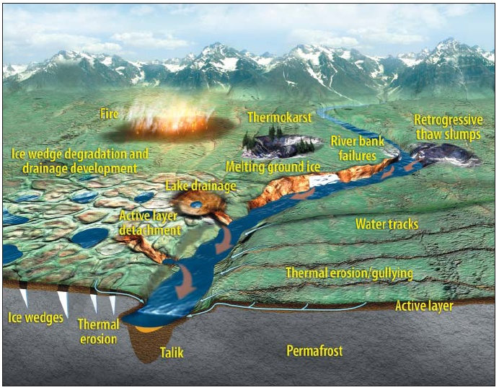
Potential changes in northern environments with a warming climate
Modelling the impact on the hydrologic system is extremely challenging

Slide 9
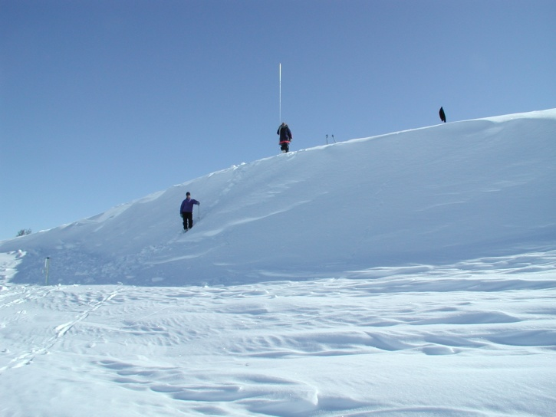
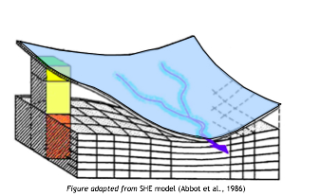
4. Improved Processes and Parameterizations
Utilizing:
  Field observations
  Small scale, physically based modelling using GEOtop

Slide 10
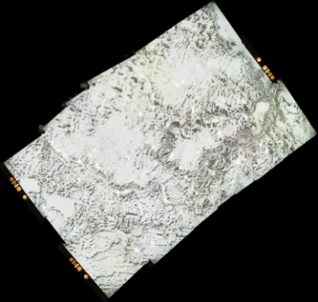
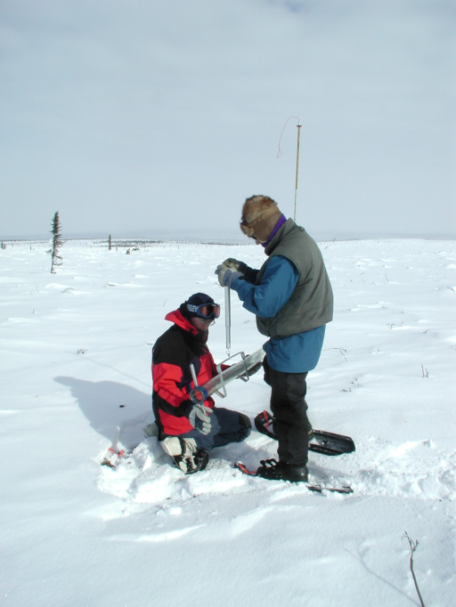
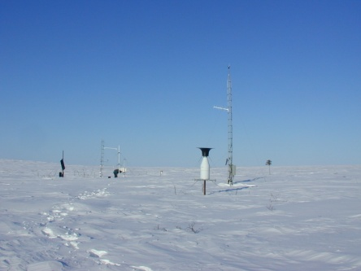
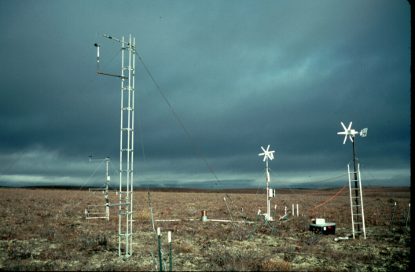
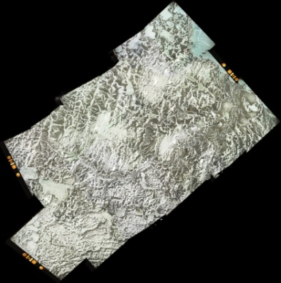

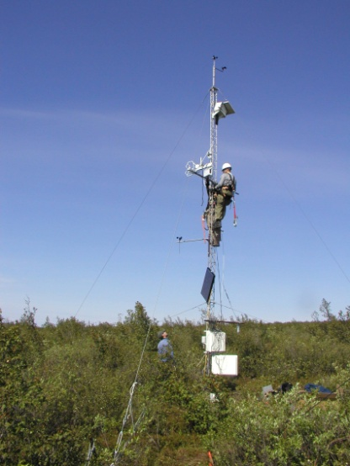
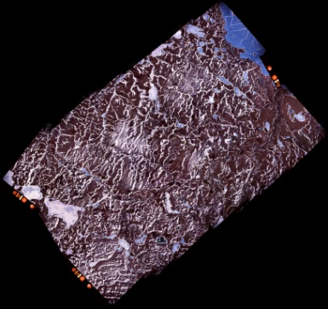
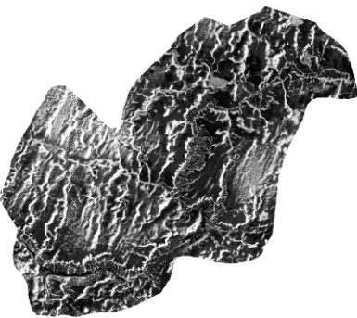
4.1 Field observations
SCA
May 23
Snow surveys
Flux measurements, Soil temp + moisture
TVC Tundra (TMM)
81.2%
TVC Tundra (TMM)
May 25
TVC Shrub (TTS)
TVC Shrub (TTS)
54.3%
May 26
25.1%
May 26
NRC Twin Otter flux aircraft
20.2%

Slide 11

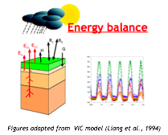
4.2 GEOtop
- spatially distributed model, using a coupled numerical solution of the subsurface flow (3D Richards equation) and energy budget (1D heat equation with phase change). This applies for soil and snow cover
model is fully distributed and can be run at grid sizes from metres to hundreds of metres
- coupled to PBSM (Pomeroy et al., 1993) to find snow wind transport rate and sublimation, and Liston wind model

Slide 12
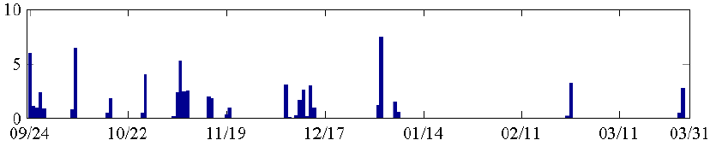
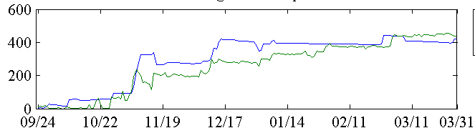
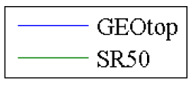
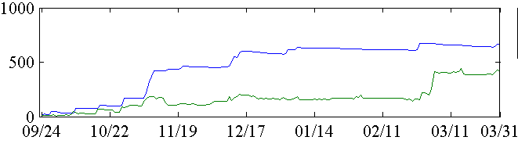
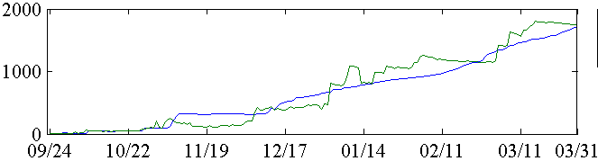
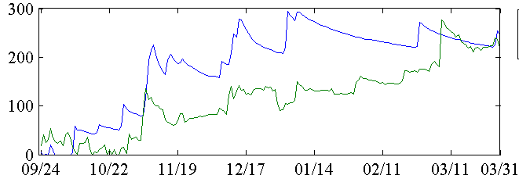
4.3 End of Winter Snow accumulation
Shrub
model
Shrub
model
Snow
Depth
(mm)
Tundra
model
SR50s offset reset by field staff
?
Drift
model
Observations are the avg. of 5 measurements
model is avg. of small domain
Forest
model
- In general the SWE of drifts are still under predicted and continuing work is needed
?

Slide 13
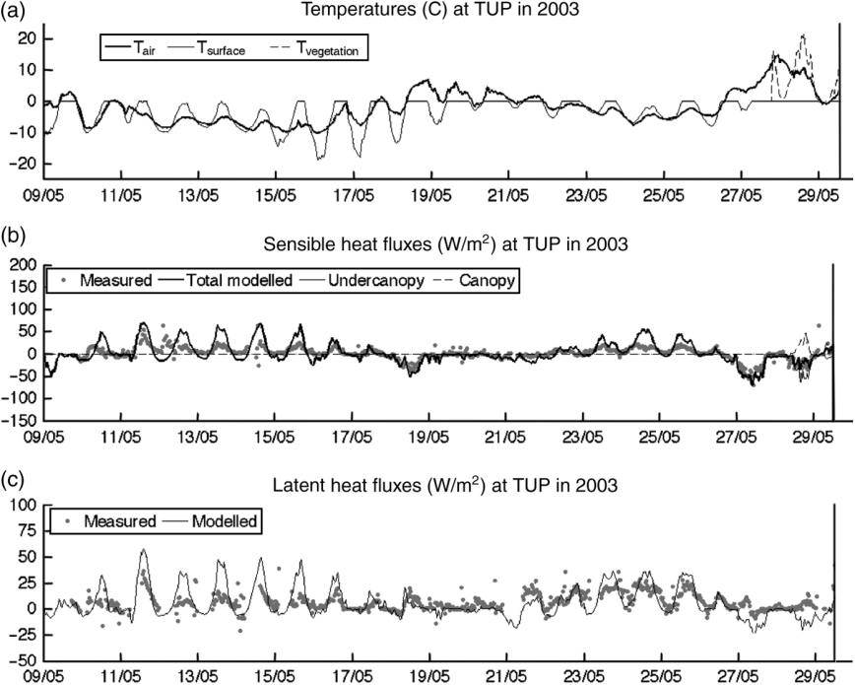
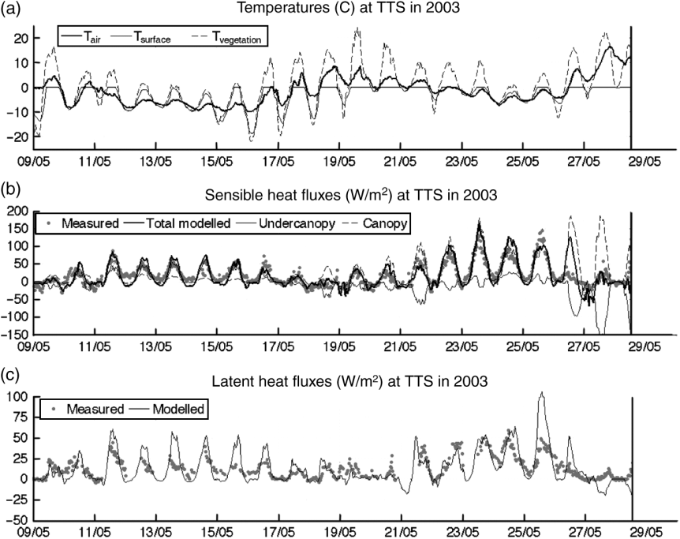
4.4 Sensible and latent heat fluxes at a point
Snowmelt period
Tundra Site
Tall Shrub Site
general pattern of fluxes are properly modelled
peaks during melt are often over estimated
the effect of shrub bending over, burial and exposure is still not fully understood and predictive ability is still limited
Endrizzi and Marsh, 2010. Hydrology Research.

Slide 14
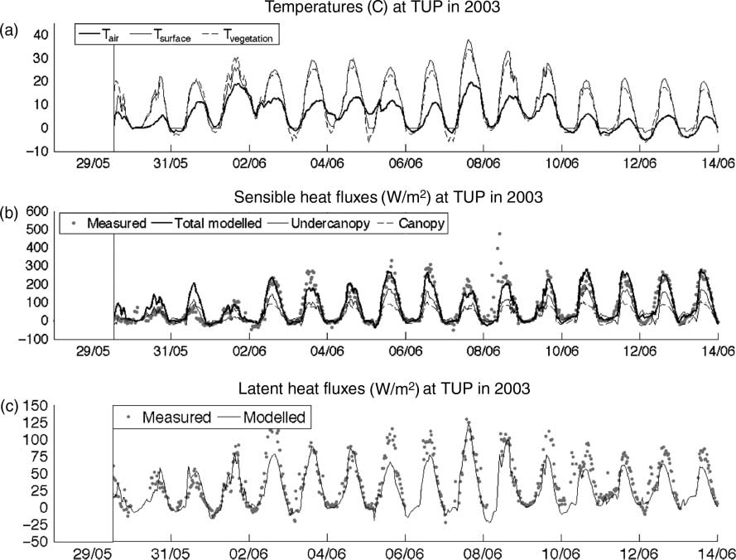
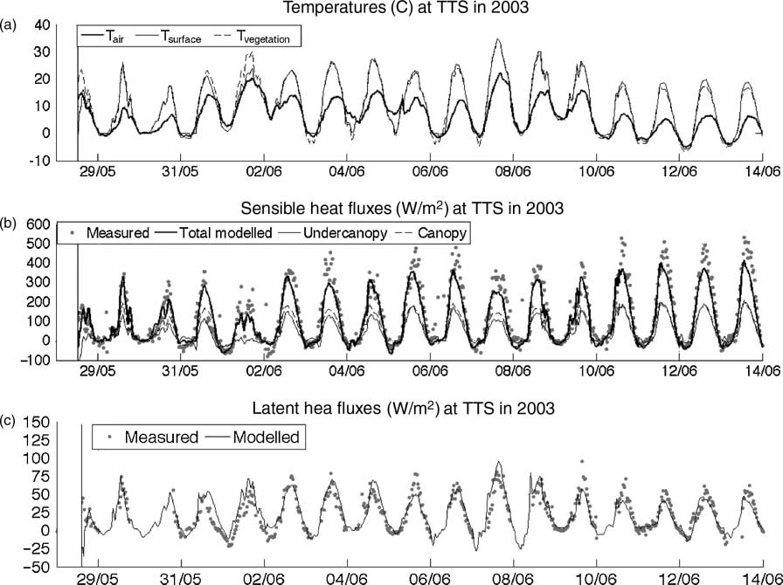
4.5 Sensible and latent heat fluxes at a point
Snow-free period
Tundra Site
Tall Shrub Site
- Model generally better captures the fluxes during the snow-free period
Endrizzi and Marsh, 2010. Hydrology Research.

Slide 15
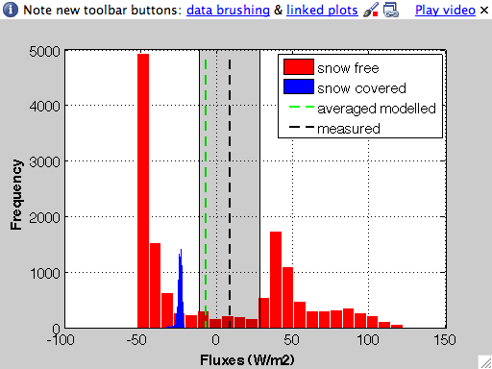
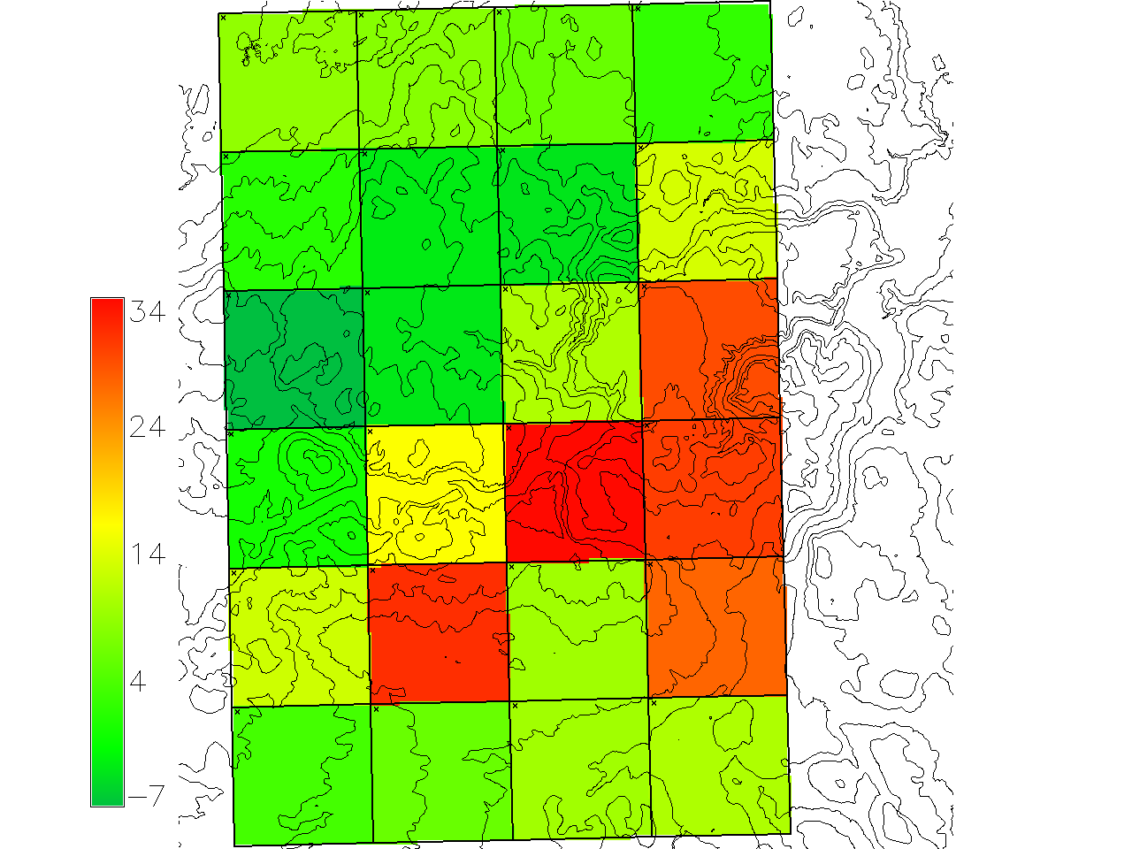
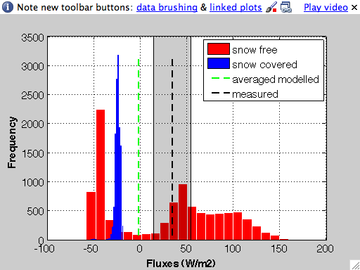
4.6 Spatially variable fluxes
Modelled Sensible heat: 100 m grids
MAGS Aircraft
Flux data
Sensible heat (W/m²): 3km x 3km grids from aircraft flux measurements
May 27, 1999
- For 15 of the 24 grids the modelled grid average is within the error bars of the aircraft data
We also have surface temperature data from the aircraft and are comparing this to model estimates
Notes:
One of the large problems always is we can measure fluxes at a point, and test, validate, improve models for these data, but how do we upscale to larger domains?

Slide 16
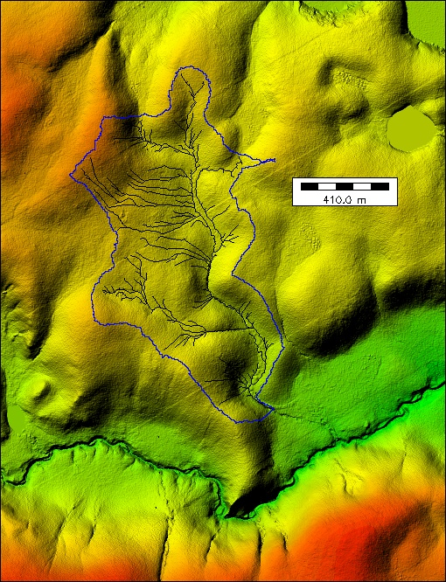
4.7 Spatial variation of ground thaw in permafrost areas
Siksik Ck., a 1 km² sub-basin of Trail Valley Creek
- Frost table depth is critical to predicting runoff from organic-covered permafrost terrain
- integrated process studies to date (snow, radiation, turbulent fluxes) to consider active layer melt over the summer
- Consider the factors controlling the spatial variability in frost table melt, and therefore runoff

Slide 17
Factors controlling thaw depth
depth of thaw is often closely related:
  cumulated heat flux (radiation plus turbulent fluxes) y et al.,1978)
Carey and Woo (2001) showed that thaw depths were related to slope aspect, with north facing slopes in sub-arctic mountain sites characterized by greater near-surface wetness as a result of shallow thaw depths, while deeper subsurface pathways due to deeper thaw were more evident on south-facing slopes
pattern of soil thaw is also influenced by the spatial pattern of snow disappearance which, in turn, is determined by the spatial distribution of the snow mass and melt energy at the snow surface (Quinton and Carey, 2008),
Subsurface water flow can also affect the thermal regime of the seasonally thawed or active, layer.
  converging flow where water accumulates, the soil thermal conductivity, which increases with soil water content is raised, producing greater thawing, even if the rate of energy transfer into the ground is offset by the energy loss due to enhanced evaporation of the relatively wet ground surface (Kane et al., 2001)
Due to these complex interactions, it is difficult to consider the relative importance of various processes. The GEOtop model was used to better understand these interactions, and then to use these results to improve predictive models where appropriate.

Slide 18
GEOtop
GEOtop includes:
  Surface energy balance and blowing snow
  Numerical solution of both heat and subsurface flow equations in soil
  Equations are solved at a small grid size (metres to tens of metres)
  30 soil layers with variable thickness to a depth of 3.5m
Appropriate field information on:
  DEM and vegetation height from Lidar
  Spatial variability in surface organic layer
Recent GEOtop improvements include:
  Representation of surface energy balance (Endrizzi and Marsh, 2010)
  Soil freezing and thawing processes (Dall’Amico et al., 2010), and
  The numerical algorithms

Slide 19
GEOtop
domain is discretized in a finite regular grid (10 m in this case), given by the intersection of the DEM cells.
heat and subsurface water flow equations are solved with finite differences schemes.
heat equation is solved in a one-dimensional form in the grid cell columns normal to the surface,
equation describing the water flow in the soil (Richards equation) is solved in a fully three-dimensional way, which allows a complete coupled description of vertical and lateral flows.
Hydraulic properties of the peat follow Carey et al. (2007), Quinton et al. (2005), Quinton et al. (2008), Quinton and Gray (2003). Mineral earth hummocks are represented as sub-grid variability.
surface water flow over land is also described, with a solution of a simplified version of the shallow water equations that neglects the inertia terms.
integration time step ranges from a few minutes to a few hours.
determination of the heat flux exchanged from the atmosphere to the ground surface (hereafter referred to as ground heat flux) is crucial, since it constitutes the upper boundary condition of the heat equation.
The ground heat flux is given by the algebraic sum of net shortwave (solar) radiation, net longwave (terrestrial) radiation, and turbulent fluxes of sensible and latent heat.

Slide 20
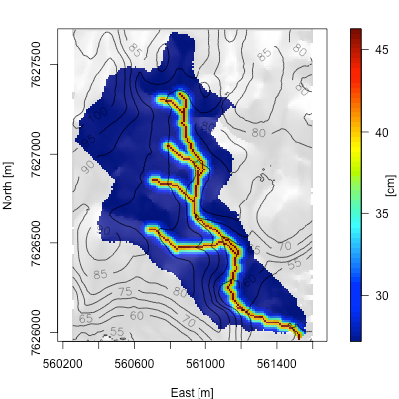
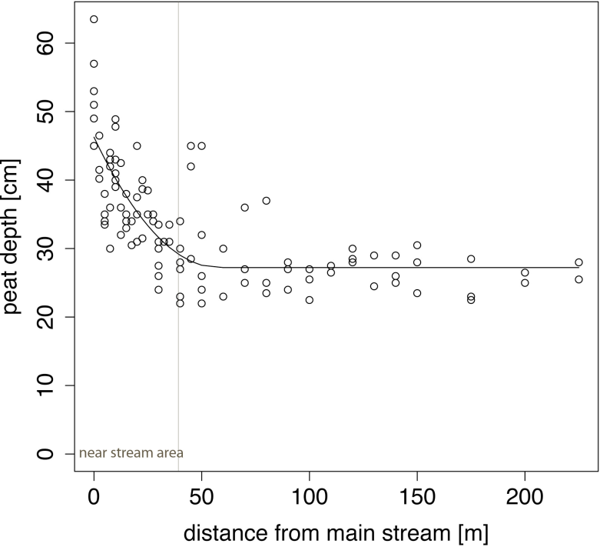
Peat thickness (fig 2)
Peat thickness is extremely important as it is highly permeable in the upper layers, with the hydraulic conductivity decreasing with depth by 2 orders of magnitude over a 20 cm depth, and it overlies less permeable mineral soil.
position of the frost table, and its change over the summer, is important as it is the major control on hillslope drainage.
Endrizzi, Quinton, Marsh. 2011. Cryosphere Discussion.

Slide 21
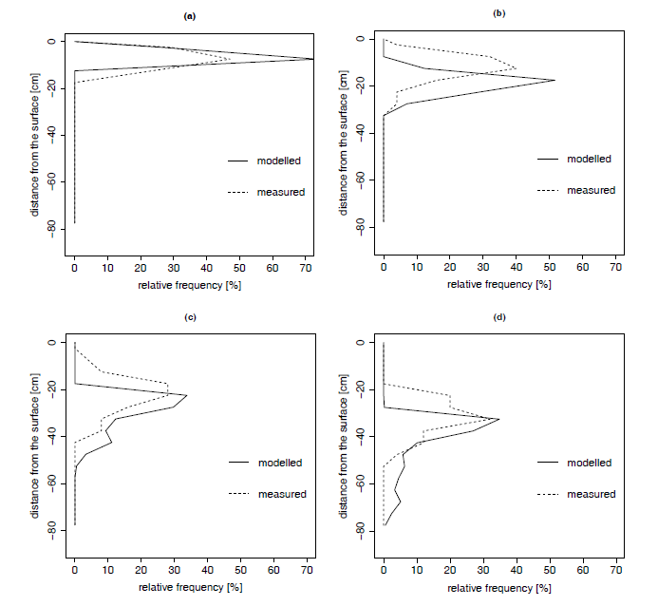
Weekly averaged frequency distributions of thaw depth (Fig 9)
May 24-31
June 17-23
July 15-22
September 9-13
Endrizzi, Quinton, Marsh. 2011. Cryosphere Discussion.

Slide 22
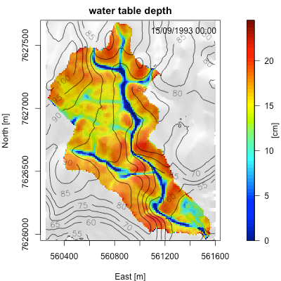
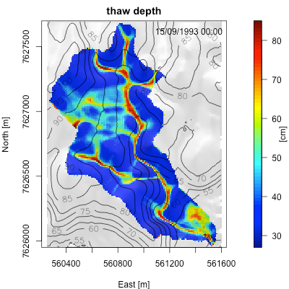
End of Summer (Fig 3a,b)
Note that thaw depths are greatest in areas with the highest water table depth
Endrizzi, Quinton, Marsh. 2011. Cryosphere Discussion.
Notes:
- Water table is always within the mineral soil
Greater water table depths in areas with higher slope and diverging curvature
water table high, or close to the surface, where topography is flat or in areas with flow convergence (especially near stream area)
end of summer thaw depth mirrors the water table depth, with deeper thaw depth where water table is closest to the surface
high soil moisture: 1) increases thermal conductivity and increases thaw depth, but 2) increases thermal capacity and hence decreases thaw
subsurface flow advects heat to downslope areas, and may provide some energy contribution. GEOtop does not include advection of sensible heat

Slide 23
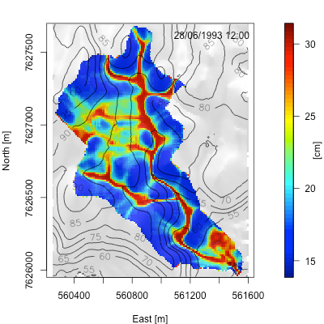
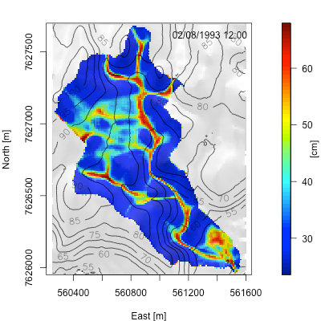
Similar patterns of thaw depth earlier in the summer(Fig 4 a, b)
June 28
Aug. 2
Endrizzi, Quinton, Marsh. 2011. Cryosphere Discussion.

Slide 24


Role of ground heat flux vs shortwave radiation(Fig 5 a,b)
Sum of surface heat fluxes
Strongly related to thaw depth
No significant correlation with thaw
Average over simulation time
Endrizzi, Quinton, Marsh. 2011. Cryosphere Discussion.

Slide 25


Surface water and temperature (Fig 6 a,b)
Strongly related to water table depth
Soil temp. is negatively correlated to soil water. Wet areas are colder
Endrizzi, Quinton, Marsh. 2011. Cryosphere Discussion.
Notes:
Therefore, the modelled surface temperature reflects both the spatial patterns of soil moisture, and those related to the spatial distribution of solar radiation.

Slide 26




Surface heat fluxes(FIG 7 a,b,c,d)
Negative values are fluxes directed towards the atmosphere
The net result:
wetter areas have relatively low energy losses to the atmosphere,
this contributes to
increase the rate of ground thaw.
- Subsurface lateral water flow, therefore, seems to
completely control the spatial patterns of the ground heat flux, which, in turn, affects the
spatial variability of ground thaw
Notes:
If we add up the turbulent fluxes of sensible and latent heat (Fig. 7c), the sum, which we refer to as net turbulent heat flux, shows a significant negative correlation
with solar radiation,

Slide 27




Relative importance of various processes in controlling end of summer thaw depth (Fig 8 a,b,c,d)
No subsurface flow in partially frozen soil
No lateral subsurface flow
All Processes
Uniform ground heat flux and spatially variable thermal conductivity
Spatially variable ground heat flux and uniform thermal conductivity
Notes:
Relative importance of factors is considered by switching off each factor individually, and comparing the maps.
No lateral flow (hydraulic conductivity = 0) – end of summer thaw is dominated by surface fluxes.
no subsurface flow in partially frozen soil – very similar to all processes. Therefore this process of little importance.
uniform surface heat flux -

Slide 28

5. Improved Prediction
Testing and validation of IP3 models:
CLASS
MESH

Slide 29

5.1 CLASS
Marsh, Paul Bartlett, Murray Mackay and Trevor Lantz. 2010. Hydrological Processes.
As with GEOtop, CLASS was able to reasonably model the fluxes of energy.
- One of the main problems is how to consider the bending/unbending of shrubs

Slide 30
5.2 MESH
MESH version 1.3 was run for TVC from May 1st to Sep 30th for 1996 to 2006
Model was run at resolution of 1 km
Initial base case runs were carried out using “traditional” vegetation based land cover classes tundra, shrub tundra, forest, water
Will not show calibration runs, or runs for all years as these have been shown previously.

Slide 31
MESH Model Run “Snow GRUs”
To better capture end of winter snow cover variability, topography based GRUs were added
Added were:
- windswept tundra and
- snow drifts
All GRUs receive the same energy inputs but have a different end of winter snow cover

Slide 32
MESH Model Run “Energy GRUs”
Finally, GRUs were chosen according to land cover type and slope orientation to improve the energy, especially solar radiation, input
Added were:
- north facing tundra slopes and
- south facing tundra slopes
The added GRUs receive the same end of winter snow cover inputs as the tundra GRU but different solar radiation inputs

Slide 33
Model Runs with Energy GRUs
Generally: Little change in runoff, some added runoff early in the melt (1999) and around the peak (1996)

Slide 34
Basin Average SCA with Energy GRUs

Slide 35
Spatial Variability (SCA) (1996)
 | Observed SCA |  | Modelled SCA |  | Modelled SCA |  | Modelled SCA
 |  |  | Base Case |  | with Snow GRUs |  | with Energy GRUs
Date | AVG | Range | AVG | Range | AVG | Range | AVG | Range
 | % | % | % | % | % | % | % | %
23-May | 90 | 45 | 95 | 12 | 91 | 16 | 87 | 21
25-May | 62 | 75 | 65 | 35 | 62 | 49 | 62 | 50
28-May | 40 | 76 | 38 | 47 | 40 | 60 | 43 | 65
01. Jun | 14 | 38 | 8 | 22 | 16 | 38 | 18 | 43
05. Jun | 11 | 32 | 3 | 8 | 10 | 26 | 10 | 28
08. Jun | 4 | 15 | 0 | 0 | 4 | 14 | 4 | 15

Slide 36
Results When Including Snow GRUs
MESH simulation results of basin runoff did not change significantly
Basin wide average SCA improved considerably
Prediction of spatial variability of SCA is greatly improved

Slide 37
Results When Including Energy GRUs
MESH simulation results of basin runoff did not change significantly
Basin wide average SCA were predicted to drop slightly more quickly in the early part of the melt as a result of the south facing slopes becoming snow free more quickly
The impact of the slower melt on north facing slopes on the basin average SCA seems to be overshadowed by the drift areas, that dominate the late season SCA in TVC
The range of SCAs increased slightly throughout the melt period

Slide 38
6. Conclusions
Have made significant progress during IP3 and IPY on:
Process understanding
Improved parameterization in a range of models including GEOtop, CLASS and MESH
But…. Still many areas where our knowledge needs improving
  blowing snow and snow accumulation in drift areas is typically underpredicted
  frost table simulations
  shrub-snow-atmosphere interactions

Slide 39
7. Next steps
We are continuing this line of research at Trail Valley Creek
Using funding from the Program for Energy R&D
  interested in improved hydrologic prediction for pipeline development in northern Canada (Mackenzie Pipeline, Yukon Pipeline, and High Arctic)
However, no funding currently to work in a larger research group like we have had in MAGS, IP3 and IPY over the last 10+ years
this will greatly hamper our continuing advance in understanding and predicting changes in northern hydrology due to climate change and resource development

