Slide 1
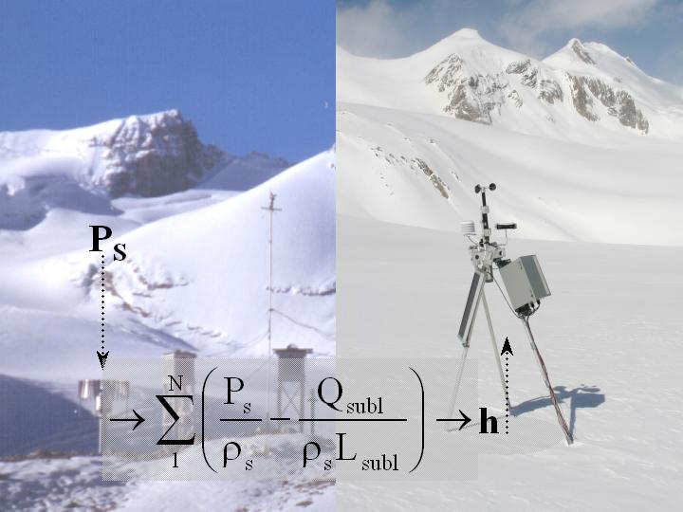
Glacier atmosphere interactions and hydrology:
Peyto field experiment discoveries.
D. Scott Munro
University of Toronto

Slide 2
AWS Network
base (2240 m) +
low (2183 m) +
← Point process investigation: glacier atmosphere interactions and hydrology
← Distribution tools (DEM, trigonometry, parameterization)
← Distributed modelling and prediction
← Base AWS/RCM forcing
middle (2461 m) +
high (2709 m) +

Slide 3
Snow reservoir
Ice reservoir
Snow accumulation
Ice & Snow melt
q_{j}

Slide 4
Model – AWS Comparisons

Slide 5
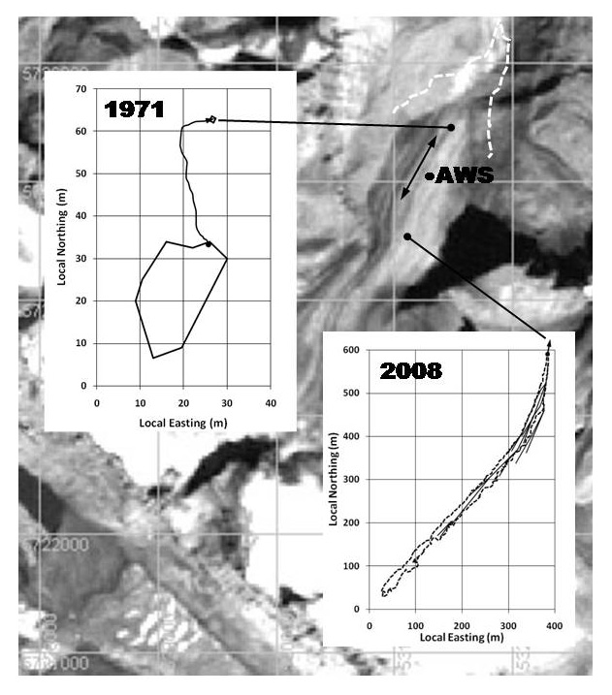
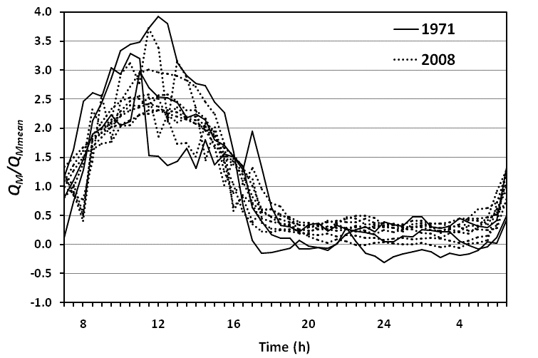
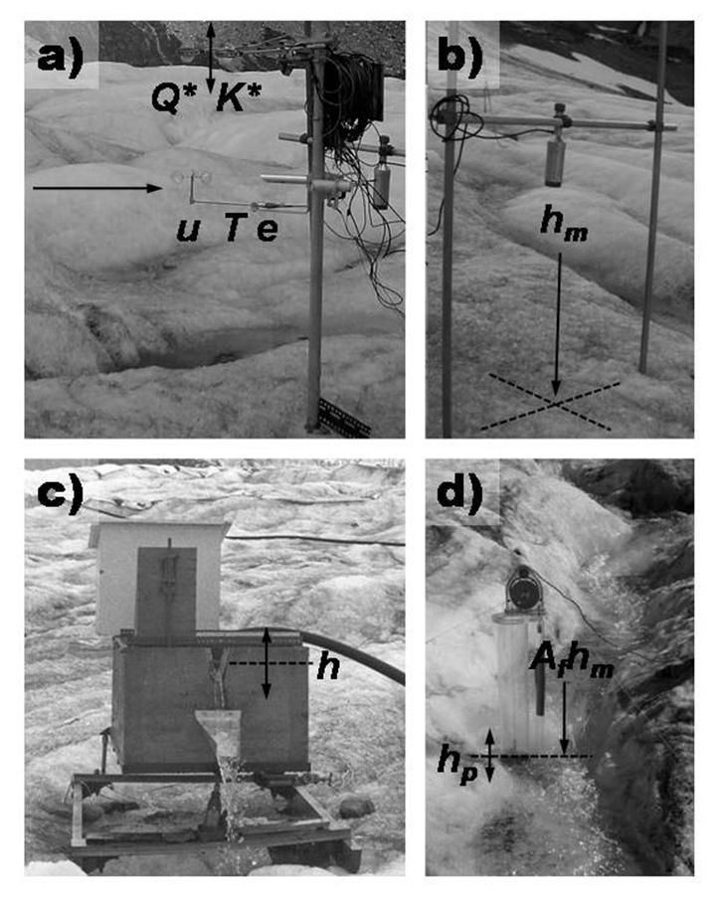
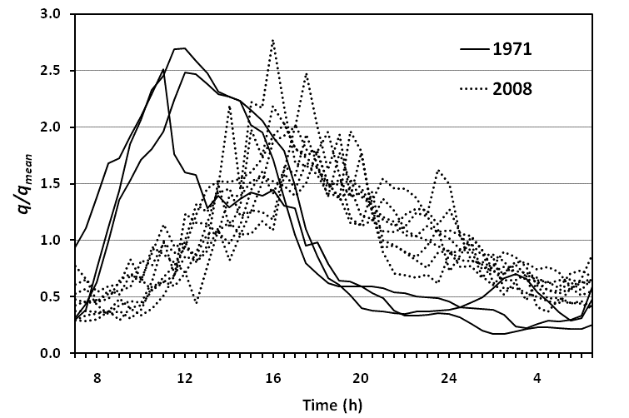
Hydrology
K~1.5 h
K~10.5 h

Slide 6
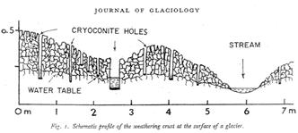

Mϋller & Keeler 1969
K~11.25 h, ice; 100 h, snow

Slide 7
Glacier – Atmosphere Interaction
Focusing on the sensible heat flux, Q_{H}, there are respectively to the right of the equal sign the gradient, eddy correlation (EC) and bulk transfer methods of obtaining the flux density:
The key feature of the flow regime is a local wind speed maximum, close to the surface, through which heat should not flow because Δu/Δz = 0, yet the bulk transfer approach seems to provide reasonable heat flux values, regardless of the measurement height used.
Although EC measurements of Q_{H} below the local wind speed maximum seem to agree with bulk transfer estimates, less is known about EC measurements near to and above the level of maximum wind speed.
• Also to consider is the Oerlemans-Grisogono parameterization (OG) ......which is convenient for modelling, but contrary to classical thinking..... ......about the nature of the glacier atmospheric boundary-layer.
wind
temperature
• If classical thinking is correct EC measurements of Q_{H} → 0 near the .....local wind speed maximum, but if OG is correct the Q_{H} measurements .....will show a step change across the level of maximum wind speed.
wind

Slide 8
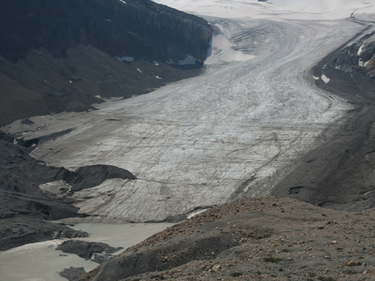
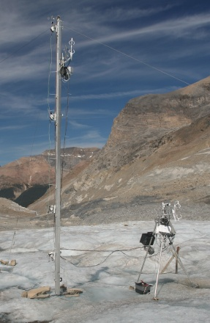
Experiment objectives:
Regional Wind ?
A: B-L turbulent flow field, 1-6 m
B to A: B-L acceleration & cooling
6 m
4 m
2 m
1 m
6 m
4 m
2 m
1 m
B
Glacier Wind
A
Mobile EC
Fixed EC
~50 m
~ 650 m

Slide 9
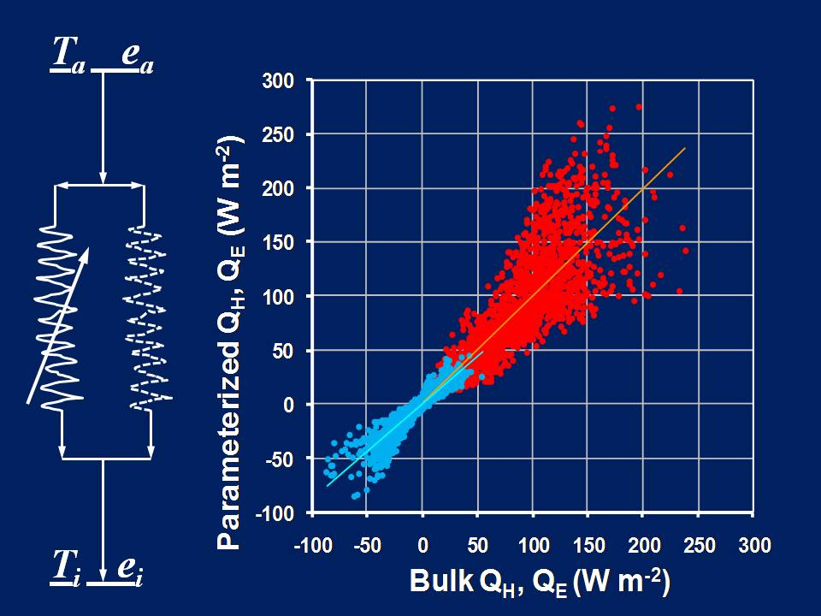
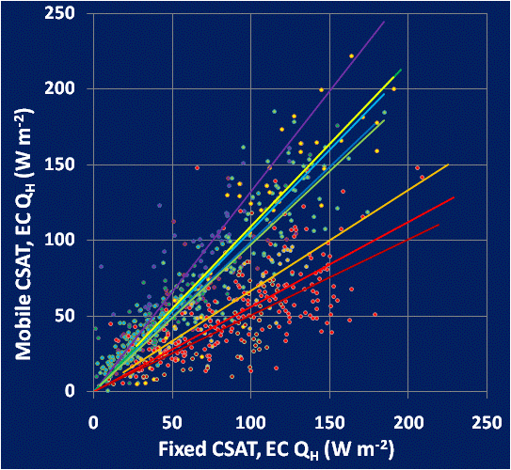
Turbulent flow field, 1-6 m
Regional
Wind
Glacier
Wind

Slide 10
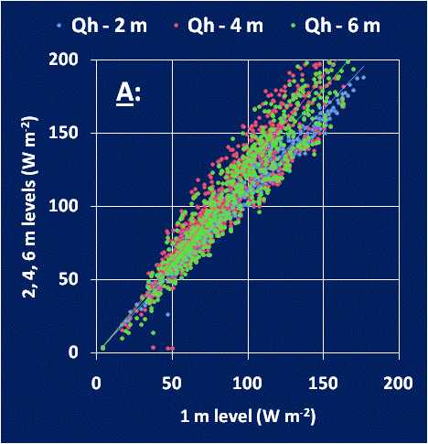
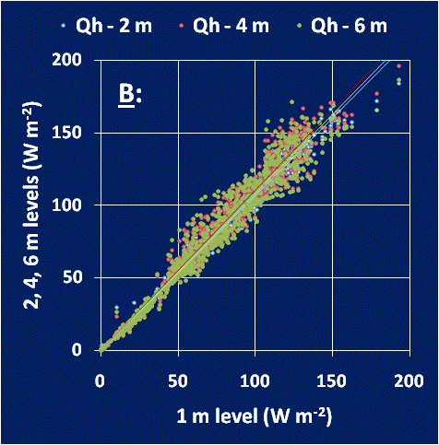
Acceleration & cooling
Taking mean values, assuming no heat transfer across 4 m and correcting for adiabatic warming, expect 1 & 2 m T_{A}< T_{B} by ~2 °C.

Slide 11
Concluding with analogues:
On hydrology:
An electrical analogue to consider for supraglacial runoff is a series resistance system that links the runoff potential of the melting ice surface to supraglacial stream discharge.
In such a system resistance should increase with weathering crust development, decrease with decay, so a good test of this idea is to continuously measure short-term runoff from a supraglacial basin all summer to see if K depends on the weather.
On glacier-atmosphere interactions:
An electrical analogue to consider for boundary-layer heat transfer to the glacier is a parallel resistance system that links the energy potential of the regional air mass to surface melt.
One branch of such a system is the geostrophic flow, the other a katabatic flow that is subject to sporadic breakdown, thus explaining hot flash behaviour.
This is supported by the 2008 eddy correlation data that suggest two turbulent transfer fields adjacent to the glacier surface, one of which extends above the level of the wind speed maximum.

Slide 12
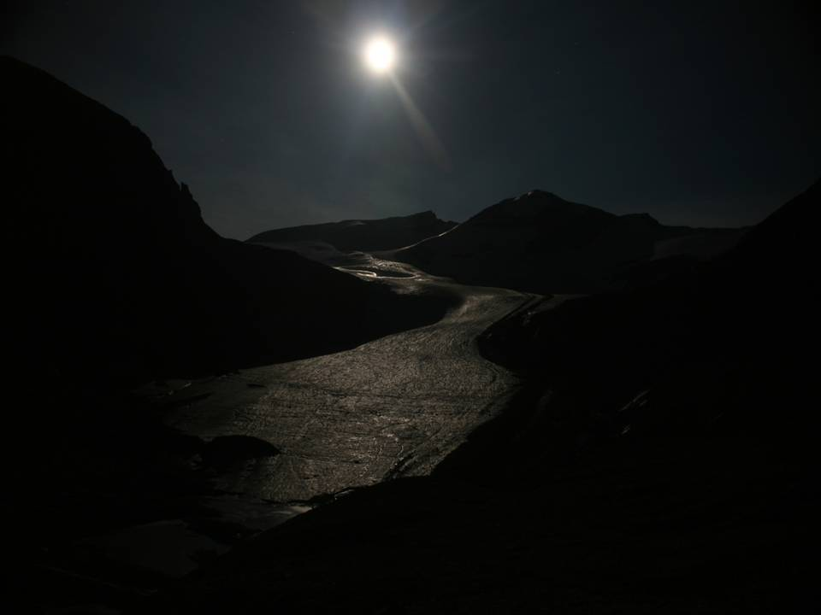
Acknowledgements
CFCAS → IP3 Network Funding
Environment Canada → CRYSYS Program
NSERC → Discovery Grants
Natural Resources Canada → GSC-CGVMAN
University of Toronto Mississauga

