Slide 1

Snow Hydrology and Modelling in Alpine, Arctic and
Forested Basins
John Pomeroy
and collaborators
Richard Essery (Edinburgh), Chris Hopkinson (CGS-NS), Rick Janowicz (Yukon Env), Tim Link (Univ Idaho), Danny Marks (USDA ARS), Phil Marsh (Env Canada), Al Pietroniro (Env Canada), Diana Verseghy (Env Canada), Jean Emmanual Sicart (IRD France
and Centre for Hydrology Faculty, Researchers and Students
Tom Brown, Kevin Shook, Warren Helgason, Chris DeBeer, Pablo Dornes, Chad Ellis, David Friddell, Warren Helgason, Edgar Herrera, Nicholas Kinar, Jimmy MacDonald, Matt MacDonald, Chris Marsh, Stacey Dumanski, Brad Williams, May Guan

Slide 2
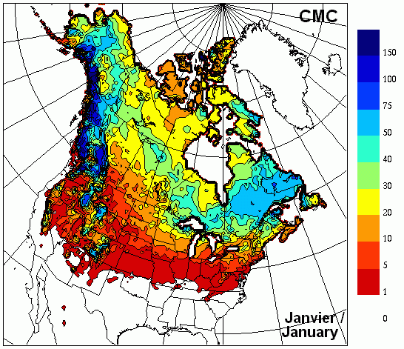
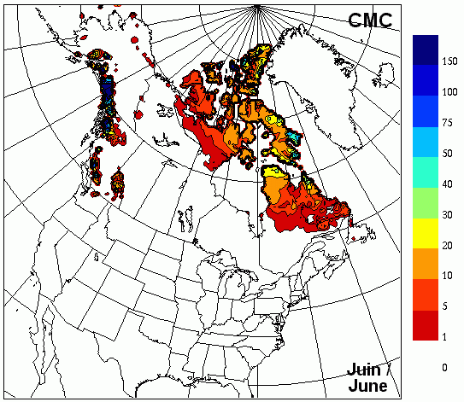
Mountain Snow
vast water reserves in winter snowpack
summer snow water reserves
Snow depth in January Snow depth in June

Slide 3
Study Elements
Processes
  Snow accumulation, structure and observation
  Turbulent transfer to snow
  Radiation effects on snowmelt under tundra shrubs and evergreen forests
Parameterisations
  Blowing snow over complex terrain
  Irradiance in complex terrain – longwave from terrain, shortwave shadows
  Forest snow interception, unloading and sublimation
  Sub-canopy snowmelt
  SCA Depletion in complex terrain,
  Contributing area for runoff generation in snowmelt period
Prediction
  Wind and atmospheric modelling over complex terrain
  Level of spatial complexity necessary in models
  Regionalisation of CLASS parameters
  Snow modelling contribution to MESH
  CRHM
    Arctic and sub-arctic snow hydrology, Wolf Creek & Trail Valley Creek
    Alpine snow hydrology, Marmot Creek
    Montane forest snow hydrology, Marmot Creek

Slide 4
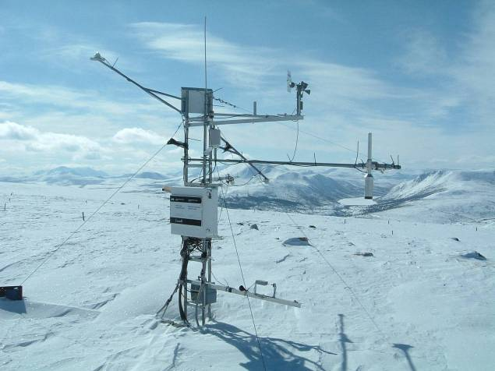
Blowing Snow in Complex Terrain
Inter-basin water
transfer
Transport of snow
to drifts
Supports glaciers,
late lying snowfields,
hydrological
contributing areas

Slide 5
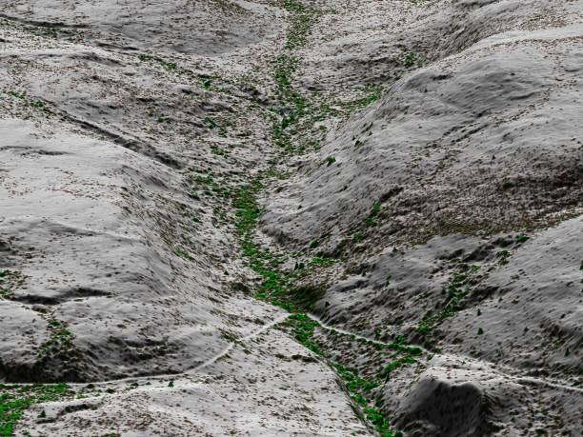
Granger Basin,
Wolf Creek,
Yukon Territory
SF
LiDAR used to develop
topography and vegetation DEM
Wind Direction
NF
Essery and Pomeroy, in preparation

Slide 6
Computer simulation of wind flow over mountains
Windspeed
Direction
3 km
Granger Basin, Wolf Creek, Yukon

Slide 7
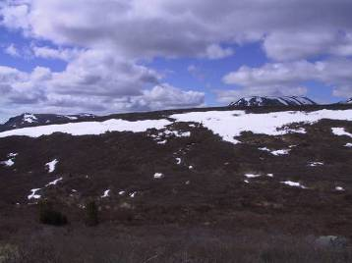
Simulation of Hillslope Snowdrift
3 km

Slide 8
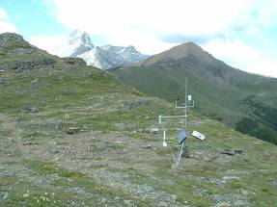
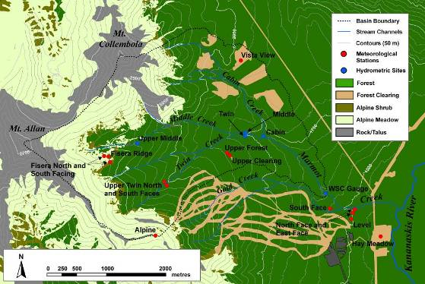
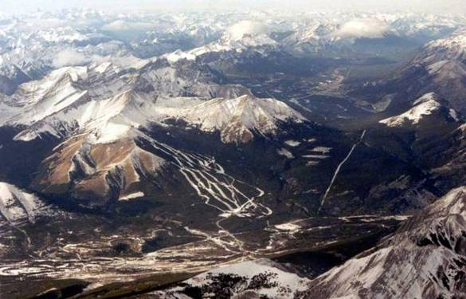
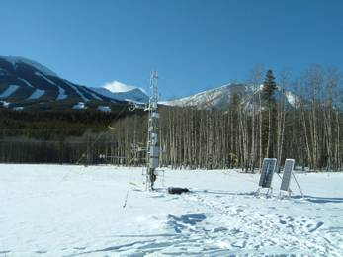
Marmot Creek Research Basin
Bow River valley
x
x
x
x
x
x
Kananaskis River valley
x

Slide 9
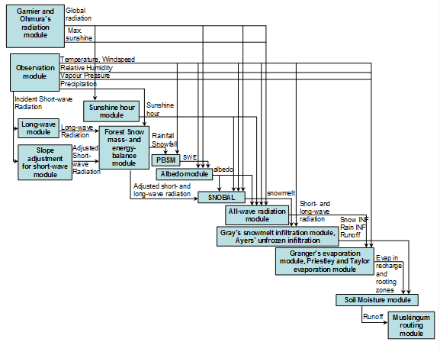
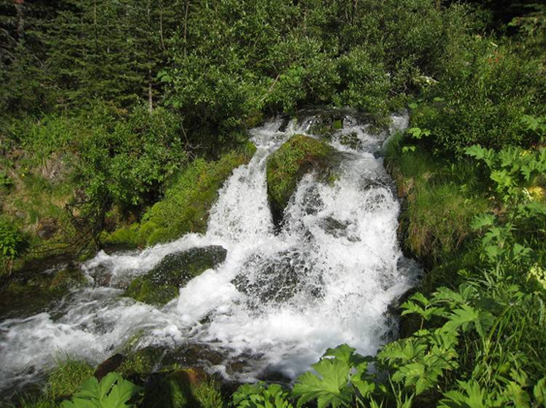
CRHM Mountain Structure

Slide 10
Alpine Hydrological Response Units
Sublimation
Wind Direction
Solar Radiation
Snow Transport
Snow Deposition
Ridge
Top
South Face
(top)
North Face
South Face (bottom)
Forest
Source
Sink

Slide 11
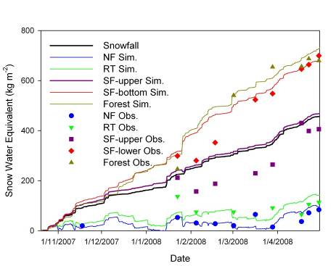
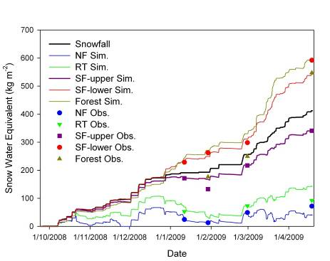
Winter Snow Redistribution Modelling
Notes:
11

Slide 12
Winter Snow Redistribution and Sublimation

Slide 13
Point Evaluation of Snowmelt Model
2008 2009
Notes:
This shows the calibration (2008) and validation (2009) for CRHM-Snobal point scale model at Fisera Ridge South-East facing location.

Slide 14
Frequency Distributions of SWE from LiDAR Depths and Measured Density
N facing slope
S facing slope
SWE distribution within HRU fit log-normal density distribution
Notes:
K-SWE plots for the North and South facing slopes, showing good fit by a straight line. Histograms of the lidar-derived SWE distributions correspond very well with fitted lognormal distribution using the same parameters (mean, CV) as for the measured data.

Slide 15
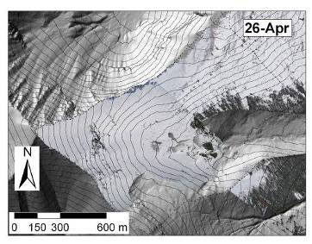
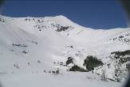
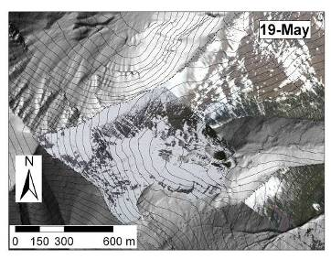
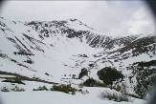
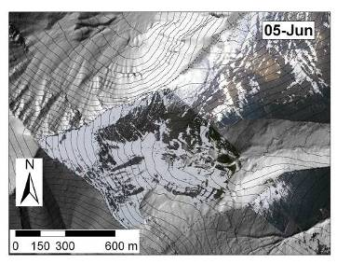
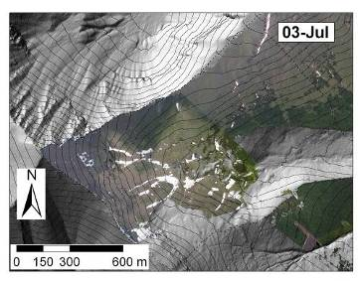
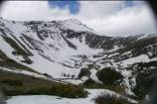
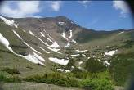
Snowcovered Area from Oblique Terrestrial Photographs, Aerial Photographs and LiDAR DEM

Slide 16
Snow-covered Area Depletion Modelling
Four HRU (NF, SF, EF, VB) with modelled melt applied to SWE frequency distributions.
Observed – using oblique photography
Uniform – spatially uniform SWE distributions and applied melt rates for each HRU
Variable SWE dist. – each HRU has a distinct distribution of SWE
Variable snowmelt – each HRU has a distinct melt rate applied
Fully distributed – each HRU has a distinct distribution of SWE and applied melt rate

Slide 17
Snowmelt Runoff Intensity by HRU

Slide 18
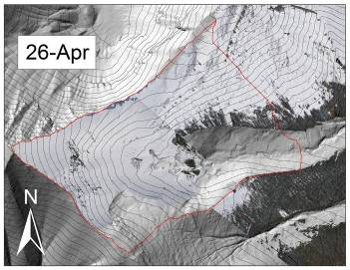
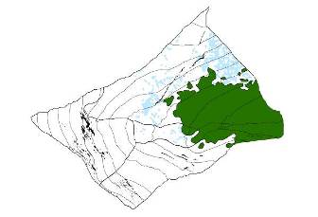
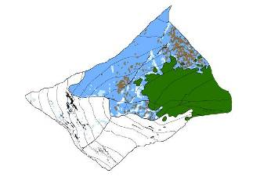
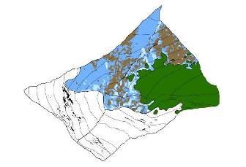
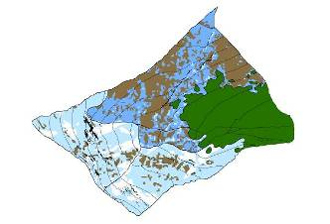
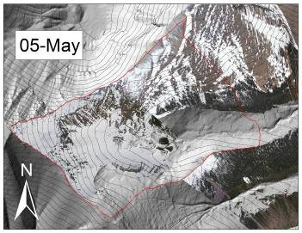

Visualisation of Snowmelt Runoff Intensity
Early Snowmelt Period - 2008
26-Apr
29-Apr
02-May
05-May
Melt rates (mm/day)
0-5 5-10 10-20 bare forest cliff
Notes:
This slide shows spatial patterns of areal SCD and SRCA over the basin in the early melt period of 2008. Patterns were mapped based on interpretation of the lidar derived SWE mapped (i.e. spatial snow depth and SWE, and accounting of melt over the distributions). This indicates the different areal extents and timing of the source areas producing different rates of snowmelt. Images at right are corrected terrestrial based photos from both Fisera Ridge and the top of Gold chair cameras for reference and comparison to the spatial depletion patterns.

Slide 19
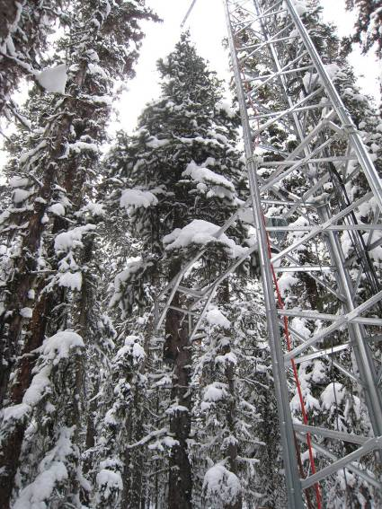
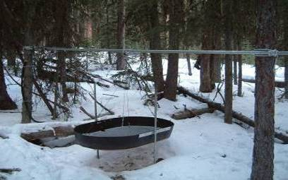
Snow Interception & Sublimation

Slide 20
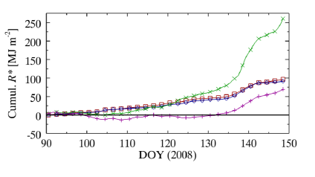
Net Radiation to Forests:
Slope Effects
South Face
Clearing
North & South
Face Forests
North Face
Clearing

Slide 21
Forest Snow Regime on Slopes
Open slopes highly
sensitive to irradiation
difference, forests are not
Notes:
21

Slide 22
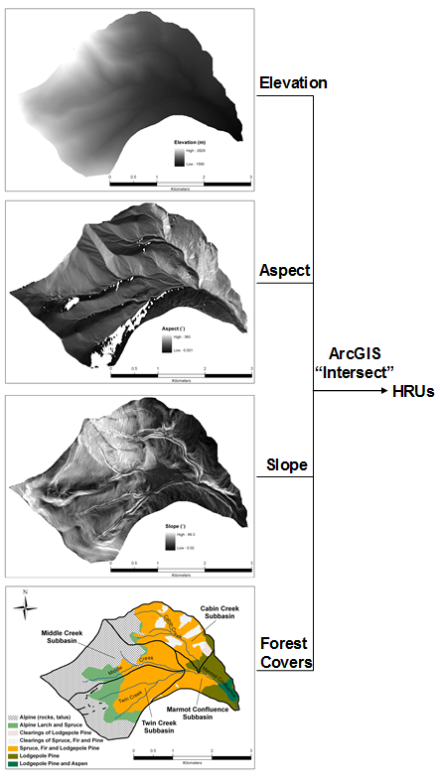
HRU Delineation
Driving meteorology: temperature, humidty, wind speed, snowfall, rainfall, radiation
Blowing snow, intercepted snow
Snowmelt and evapotranspiration
Infiltration & groundwater
Stream network

Slide 23
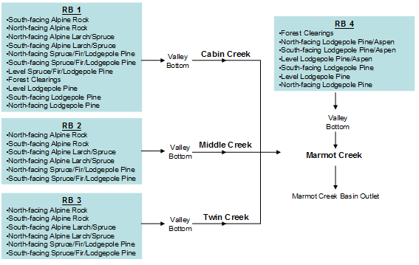
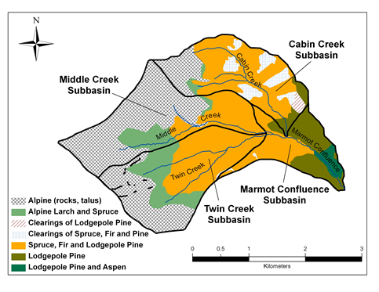
Model Structure

Slide 24
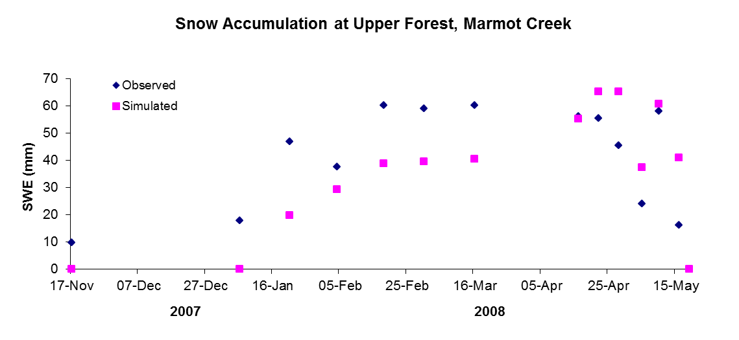
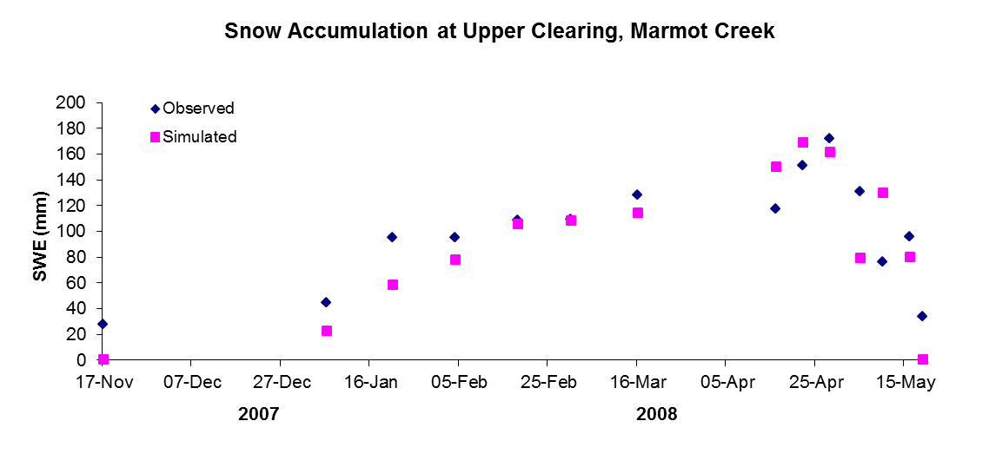
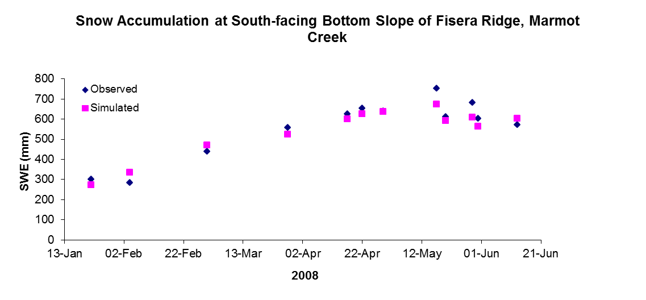
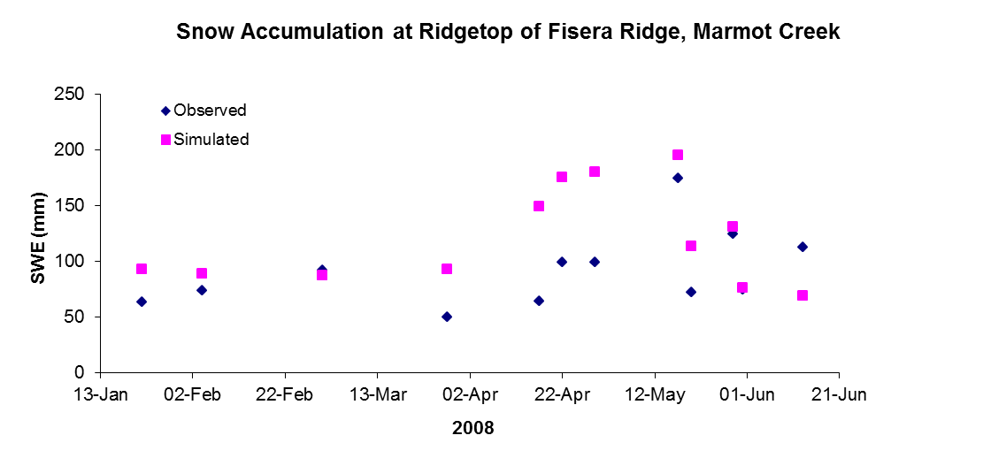
Model Tests - SWE

Slide 25
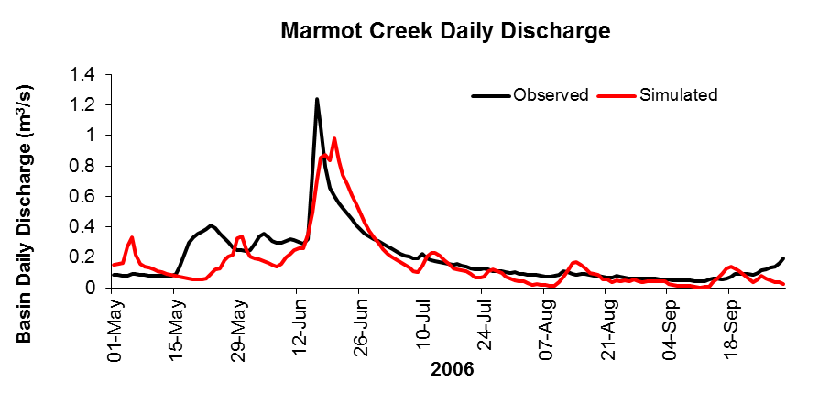
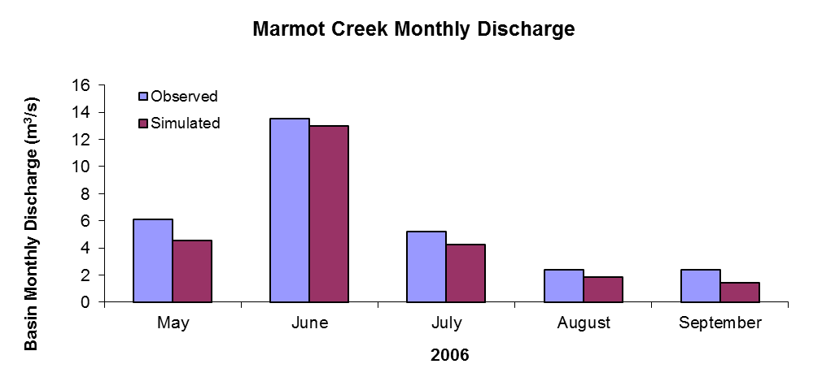
Streamflow Prediction 2006
Mean Bias = -0.13
all parameters estimated from basin data

Slide 26
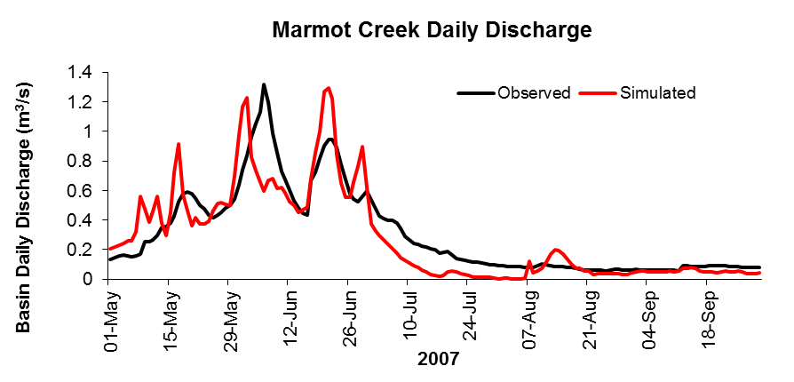
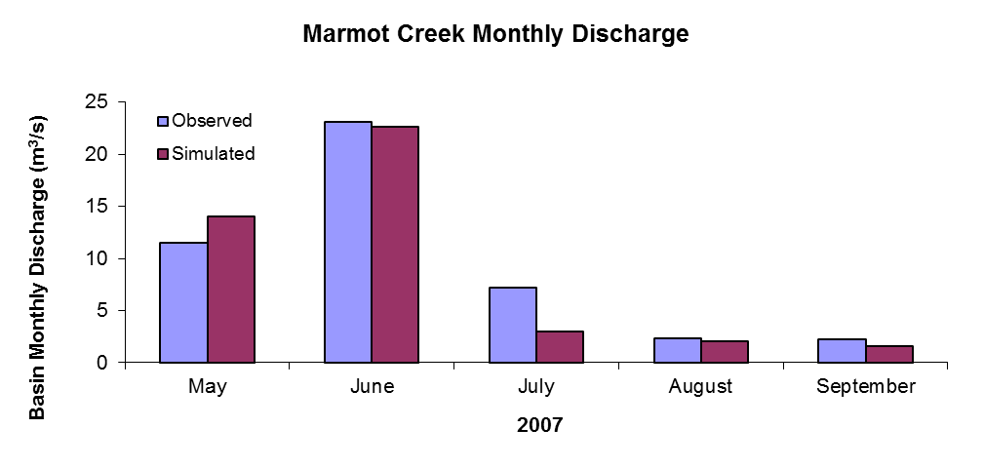
Streamflow Prediction 2007
Mean Bias = -0.068
all parameters estimated from basin data

Slide 27
Conclusions
Appropriate process based models driven by enhanced remote sensing and good observations can be used to achieve adequate hydrological prediction in the alpine.
Model process and spatial structure must be appropriate to the complexity of the energy and mass exchange processes as they operate on the landscape.
It is possible to test for the most appropriate structure for balance between model complexity and predictive ability.

