Slide 1


Progress in Closing the Water Balance with Land Surface Schemes
UNIVERSITY OF
WATERLOO
IP3, 7-10September, 2011, Saskatoon, Saskatchewan, Canada
E.D. Soulis, J.R. Craig, and G. Liu

Slide 2
Process
Lateral flow is an important process for part of the water cycle, yet it is the most poorly parameterised.
  It is often completely ignored, all flow is vertical and lateral flow is from the saturated zone or;
  assumed to be some simple decay function of storage with no explicit reference to resistance or;
  modelled using expensive numerical solutions to Richard’s Equation
Process
Parameterisation
Prediction

Slide 3
Approach
Find analytical approximation to bridge gap between Richard’s Equation and Q=Q₀S_{eff}^{D}, where Q₀ is maximum interflow, S_{eff} is effective saturation given by (S-S_{R})/(S_{C}-S_{R})
Q₀ is predictable from Darcy’s equation for saturated flow
S_{eff} is based on retained soil moisture (field capacity)
D is an exponent >1
Process
Parameterisation
Prediction

Slide 4
Parameterisation
Needed to establish configuration of subsurface system
Started with 3 layer FlatCLASS system (circa 1990), currently using 6 layer, sloped WATDRAIN2
WATDRAIN3 being tested
Process
Parameterisation
Prediction

Slide 5
Classic, Flat CLASS
Surface
Excess
θ₁
θ₂
θ₃
Drainage
Process
Parameterisation
Prediction

Slide 6
Features
Simple
Good for vertical fluxes over large areas
Problems
Poor timing of run-off
Local distribution of soil moisture is not represented
Process
Parameterisation
Prediction

Slide 7
Slope CLASS/WATDRAIN-0
Surface Runoff
Manning’s Equation
θ₁
θ₂
Interflow
Richard’s Equation
slope
θ₃
Darcy’s Law
Drainage
Process
Parameterisation
Prediction

Slide 8
“Groovy” CLASS
Surface Runoff
θ₁
θ₂
Interflow
slope
θ₃
Drainage
Process
Parameterisation
Prediction

Slide 9
Features
Physically based
Sensitive to soil moisture
Problems
Dried soil completely under drought conditions
Too flashy and recession curves too steep
Difficult to calibrate
Souils and Snelgrove, 2000
Process
Parameterisation
Prediction

Slide 10
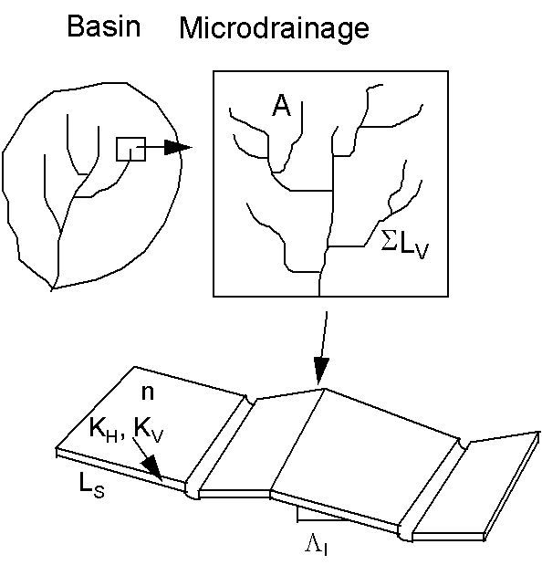
Subgrid Representation
Process
Parameterisation
Prediction

Slide 11
WATDRAIN1
Surface Runoff
θ₁
θ₂
Interflow
slope
θ₃
Drainage
Process
Parameterisation
Prediction

Slide 12
Features
Easier to calibrate and more realistic hydrographs
Uses same horizontal and vertical flow layers
Problems
No soil suction (still allows soil to dry out completely)
Process
Parameterisation
Prediction

Slide 13
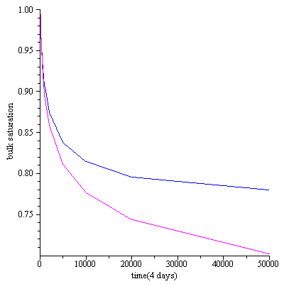
Bulk Saturation
sand
silt
Process
Parameterisation
Prediction

Slide 14
Process Round 2 (Back to the Drawing Board)
WATDRAIN1 had worked for MAGS, but was inadequate for IP3
Could not avoid addressing soil suction
Used finite difference numeric solution to Richard’s Equation guided search for analytic solution
Process
Parameterisation
Prediction

Slide 15
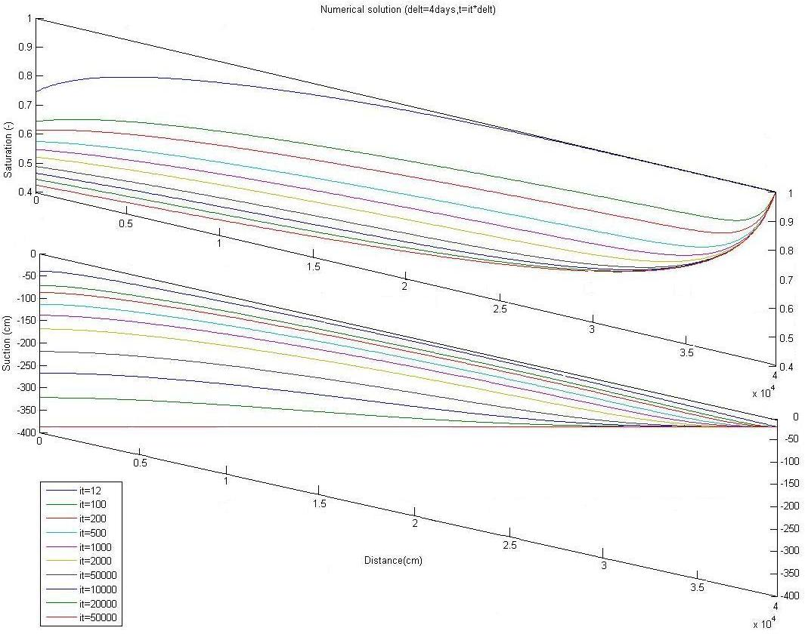
Numerical Solution to Richard’s Equation
Soil Moisture Deficit
Saturation (S) vs. Downhill Distance (x)
S
time (4 day timesteps)
“Field Capacity”
x (m)
Process
Parameterisation
Prediction

Slide 16
Process
Parameterisation
Prediction

Slide 17
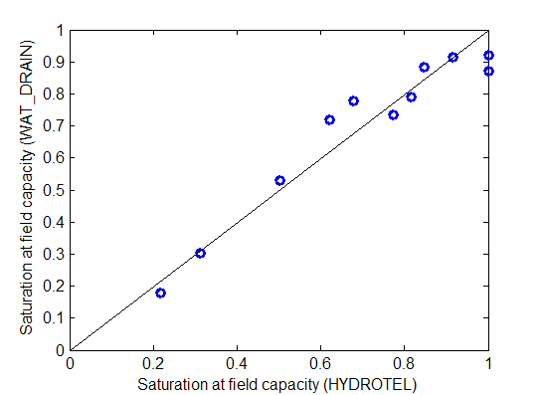
Predicted Saturation at Field Capacity
Retained soil moisture (depth of 50 cm) WATDRAIN vs. HYDROTEL
Process
Parameterisation
Prediction

Slide 18
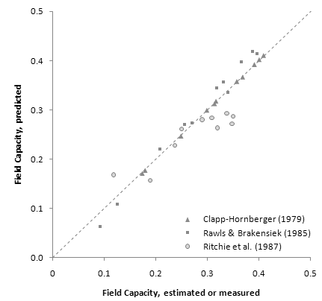
Field Capacity Comparison
A simple expression for the bulk field capacity of a sloping soil horizon, 2010
E. D. Soulis, J. R. Craig, V. Fortin, G. Liu
Process
Parameterisation
Prediction

Slide 19
Prediction
θ₁
θ₁
θ₁
θ₂
θ₂
θ₂
θ₃
θ₃
θ₃
CLASS
CCC
GEM Model
RPN
Stand Alone MESH
NHRI
Process
Parameterisation
Prediction

Slide 20
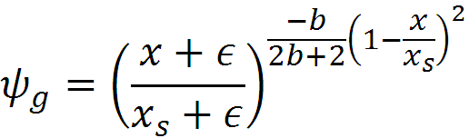

Suction,ψ vs. Downhill Distance,x
Ψ (cm)
Ψ?
f
time (4 day timesteps)
X(m)
Process
Parameterisation
Prediction

Slide 21
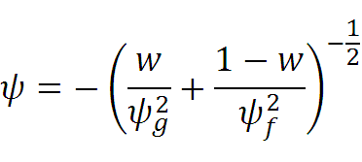


Combined Flow
It can be argued that the hydraulic resistance is proportional to the square of suction. Therefore, using a parallel electric circuit analog:
w is a weighting factor, where:
w_{a} reflects the left boundary condition
w_{Q} reflects right boundary condition
And w_{x} is a spatial interpolator
Process
Parameterisation
Prediction

Slide 22
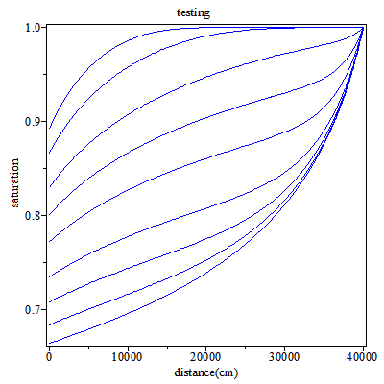
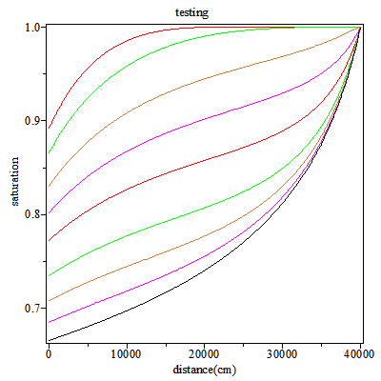
Testing Parameterisation
Saturation, S vs. Distance, d for Loam
Numerical Solution
S
Analytical Approximation
D (cm)
Process
Parameterisation
Prediction

Slide 23
Prediction
Soil moisture profile can be used to identify saturated area, recharge and interflow
Process
Parameterisation
Prediction

Slide 24
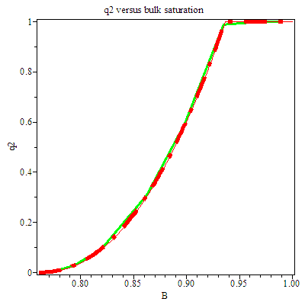
Target Characteristic Curve
Process
Parameterisation
Prediction

Slide 25
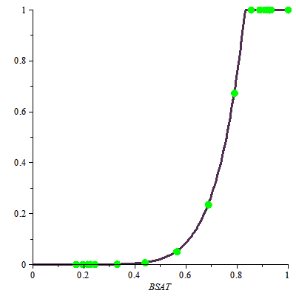
Characteristic Curve
Best fit curve:
q/q0=5.65*(B-0.049)^{7.09}
Solution at 20 specified timesteps
Normalized Flow
Retained Soil Moisture
End of Saturated Flow
Bulk Saturation
Process
Parameterisation
Prediction

Slide 26
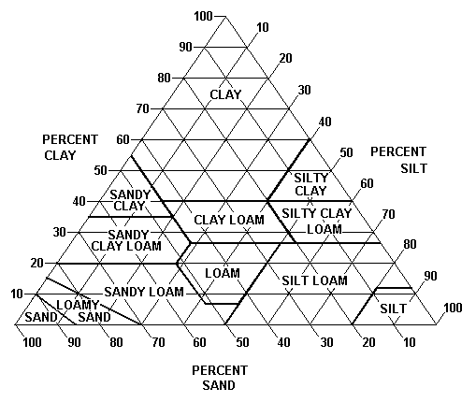
SCS Triangle
Process
Parameterisation
Prediction

Slide 27
Characteristic Curve Overview
 | Slope % | Slope Length | Sand (%) | Clay (%)
Sand | 6% | 1000m | 74.6 | 7.17
Silt | 6% | 1000m | 54.8 | 26.5
Loam | 6% | 1000m | 30.2 | 15.6
 | Q₀ (m/sec) | S_{R} | S_{C} | D
Sand | 1.05x10⁻⁵ | 0.285 | 0.922 | 5.74
Silt | 3.77x10⁻⁷ | 0.549 | 0.949 | 4.94
Loam | 4.16x10⁻⁷ | 0.494 | 0.932 | 4.14
Process
Parameterisation
Prediction

Slide 28
WATDRAIN3
Surface Runoff
θ₁
θ₂
Interflow
slope
θ₃
Baseflow=k<S^{c}>
Process
Parameterisation
Prediction

Slide 29
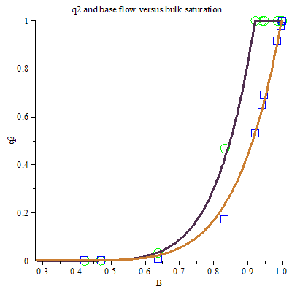
Proposed Characteristic Curve
Sand
Normalized Interflow
Normalized Recharge
Solution Points
Interflow
Bulk Saturation
Process
Parameterisation
Prediction

Slide 30
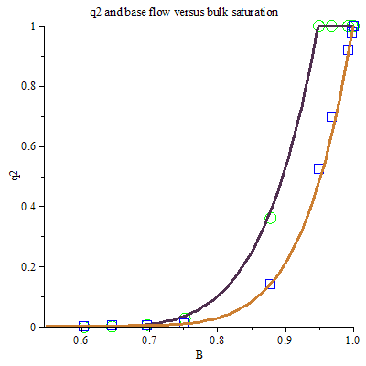
Silt
Normalized Interflow
Normalized Recharge
Solution Points
Process
Parameterisation
Prediction

Slide 31
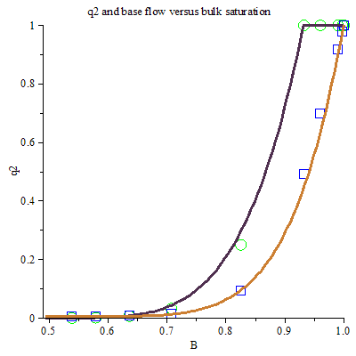
Loam
Normalized Interflow
Normalized Recharge
Solution Points
Process
Parameterisation
Prediction

Slide 32
Whitegull Hydrograph

Slide 33
SSRB Hydrograph

